Slide 1



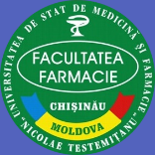
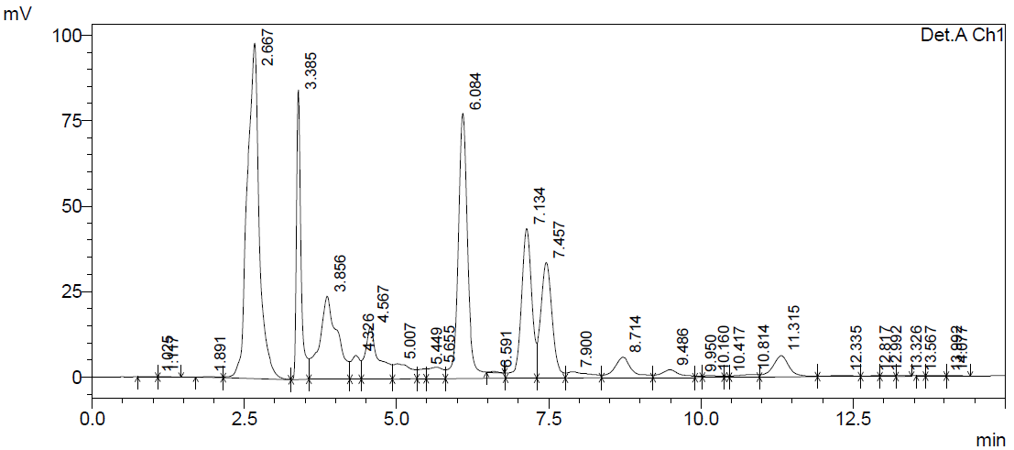
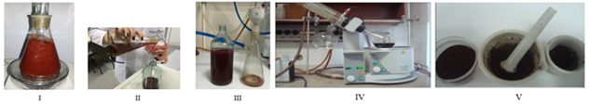
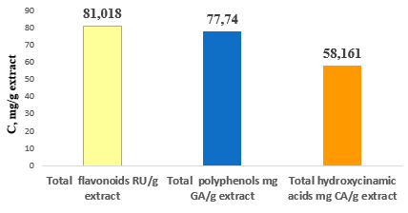
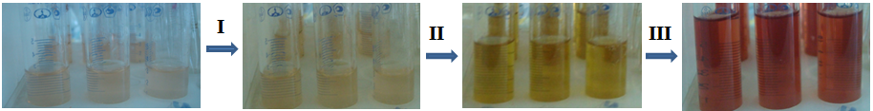
CHEMICAL PROFILE OF THE DRY EXTRACT OF HYPERICUM PERFORATUM FROM THE FLORA OF THE REPUBLIC OF MOLDOVA
Anna Benea, Ecaterina Mazur, Valeriana Pantea, Ianoș Corețchi
Nicolae Testemitanu State University of Medicine and Pharmacy, Chisinau, Republic of Moldova
Aim of the study. The aim of this study was to obtain a dry extract from the aerial parts of the plant using the maceration method and to determine its chemical composition
Figure 3. HPLC chromatogram of the dry extract of Hyperici herba, obtained at a wavelength of 280 nm
Materials and methods. The phenolic compounds were extracted using the fractional maceration method with agitation, employing ethanol 80% (ratio 1:20 w/v) as the solvent. The extract solution was concentrated using a rotary evaporator. The phenolic compounds were identified using HPLC, the total content of flavonoids, polyphenols, and hydroxycinnamic acids was determined using spectrophotometric methods.
Figura 4. The total of phenolic compounds in the extract obtained from the aerial parts of Hypericum perforatum
Figure 1. Process for obtaining dry extracts from Hyperici herba I – fractional maceration with agitation; II – separation of the residue from the extractive solution; III – filtration; IV – concentration of the extractive solution; V – grinding of the dry extract.
Figure 2. Determination of total hydroxycinnamic acids using the Arnow reagent
Conclusions. Although the simplest method was used to extract phenolic compounds from the plant material Hyperici herba, the results of the chemical analysis indicate a high content of phenolic compounds in the dry extract. This extract can subsequently be used in preclinical studies to determine its anti-inflammatory and antioxidant activity in vivo.
Results. The chemical compounds were identified using HPLC by comparing their retention times (tR) with those of standard substances analyzed under the same conditions. The following were identified: rutin (6.084), hyperoside (7.134), isoquercitrin (7.457), quercitrin (11.315), chlorogenic acid (3.846), and catechin (4.048). The total flavonoids (81.018 ± 0.953 mg RU/g extract, expressed as rutin equivalents), polyphenols (77.740 ± 2.348 mg AG/g extract, expressed as gallic acid equivalents), and hydroxycinnamic acids (58.161 ± 0.258 mg AC/g extract, expressed as caffeic acid equivalents) indicate a high content of phenolic compounds in the analyzed extract
Acknowledgments This study was supported by the research project 25.80012.8007.04SE „In vivo evaluation of the anti-inflammatory activity of polyphenolic extracts from Hypericum perforatum L. and Agrimonia eupatoria L., derived from local raw materials”, funded by ANCD.
National Conference with International Participation: Natural Sciences in the Dialogue of Generations, VIIIth edition, Chisinau, Republic of Moldova, September 17–19, 2025

