Slide 1


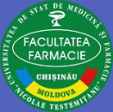

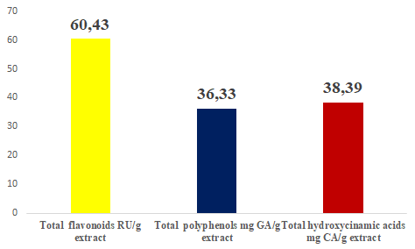
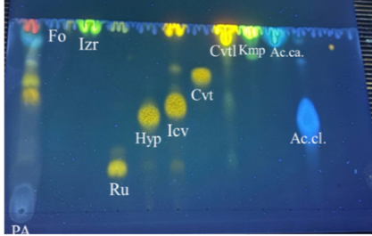
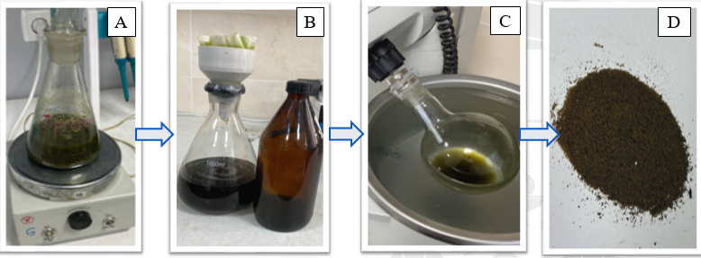
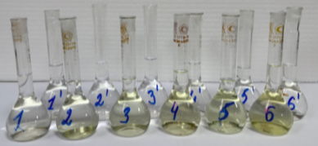
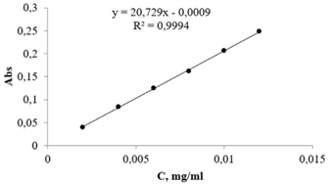
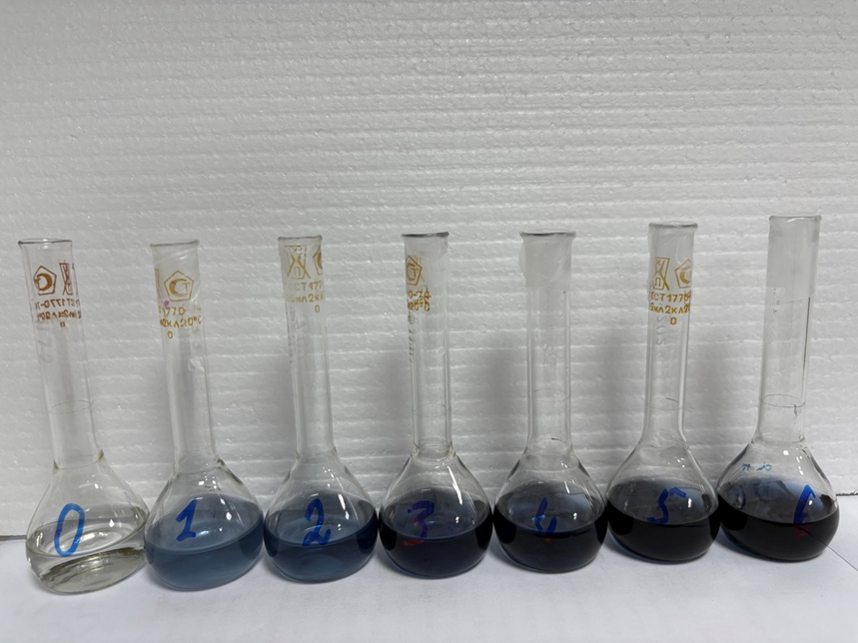
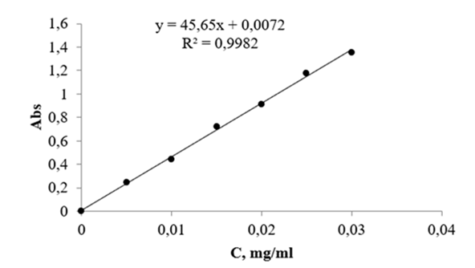
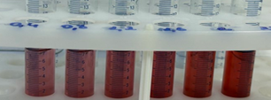
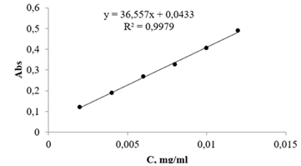
THE PHYTOCHEMICAL PROFILE OF DRY EXTRACT OF TRIFOLIUM PRATENSE
Anna Benea, Maria Cojocaru-Toma
Scientific-Practical Center of Medicinal Plants of the Nicolae Testemitanu State University of Medicine and Pharmacy, Chisinau, Republic of Moldova
Aim of the study. The aim of this study was to obtain a dry extract from the aerial parts of T. pratense using the agitated fractional maceration method. Chemical analysis identified compounds belonging to the flavonoid class, while spectrophotometric methods were employed to determine the total content of flavonoids, polyphenols, and hydroxycinnamic acids.
Results.The total polyphenol content in the extract from the aerial parts of T. pratense (36.33 ± 2.16 mg GA/g extract), expressed as chlorogenic acid equivalent, was determined. The total content of hydroxycinnamic acids, expressed as caffeic acid equivalent, was 38.39 ± 0.87 mg CA/g dry extract, and the flavonoid concentration reached 60.43 ± 1.16 mg RU/g dry extract (expressed as rutin equivalent) 9fig. 4). Using thin-layer chromatography, it was demonstrated that the dry extract obtained from Trifolii herba contains the following active compounds: rutin (Rf = 0.20), hyperoside (Rf = 0.47), isoquercitrin (Rf = 0.52), and caffeic acid (Rf = 0.93).
Materials and methods. Phenolic compounds were extracted from the plant material (herba) by fractional maceration with agitation, using 70% ethanol as the solvent, at a plant material-to-solvent ratio of 1:20. The extraction procedure was repeated four times, with each extraction cycle lasting 60 minutes. The total flavonoid content of the dry extract was determined using the aluminum chloride colorimetric method (fig.2). Total polyphenols were quantified by the Folin–Ciocalteu method (fig. 2), and hydroxycinnamic acids were quantified by the Arnow reagent (fig. 3 ).
Fig. 1. A – fractional maceration by agitation, B – filtration, C – concentration of the extractive solution, D – the resulting dry extract
Fig. 4. The content of phenolic compounds in the extract obtained from the aerial parts of Trifolium pratense
Fig. 5. The chromatogram of the ethanolic solution of the Trifolii pratense herba: PA – aerial parts
Conclusions. The results showed that T. pratense is rich in phenolic compounds, which could serve as a basis for biological studies aimed at evaluating the antibacterial and antioxidant activities of the dry extract obtained from plants grown under the climatic conditions of the Republic of Moldova.
Fig. 2. Spectrophotometric determination of total flavonoid content ant total polifenols in the dry extract of T. pratense
Fig. 3Spectrophotometric determination of total hydroxycinnamic acids in the dry extract of T. pratense
Acknowledgments: This study was supported by the research project 25.80012.8007.05SE „Optimization of extraction methods of phenolic compounds from plant products, with evaluation of antimicrobial and antioxidant actions”,
funded by ANCD.
National Conference with International Participation: Natural Sciences in the Dialogue of Generations, VIIIth edition, Chisinau, Republic of Moldova, September 17–19, 2025

