Slide 1
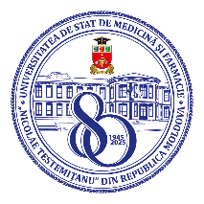
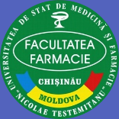
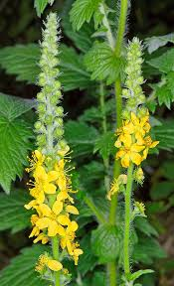
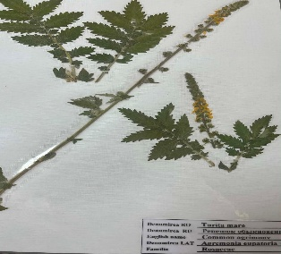
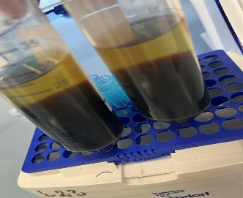
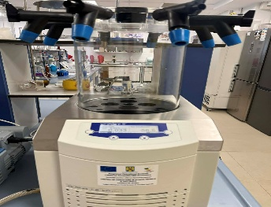
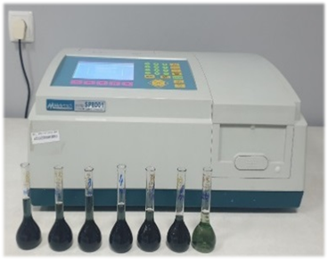
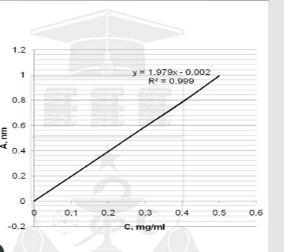
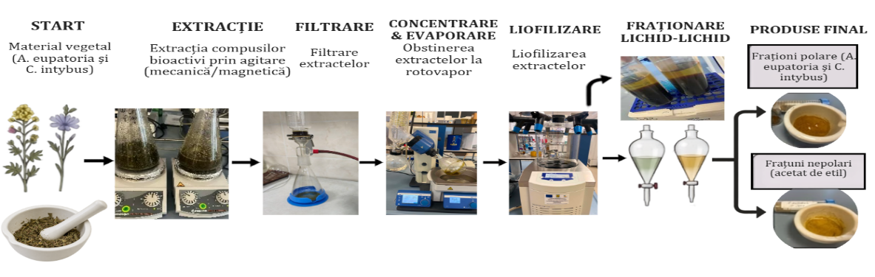
TOTAL PHENOLIC CONTENT IN THE POLAR AND NON-POLAR FRACTIONS
FROM AGRIMONIA EUPATORIA L.
Vlada Turcanu, Alexandrina-Cătălina Gicul, Anna Benea, Maria Cojocaru-Toma
Nicolae Testemitanu State University of Medicine and Pharmacy, Chisinau, Republic of Moldova
Aim of the study. To evaluate the total phenolic content (TPC) in the polar and non-polar fractions from A. eupatoria extract with a view to identifying the fractions with a higher content of bioactive compounds.
Results. The total phenolic content (TPC) was determined using the Folin-Ciocalteu reagent, with absorbance measured at a wavelength of λ = 760 nm on Metertech UV/VIS SP 8001 spectrophotometer; the result was expressed as gallic acid equivalent (mg GA/g).
Materials and methods. To obtain the nonpolar or organic fractions, an extraction was performed using a weakly polar organic solvent commonly used under laboratory conditions (ethyl acetate); the extraction was carried out in three stages, after the dried ethanol extract had been redissolved in distilled water. The aqueous phase remaining after extraction with ethyl acetate represents the polar fraction, which contains water-soluble polar compounds.
Figure 2. The total phenolic content (TPC) in polar and non-polar fraction
The results indicate that the polar fraction of A. eupatoria, rich in tannins, phenolic glycosides, and water-soluble polar compounds, has a higher content of total phenolic compounds (TPC = 31.72±0,42 mg GA/g), compared to the nonpolar fraction, which is rich in aglycones (TPC = 23.46±0,78 mg GA/g), data confirmed by HPLC and FTIR-ATR analyses.
Figure 1. obtaining of polar and non-polar fraction
Acknowledgments: research project „In vivo evaluation of the anti-inflammatory activity of polyphenolic extracts from Hypericum perforatum L. and Agrimonia eupatoria L., derived from local raw materials”, nr. 25.80012.8007.04SE, funded by ANCD.
Conclusions. The results indicate that the polar fractions are richer in phenolic compounds than the nonpolar fractions obtained from A. eupatoria extracts; these will be used in subsequent pharmaceutical studies.
National Conference with International Participation: Natural Sciences in the Dialogue of Generations, Chisinau, Republic of Moldova, 2026

