Slide 1
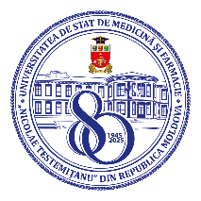
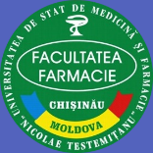
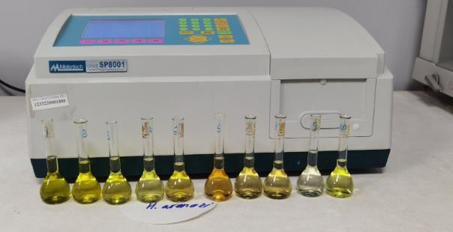
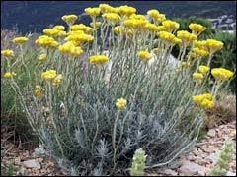
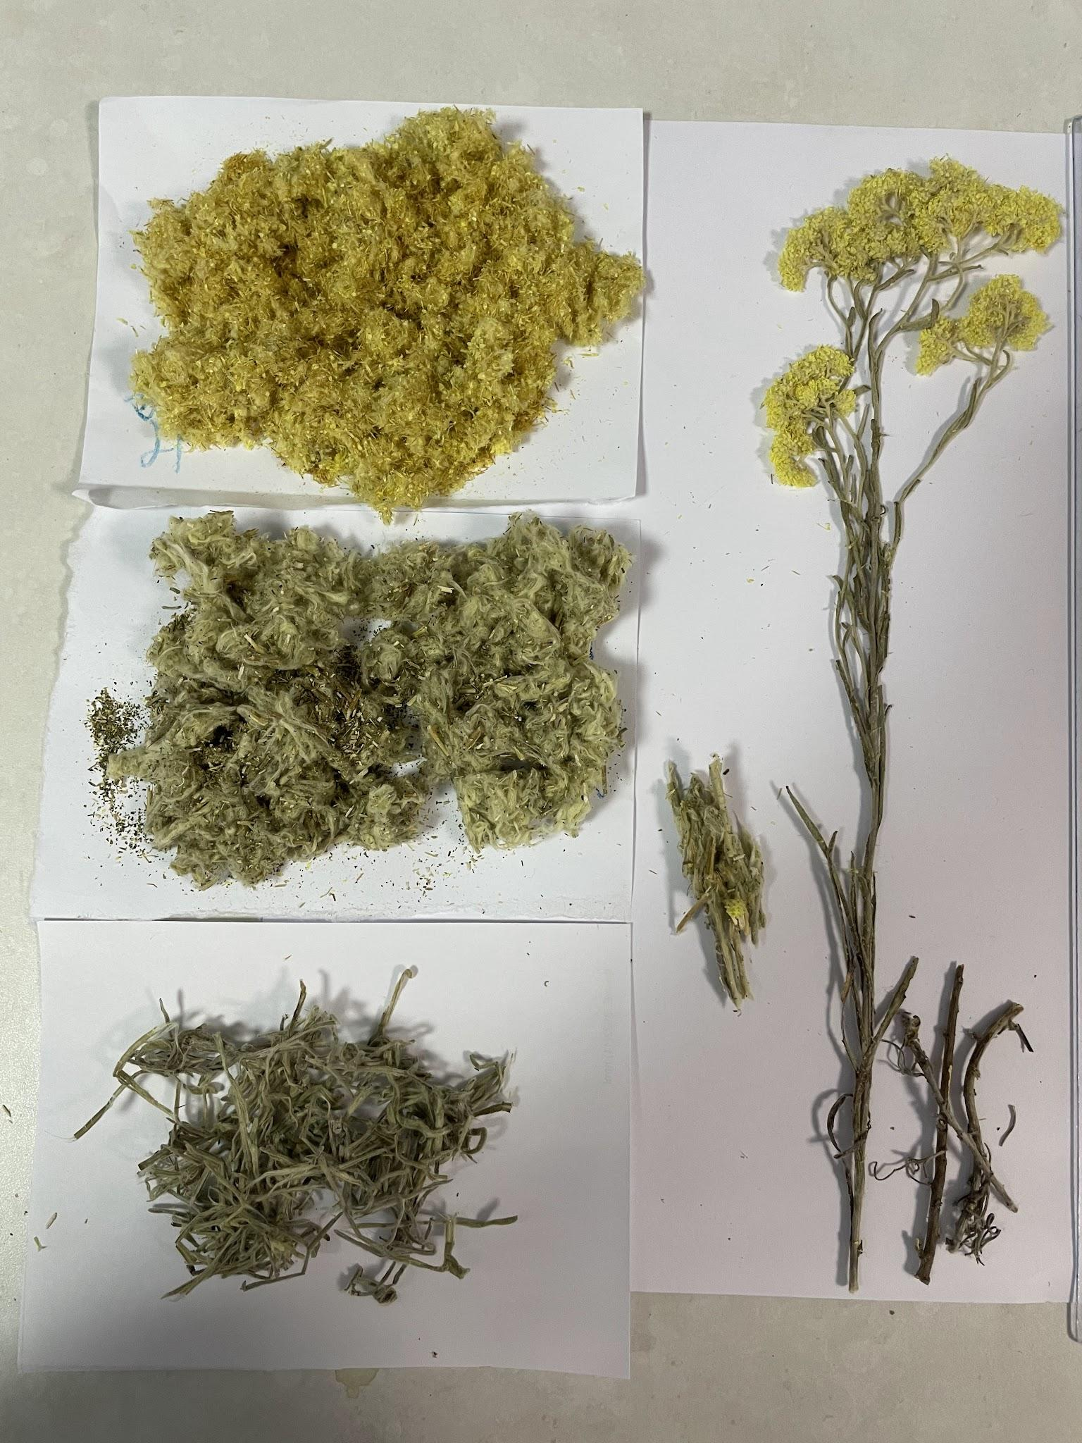
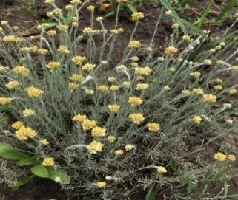
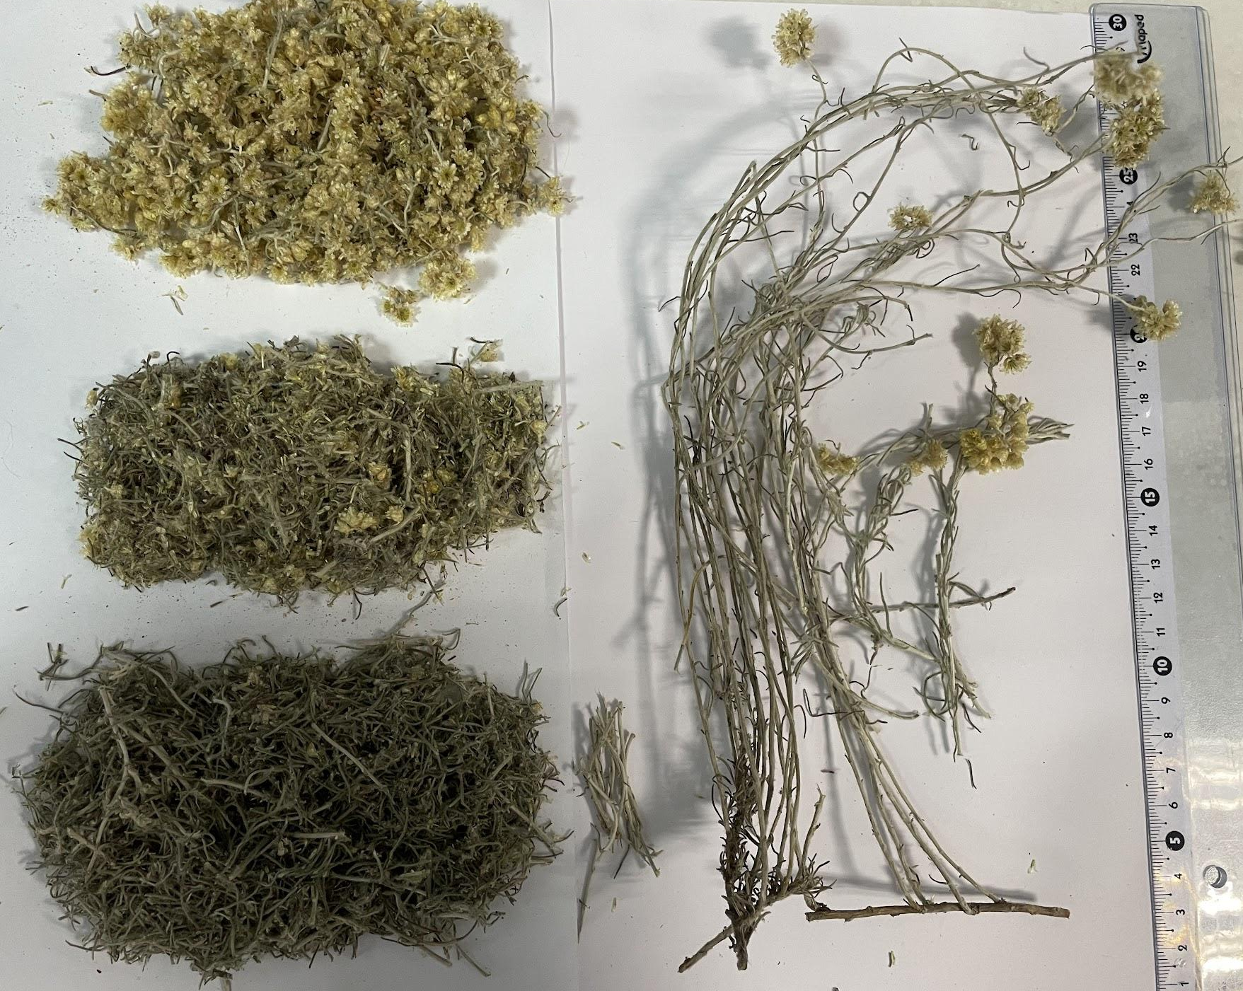
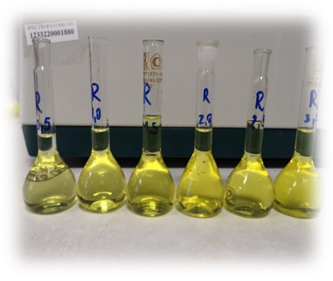
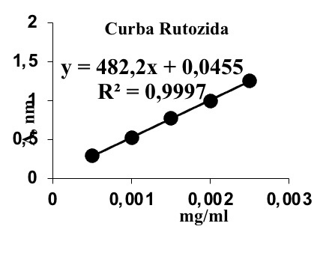
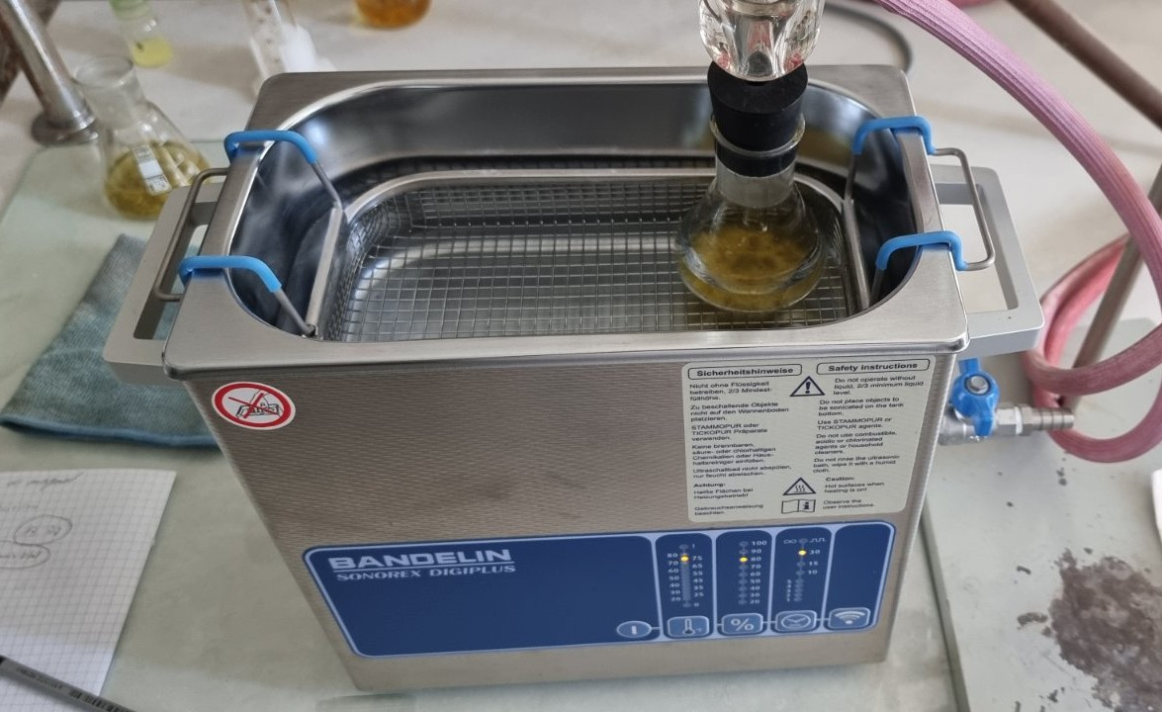
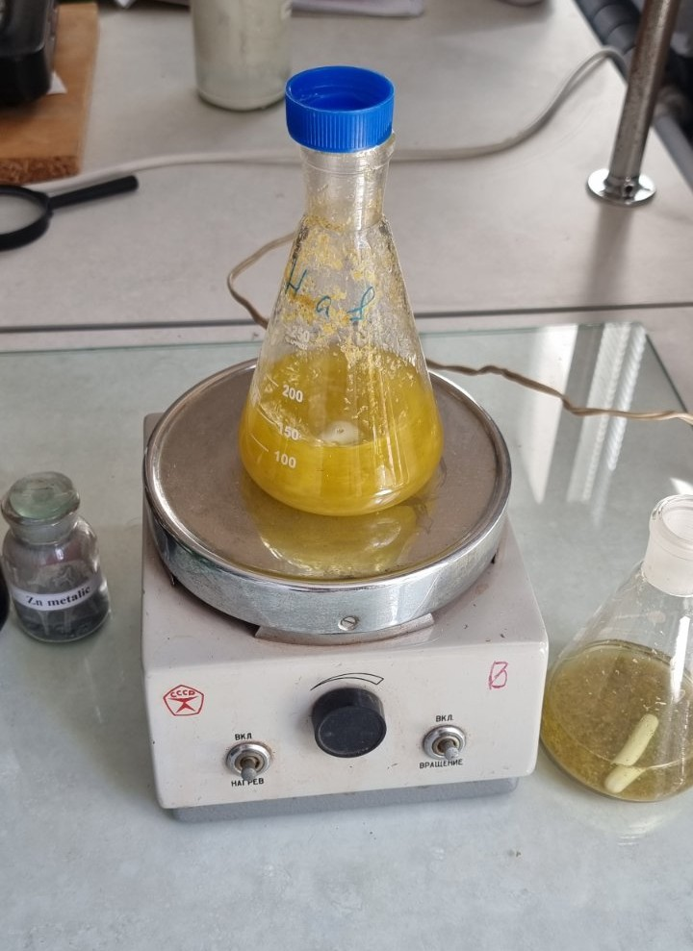
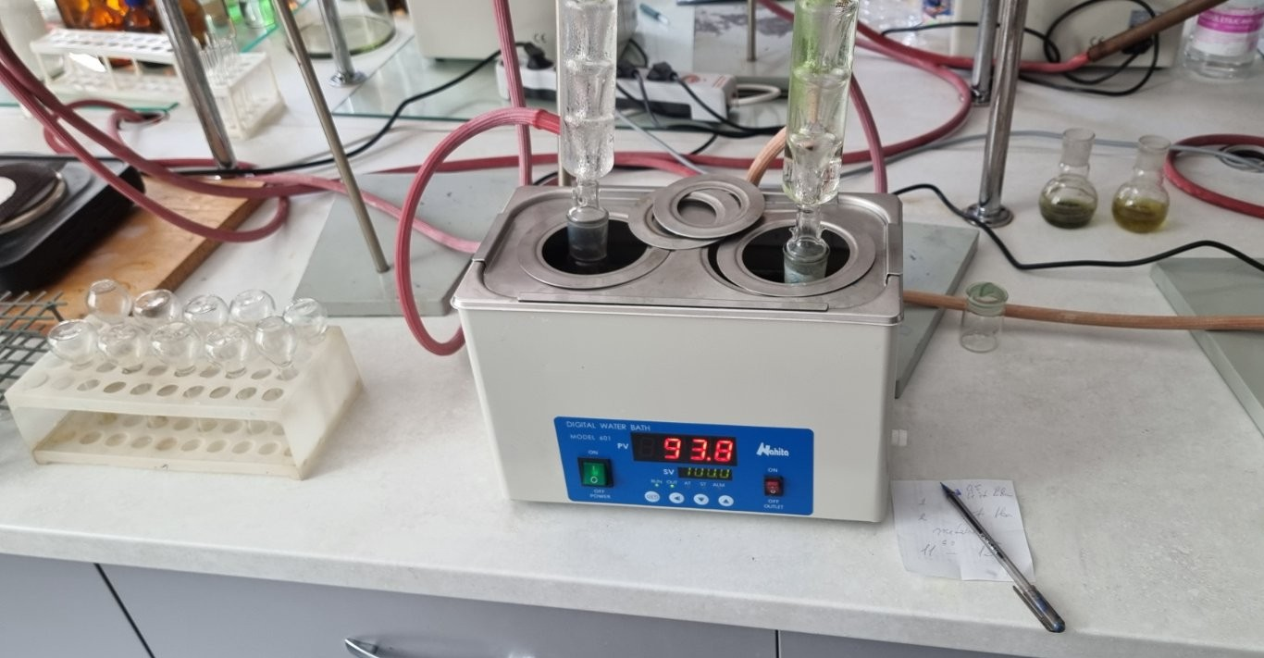
OPTIMIZATION OF THE EXTRACTION METHOD OF FLAVONOIDS IN PLANT PRODUCTS FROM SPECIES OF THE GENUS HELICHRYSUM
Daniela Cazacu, Mihaela Nartea, Maria Cojocaru-Toma
Nicolae Testemitanu State University of Medicine and Pharmacy, Chisinau, Republic of Moldova
Aim of the study. To quantifying the flavonoids in the plant products of Helichrysum species: flowers and aerial parts, by identifying the optimal method for flavonoid extraction.
The following extraction methods were used: ultrasound assisted extraction, magnetic stirring and water bath on reflux, to identify the optimal method for extracting flavonoids, using 60% ethyl alcohol as the solvent and the same extraction time of 30 minutes for all methods.
Figure 1. Helichrysum sp. (a, b- H. arenarium; c, d- H. italicum)
The extraction methods: a) ultrasound assisted extraction, b)magnetic stirring, c) water bath on reflux, d) spectrophotometrically determination of flavonoids ( λ=430 nm)
Materials and methods. The plant materials (flos, herba) were harvested from the spontaneous flora of the Republic of Moldova (H. arenarium) and from the Medicinal Plant Collection of Nicolae Testemițanu State University of Medicine and Pharmacy (H. italicum).
The total flavonoid content was determined spectrophotometrically using an AlCl₃ solution, with the absorbance read at wavelength λ=430 nm at Metertech UV/VIS SP 8001 spectrophotometer; and the results were expressed as rutoside (mg RU/100 g of product).
Results. The total flavonoid content (TFC) was higher in the inflorescences than in the aerial parts for both species. H. arenarium exhibited higher values compared to H. italicum for all three methods used. Magnetic stirring yielded the highest total flavonoid content values among all the extraction methods used. The maximum value was 2.678 mg RU/g in H. arenarii flos when extracted using a magnetic stirrer, while the minimum value was 0.099 mg RU/g in H. italici herba, where extraction was performed in a reflux water bath.
Conclusions. Extraction methods influence the total flavonoid content in Helichrysum species products and magnetic stirrer extrction can be used as the optimal method for flavonoid extraction, followed by ultrasonic and refrigerant bath extraction.
Acknowledgments: the project: Impact of different habitats and abiotic stress factors on plant metabolites of genus Galium and Helichrysum, project no.17ROMD, funding organization UE Fiscdi and national project nr. 25.80012.8007.05SE
National Conference with International Participation: Natural Sciences in the Dialogue of Generations, Chisinau, Republic of Moldova, 2026

