Slide 1
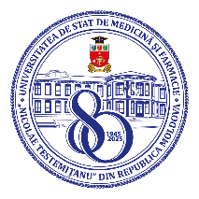
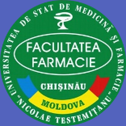
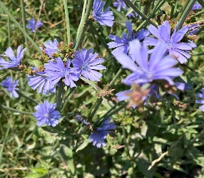
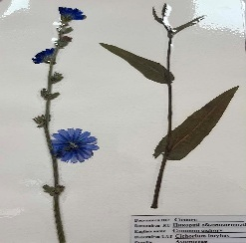
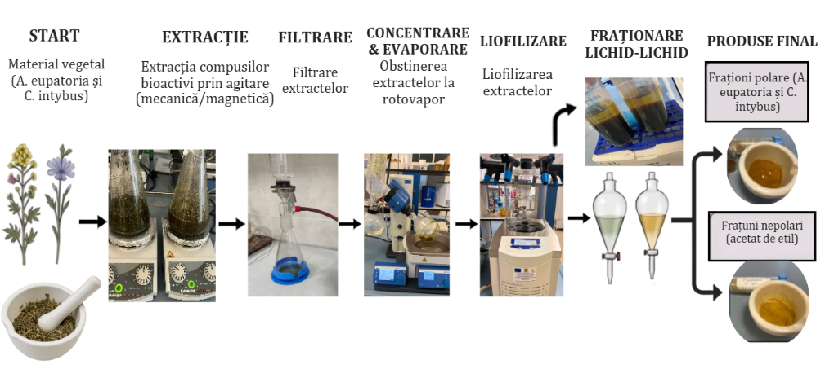
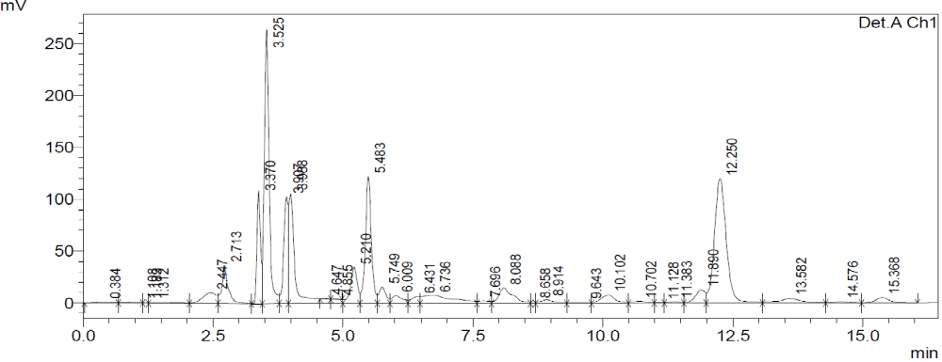
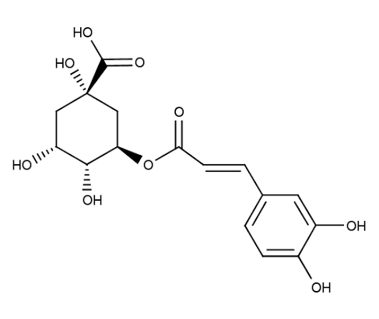
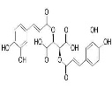
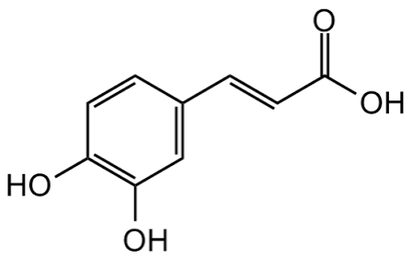
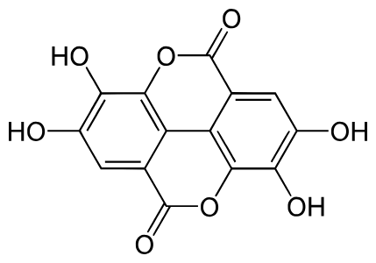
HPLC ANALYSIS FOR THE QUANTIFICATION OF PHENOLIC COMPOUNDS IN THE POLAR AND NON-POLAR FRACTIONS OF CICHORIUM INTYBUS L.
Alexandrina Gicul, Vlada Țurcanu, Maria Cojocaru-Toma
Nicolae Testemitanu State University of Medicine and Pharmacy, Chisinau, Republic of Moldova
sp. C. intybus
Aim of the study. To quantify the phenolic compounds in the polar and non-polar fractions of C. intybus using HPLC (on a Shimadzu LC-20AD chromatograph).
Results. The HPLC analysis was performed on a Shimadzu LC-20AD chromatograph with a UV detector, stationary phase: Zorbax Exlipse Plus C18; 2 mobile phases: solvent mixture: methanol: water (40:60) with gradient elution and 0.5% orthophosphoric acid:acetonitrile (80:20) with isocratic elution, detection at 280, 325, and 360 nm, with the optimal separation of phenolic com. (system of 0.5% orthophosphoric acid:acetonitrile
The results of the HPLC analysis indicate that the nonpolar fractions of C. intybus extracts have a higher content of hydroxycinnamic acids (clorogenic (3,9) chicoric, caffeic, and ellagic) and, in smaller amounts flavonoids (rutin, quercetin, luteolin, kaempferol, apigenin), while the polar hydroalcoholic fractions have a higher content of tannins (catechin and epicatechin) based on the retention times on the extract chromatogram compared to those on the standard solution chromatograms.
Materials and methods. The aerial parts of C. intybus was collected in flowering time, 2025. Polar and non-polar fractions were obtained from ethanol extracts of C. inybus after redissolving the extract in distilled water. The non-polar fraction was prepared by extraction with a weakly polar organic solvent (ethyl acetate) in a three-step process. The aqueous phase remaining after extraction with ethyl acetate represents the polar fraction, which contains water-soluble polar compounds.
Figure 1. obtaining of polar and non-polar fraction
Figure 2. HPLC of nonpolar fraction of C. intybus * Rt (min) clorogenic acid (3,9), chicoric (12,3), caffeic (5,4), ellagic (2,7)
Acknowledgments: the research project „Optimization of extracction methods of phenolic compounds from plant products, with evaluation of antimicrobial and antioxidant actions”, nr. 25.80012.8007.05SE, funded by ANCD.
Conclusions. The species in the SPCMP collection, C. intybus, contains nonpolar phenolic compounds (phenolic acids, flavonoids) and water-soluble polar compounds (tannins), as determined by HPLC, which are of value to the pharmaceutical industry.
National Conference with International Participation: Natural Sciences in the Dialogue of Generations, Chisinau, Republic of Moldova, 2026

