Slide 1

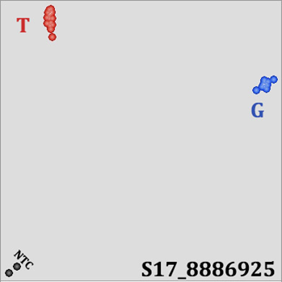
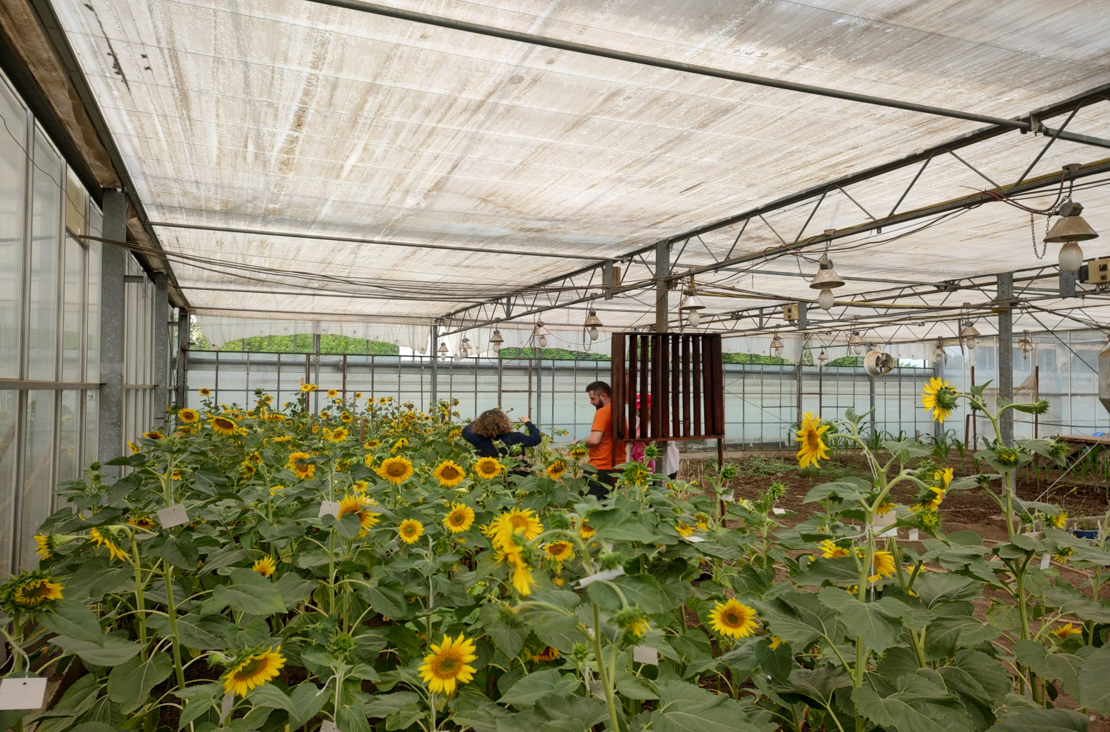

THE USE OF MOLECULAR MARKERS FOR THE SELECTION OF DROUGHT RESISTANT SUNFLOWER GENOTYPES
.
ANTON Florin Gabriel¹, CRISTINA Daniel¹, PACUREANU-JOITA Maria^{1,2}, CIUCA Matilda^{1,} CONTESCU Laura¹
¹National Agricultural Research and Development Institute Fundulea, Fundulea, Romania, email: gabi22mai@yahoo.com,
²Romanian Academy, Center of Study and Research for Agroforestry Biodiversity “Acad. David Davidescu”, Bucharest, Romania, email: mariapacureanu2@yahoo.com
Keywords: sunflower, molecular markers, drought
Drought stress represents one of the major limiting factors affecting sunflower productivity, causing a wide range of morphological, physiological, and molecular changes. Water deficit negatively affects seed germination, reduces plant height, leaf area, and biomass accumulation during the vegetative stage, while during the reproductive stage it may induce pollen sterility and substantial yield losses.
No. | Sunflower genotype
1 | SPL 21-2 x Helianthus argophyluus
2 | SPL 21-2 x Helianthus maximiliani
3 | 17x2 Pop. Sint. X Helianthus maximiliani
4 | Cep B x Helianthus argophyluus
5 | Cep C x Helianthus argophyluus
6 | Cep C x Helianthus tuberosus
7 | Cep C x Helianthus maximiliani
8 | 1010 B x Helianthus debilis
9 | 1050 B x Helianthus strumosus
10 | 1093 B x Helianthus maximiliani
11 | 0305 C x Helianthus molis
12 | P. pit. / 16438B x Helianthus argophyluus
13 | 1066C x H. petiolaris x H. praecox
14 | 1095 C x H. petiolaris x H. debilis
15 | Arg/84 19669b x Helianthus praecox
16 | Tex/23-602b x Helianthus praecox
17 | 0925C x Helianthus debilis
18 | 1103C x Helianthus maximiliani
19 | 1064C x Helianthus molis
20 | P. pit. / 79-16471B x Helianthus neglectus
21 | 991B x Helianthus argophyluus
22 | 1093B x Helianthus argophyluus
23 | 1085C x Helianthus argophyluus
24 | 1085C x H. argophyluus. X H. maximiliani
25 | 1088C x Helianthus argophyluus
26 | O-7493A x Helianthus argophyluus
27 | RPC-46-5412A X H. argophyluus
28 | RPC-46-5412A X H.argophyluus
29 | TARD 85 20072 A x H. argophyluus
30 | TARD 85 20072 A x H. argophyluus
31 | Pop. Pit./79-1643Ax H. argophyluus
32 | Pop. Pit./79-1643Ax H. argophyluus
33 | TARD 85 19982 A x H. argophyluus
34 | FD15E27- control
The present study evaluated 34 sunflower genotypes for drought tolerance using molecular marker analysis based on KASP technology. A total of seven KASP markers localized on chromosomes 1, 4, 8, 10, 11, 14, and 17 were tested for their potential use in marker-assisted selection for drought tolerance.
Only two markers, S17_8886925 and S11_160090021, revealed significant variability within the analyzed sunflower germplasm.
The marker S17_8886925, containing the SNP (C/A), is associated with the gene LOC110920644, previously linked to leaf surface area and drought tolerance index. The control, sunflower hybrid FD15E27, presented the T allelic variant [A]. The marker S11_160090021, located on chromosome 11 and characterized by the SNP C/T, belongs to the gene LOC110891369, a receptor-like protein kinase associated with leaf surface area under water stress conditions.
An additional interesting result was obtained for marker S8_68352115 (SNP A/T), located on chromosome 8 within the gene LOC110872899, identified as an inactive leucine-rich repeat receptor-like serine/threonine-protein kinase associated with root surface area and water stress tolerance index. Although this marker appeared to present predominantly the T allelic variant, two closely related groups were observed among the analyzed genotypes.
NATURAL SCIENCES IN THE DIALOG OF GENERATIONS, IX EDITION, NATIONAL CONFERENCE WITH INTERNATIONAL PARTICIPATION
September 21–22, 2026, Chisinau, Republic of Moldova
DNA Extraction
The collected samples (leaves) were stored at -25°C; subsequently, each sample was ground in liquid nitrogen, and approximately 100 mg of the resulting ground material was transferred into sterile 2 ml tubes. Multiple DNA extractions were performed from the same line.
DNA extraction was carried out using the "NucleoSpin Plant II" kit.
Detection of A/T SNPs using the KASP technique
DNA Amplification
DNA amplification reactions for the KASP (Kompetitive Allele Specific PCR) technique were performed using PACE2.0 Genotyping Master Mix 2x (std. ROX) from 3CR BIOSCIENCE, in accordance with the manufacturer's specifications. Reading and interpretation of the KASP results were carried out using the FLUOstar Omega plate reader (BMG Labtech) and KlusterCaller software (LGC Biosearch Technologies).
Detection of G/T (C/A) SNPs using the KASP technique
CONCLUSIONS
These results demonstrate the usefulness of KASP-based SNP markers for identifying genetic variability associated with drought tolerance traits in sunflower and support their application in marker-assisted breeding programs aimed at developing climate-resilient sunflower hybrids.
Detection of C/T SNPs using the KASP technique

