Slide 1



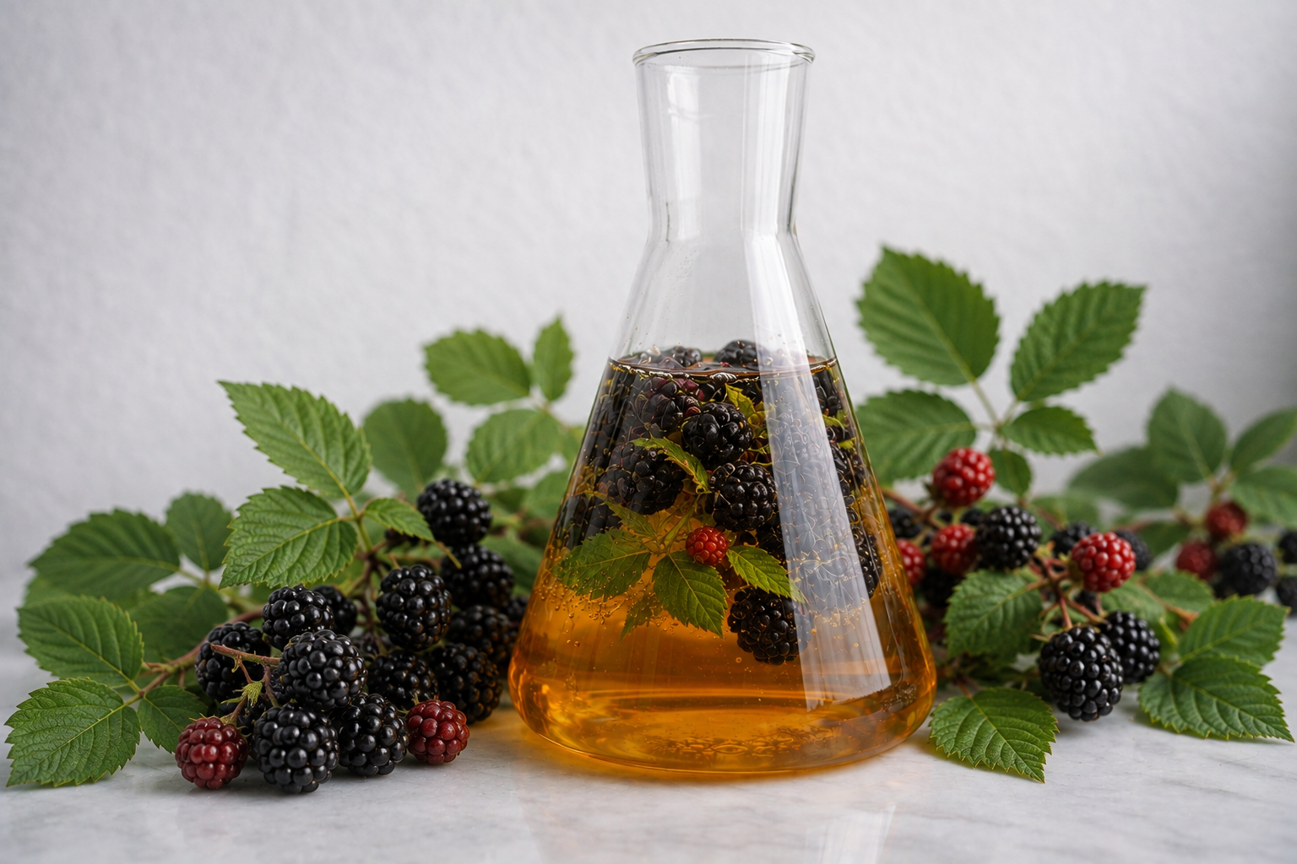
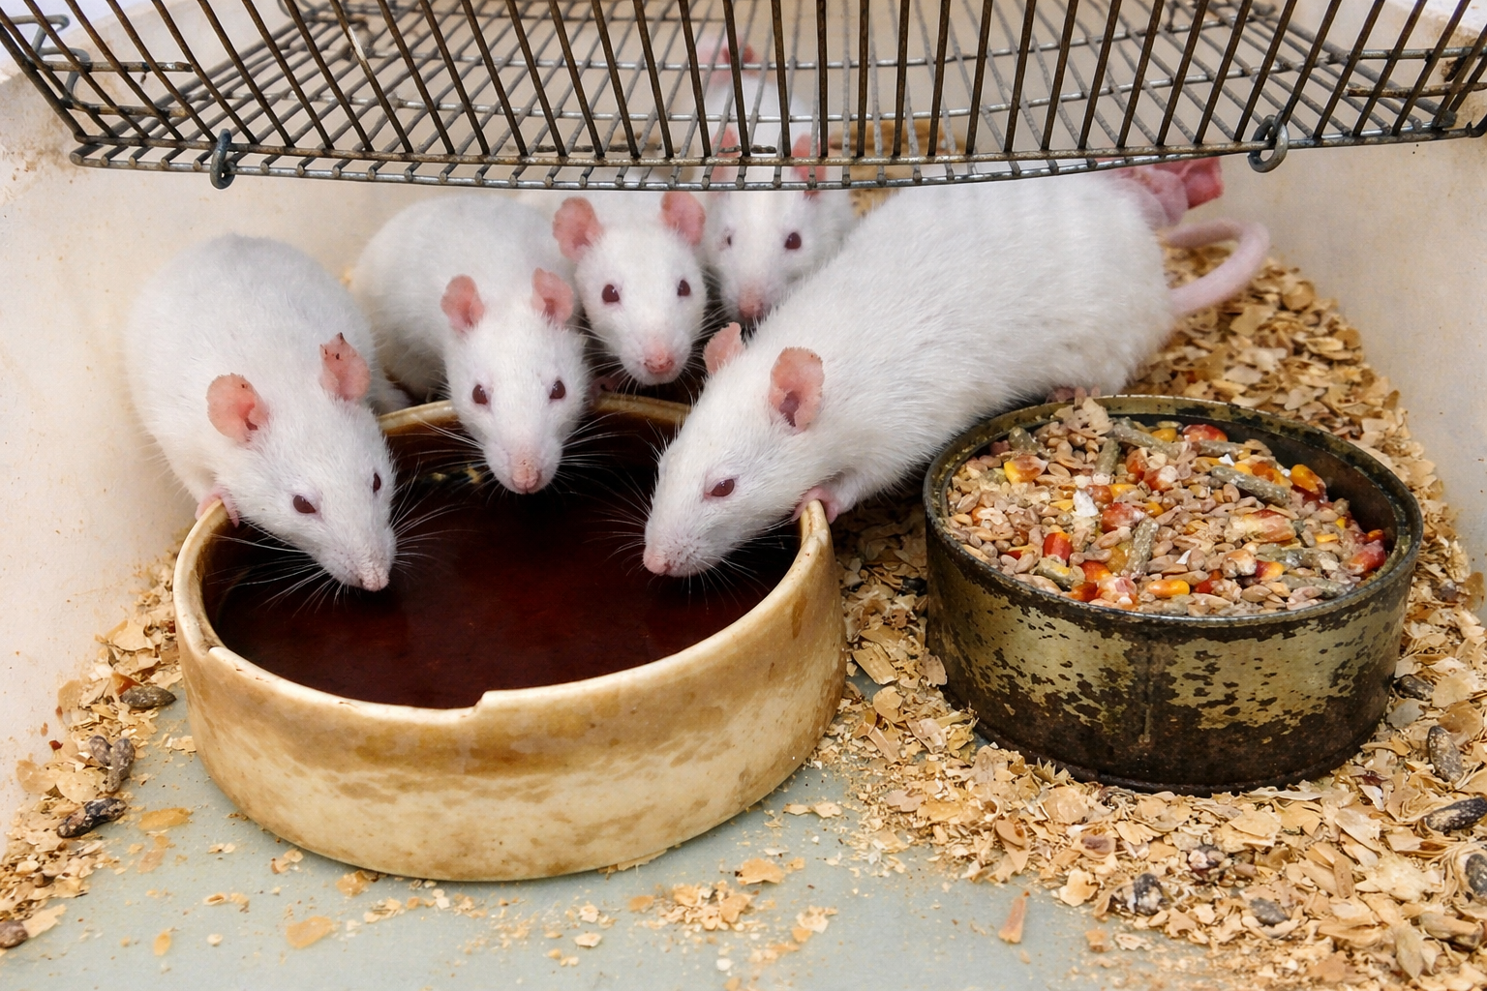
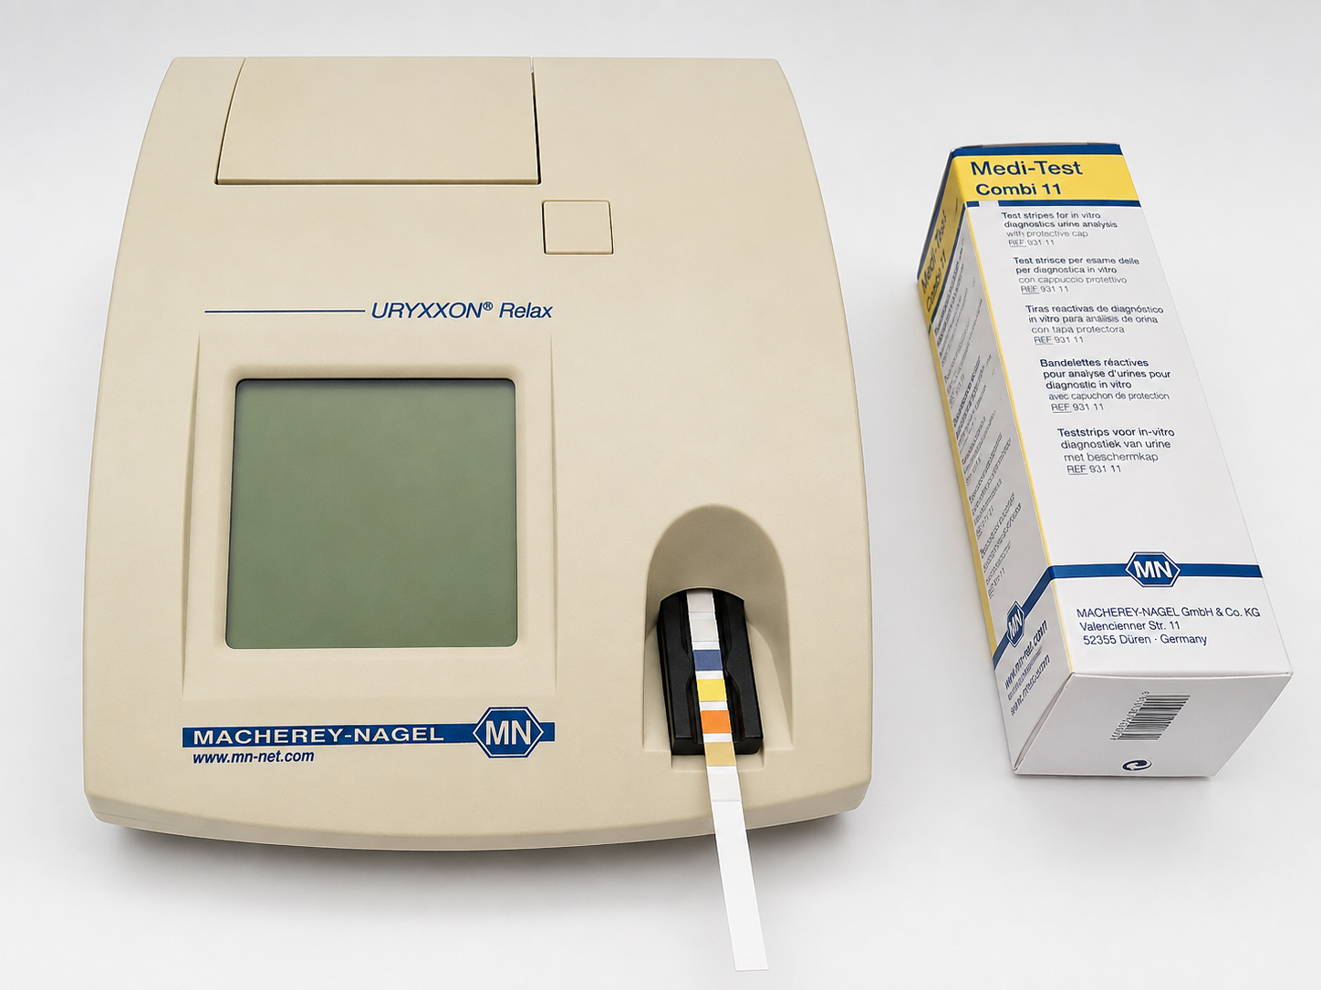
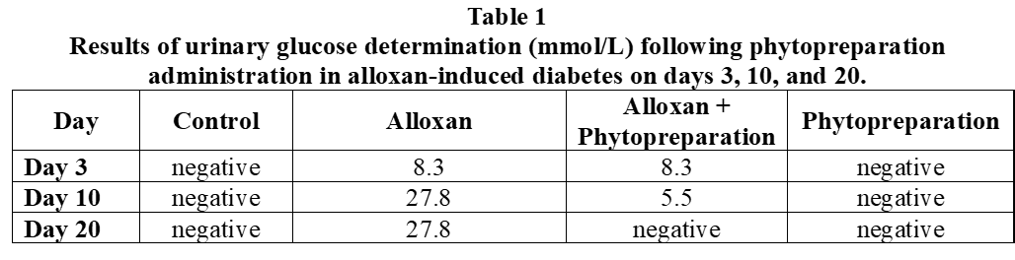
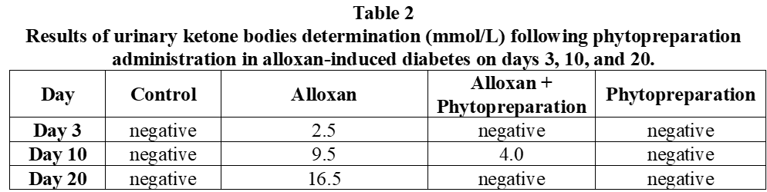
MOLDOVA STATE UNIVERSITY
Institute of Physiology and Sanocreatology
Scientific Research Laboratory Human and Animal Ecophysiology
65 A, Mihail Kogălniceanu str., Chisinau, MD-2009, Republic of Moldova
Tel.: +373 68082030; E-mail: iurabacalov@mail.ru
METABOLIC IMPACT OF THE AQUEOUS EXTRACT OF RUBUS FRUTICOSUS IN DIABETES LEAVES
AUTHORS: Iurie BACALOV, Aurelia CRIVOI, Elena CHIRIȚA, Adriana DRUȚA.
INTRODUCTION: Given the metabolic imbalances in diabetes mellitus and the rising interest in plant-derived bioactive compounds, Rubus fruticosus stands out due to its rich content of polyphenols and flavonoids capable of ameliorating carbohydrate disorders.
AIM: To evaluate the changes in certain urinary metabolic parameters (glucosuria and ketonuria) in rats with experimental diabetes following the administration of an aqueous extract from Rubus fruticosus leaves.
RESULTS: The results demonstrated that, in the experimental diabetic group, a significant increase in glucosuria was recorded, determined by exceeding the renal threshold for glucose under conditions of persistent hyperglycemia. Additionally, ketonuria was observed as a result of intensified lipolysis and the use of fatty acids as an alternative energy source.
Administration of the aqueous extract from Rubus fruticosus leaves led to a reduction in glucosuria levels compared with the untreated diabetic group. This decrease may be explained by the hypoglycemic effect of the bioactive compounds present in the extract, which contribute to improved glucose utilization at the tissue level and/or stimulation of insulin secretion. Regarding ketonuria, the results demonstrated a decrease in treated animals, suggesting a reduction in ketogenesis. This effect indicates a possible partial restoration of energy metabolism, with the organism shifting toward carbohydrate utilization rather than lipids.
CONSLUSION: The study highlights that the aqueous extract from Rubus fruticosus leaves reduced glucosuria and ketonuria, suggesting an improvement in the metabolic disturbances characteristic of diabetes mellitus. The extract may therefore be used as an adjuvant agent in correcting metabolic disorders associated with this condition.
ACKNOWLEDGMENTS: This research subproject: 011001
Notes:
1

