Slide 1



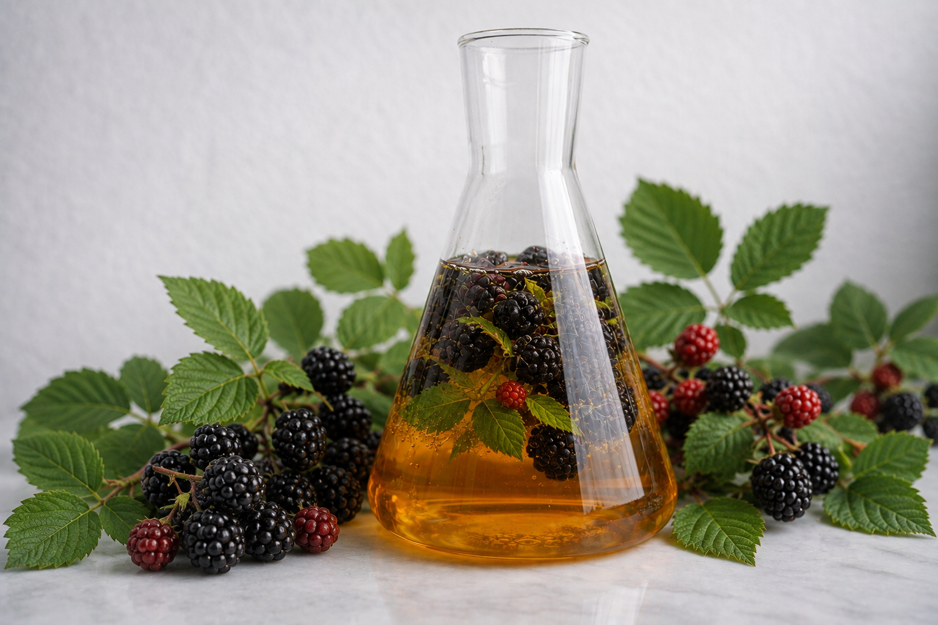
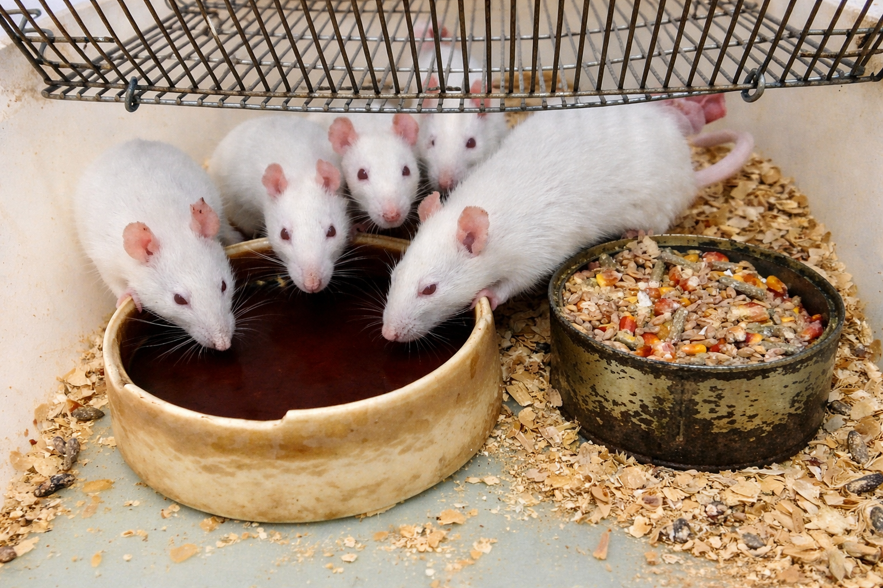
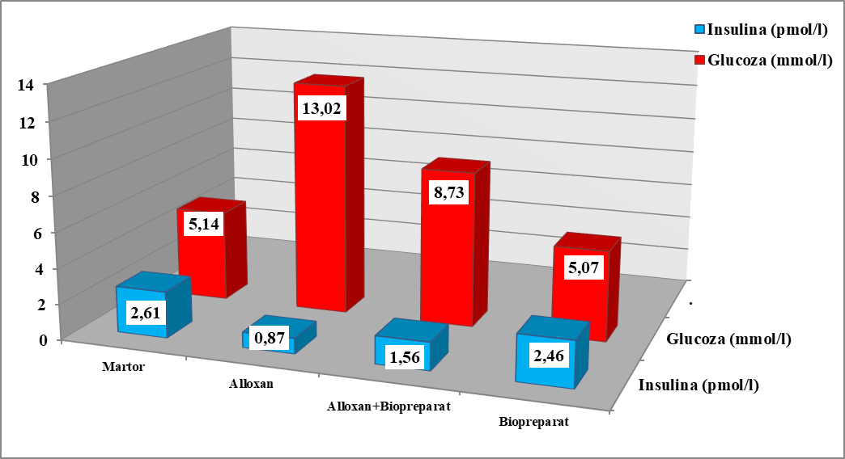
MOLDOVA STATE UNIVERSITY
Institute of Physiology and Sanocreatology
Scientific Research Laboratory Human and Animal Ecophysiology
65 A, Mihail Kogălniceanu str., Chisinau, MD-2009, Republic of Moldova
Tel.: +373 68082030; E-mail: iurabacalov@mail.ru
EFFECTS OF RUBUS FRUTICOSUS EXTRACT ON GLYCEMIA AND INSULIN IN DIABETES
AUTHORS: Iurie BACALOV, Adriana DRUȚA.
INTRODUCTION: Given that diabetes impairs the hormonal regulation of glycemia and insulin, Rubus fruticosus stands out as a promising therapeutic resource due to its rich content of polyphenols and flavonoids with proven hypoglycemic and metabolic protective effects.
AIM: The aim of this study was to evaluate the effect of the aqueous extract from Rubus fruticosus leaves on glycemia and insulin concentration in experimental diabetes.
RESULTS: The results revealed significant alterations in carbohydrate metabolism in diabetic animals, characterized by a marked increase in glycemia (≈13.02 mmol/L) compared to the control group (≈5.14 mmol/L), confirming the presence of metabolic imbalance. Concurrently, insulin concentration was reduced (≈0.87 pmol/L vs. ≈2.61 pmol/L in the control group), indicating impaired pancreatic endocrine function. Administration of the aqueous extract from Rubus fruticosus leaves led to an improvement in these metabolic disturbances, as evidenced by a reduction in glycemia (≈8.73 mmol/L) compared to the untreated diabetic group, as well as an increase in insulin concentration (≈1.56 pmol/L). These findings suggest that the extract exerts both hypoglycemic and potential insulinotropic effects, contributing to improved insulin secretion. The underlying mechanisms may be attributed to the high content of polyphenols and flavonoids, which act by reducing oxidative stress, enhancing peripheral glucose utilization, inhibiting hepatic gluconeogenesis, and protecting pancreatic β-cells.
Hypoglycemic effect
CONSLUSION: Overall, the study demonstrates that the aqueous extract from Rubus fruticosus leaves exerts a beneficial effect on carbohydrate metabolism parameters in experimental diabetes by reducing hyperglycemia and increasing insulin levels. These findings support the therapeutic potential of the extract and recommend its use as an adjuvant agent in diabetes prevention strategies.
ACKNOWLEDGMENTS: This research subproject: 011001
Notes:
1

