Slide 1


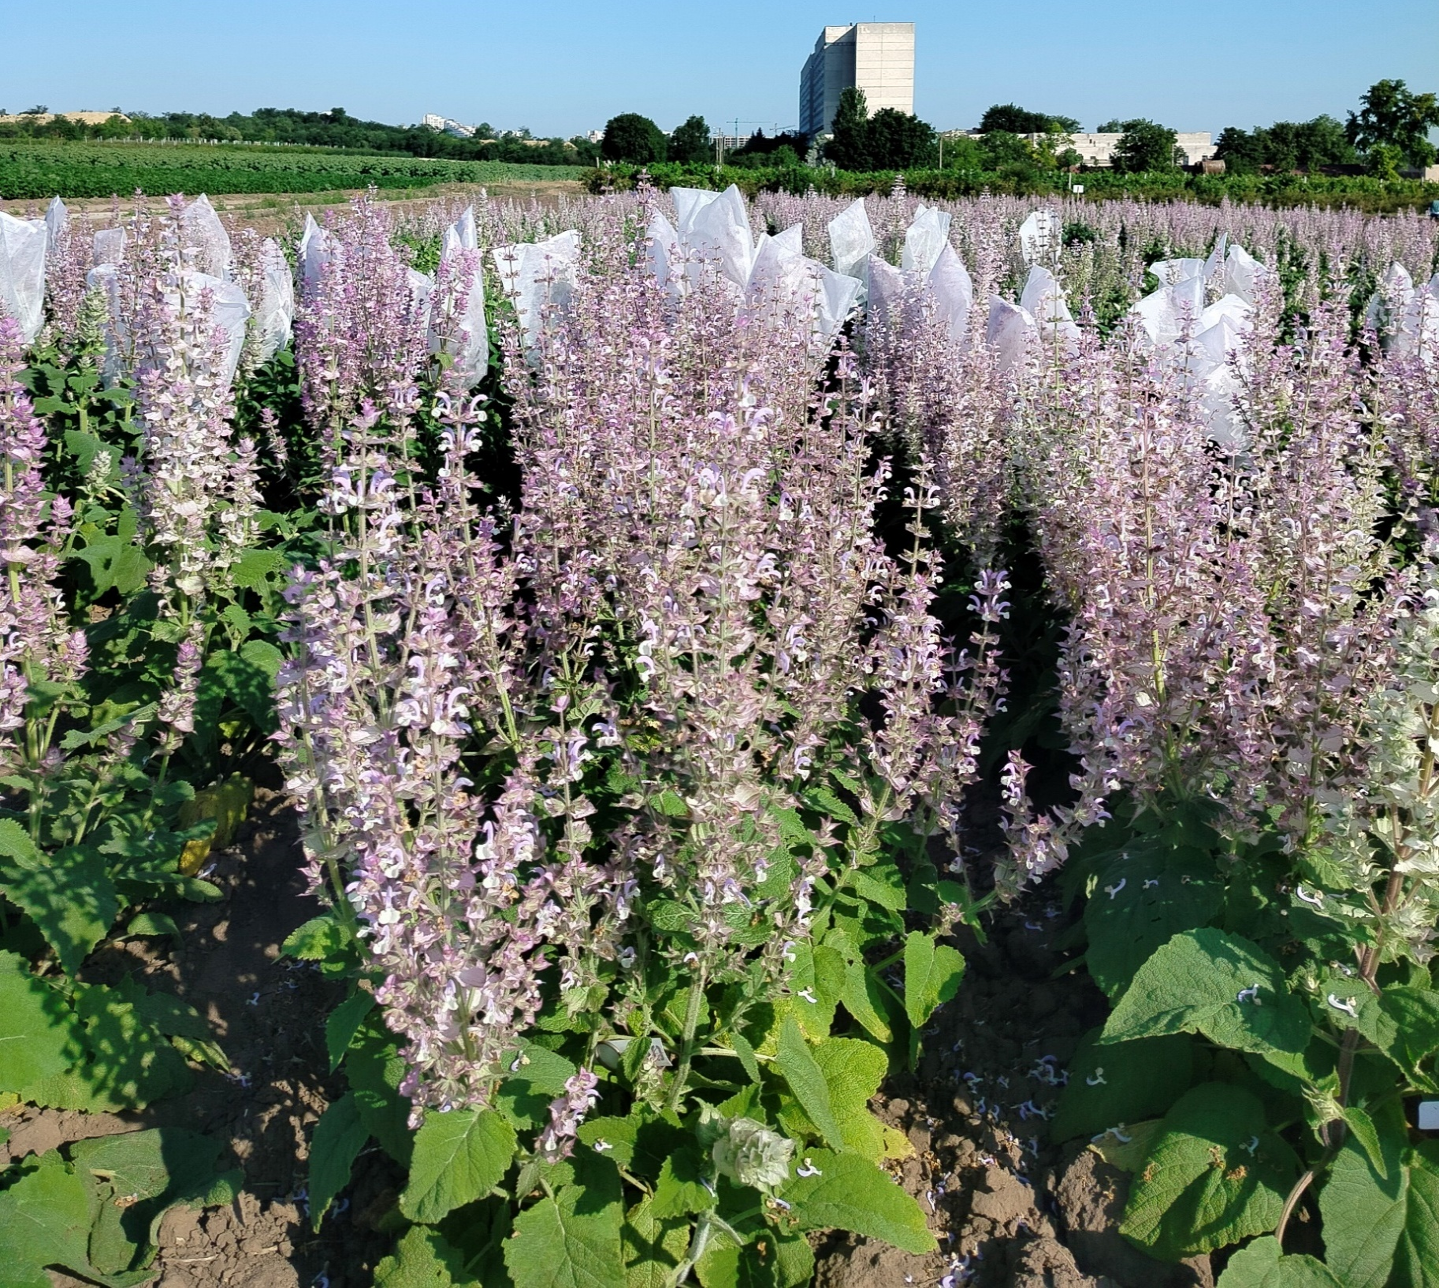
MOLDOVA STATE UNIVERSITY
INSTITUTE OF GENETICS, PHYSIOLOGY AND PLANT PROTECTION
Scientific Research Laboratory of Aromatic and Medicinal Plants
60, Alexei Mateevici str., MD2009, Chisinau, Republic of Moldova
INBREED LINES OF CLARY SAGE (Salvia sclarea L.)
AUTHORS: Zinaida BALMUS*, Ludmila COTELEA, Violeta BUTNARAS
E-mail: zinaida.balmus@sti.usm.md
The aim of research on the improvement of clary sage (S. sclarea.) is to create and diversify the initial material, with an advanced degree of flowering in the first year of vegetation, in order to obtain varieties resistant to abiotic factors, capable of ensuring high production of raw material and quality essential oil, due to the increased concentration of active principles and the unique correlation of components.
The biological material used in the present study was represented by 63 inbred lines S₆ – S₁₆ of different origins. The creation of the initial breeding material was achieved through inbreeding, by closing the inflorescence in an isolater, at the beginning of the flowering stage and forcing pollination with its own pollen. The essential oil was obtained by hydro distillation in Ginsberg apparatus. The experiments were carried in accordance with internationally accepted methods for this crop.
The results obtained show that the flowering of the sedge in the first year of vegetation varies from year to year and depends on the pedoclimatic conditions, the thermal regime of the period from the seedlings emergence to leaf rosette and adherence cultivation technology. As a result of research conducted with a large number of inbred lines, it was found that there are lines with full flowering in the first year of vegetation, as well as lines with an increased content of essential oils. Finally, lines with an essential oil content exceeding 2% (dry matter), were identified: AP 97-11 S6– 2.076%; M-69 428-82 S₁₆ – 2.227 %; M-69 815-82 S₁₆ – 2.140 %. Lines with essential oil content exceeding 1.5 %: AP 2-11 S₆– 1.642 %; AP 11-11 S₆– 1.630 %; AP 28-11 S₆– 1.221 %; AP 30-11 S₆– 1.912 %; AP 32-11 S6– 1.719%; AP 66-11 S₆– 1.643 %; NC 98-11 S6– 1.810%; NC 11-11 S6– 1.753 %; NC 38-11 S6– 1.646 %; NC 98-11 S6– 1.810%,; AP 67-11 S₆– 1,573 %; NC 6 -11 S₆– 1,356 %; NC 4 -11 S₆– 1.358 %; NC 11 -11 S₆– 1,753 %; NC 19 -11 S₆– 1.499 %; NC 38 -11 S₆– 1.646 %; NC 98 -11 S₆– 1.810 %, etc.
Conclusion: The inbred lines developed are divided into three groups: those affected by inbreeding degeneration, those unaffected by degeneration, and lines in which new characters appear as a result of inbreeding, which proves that inbreeding is a factor of morphogenesis and a source of new characters, some of which are very valuable for breeding. Inbreed lines represent exceptional material for the creation of complex hybrids.
Key words: Clary sage, inbred lines, essential oil.
Acknowledgments: This study was supported by the research project 011102 Increasing and conservation genetic diversity, agricultural crop breeding in the context of climate change, funded by Ministry of Education and Research
NATURAL SCIENCES IN THE DIALOGUE OF GENERATIONS The National Conference with International Participation, edition IX-^{th} September 21-22, Chisinau, Republic of Moldova, 2026

