Slide 1




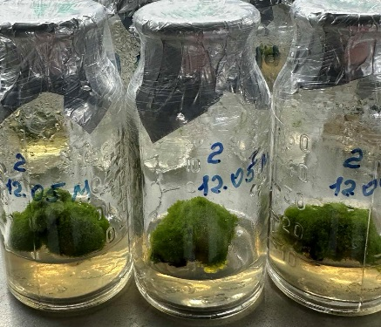
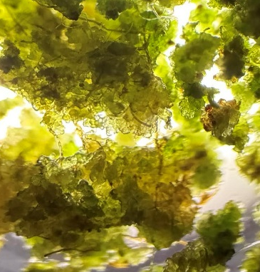
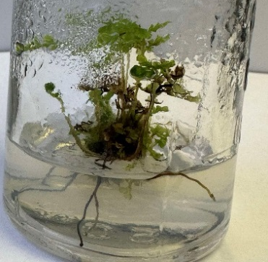
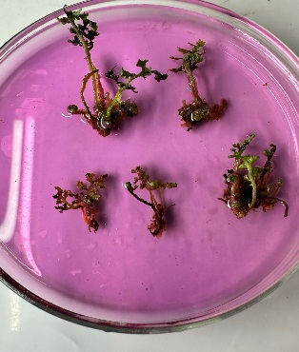
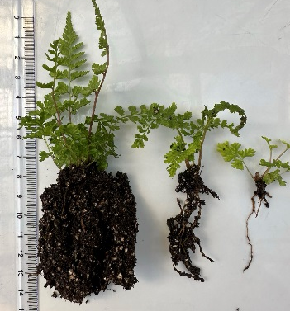
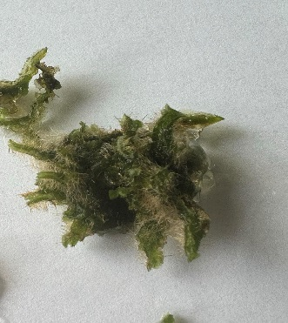
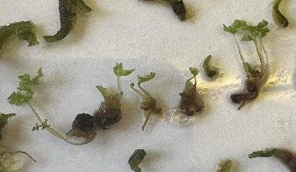
Moldova State University
Xth National Conference with International Participation “Natural Sciences in the Dialogue of Generations “
21–22 September, 2026. Chisinau, Republic of Moldova
INITIATION OF MICROPROPAGATION OF THE FERN ATHYRIUM NIPONICUM 'URSULA'S RED
Mariana TROFIM *, Maria TABĂRA, Aliona GLIJIN, Elvira CUZMINA
„Alexandru Ciubotaru” National Botanical Garden (Institute) of MSU
*E-mail: *marianatrofim1977@gmail.com
AIM OF THE STUDY
RESULTS
To initiate and multiply in vitro the Japanese painted fern, Athyrium niponicum 'Ursula's Red', and to develop an efficient propagation protocol for obtaining a large number of healthy plantlets within a relatively short period.
After 30 days of incubation, abundant formation of meristematic structures was observed from immature sori.
The green globular bodies (GGBs) subsequently served as an efficient propagation material.
Approximately 300–350 gametophytes per culture vessel were obtained within a relatively short cultivation period.
The obtained results demonstrate the high morphogenitic potential of immature sori for in vitro propagation of A. niponicum 'Ursula's Red'.
MATERIALS AND METHODS
Rhizome fragments, primordia, frond apices, and fragments of incompletely differentiated sporangia (sori) collected from juvenile sporophytes.
EXPERIMENTAL FLOW
Inoculum preparation and initiation.
Collection, sterilization, and inoculation of rhizome fragments, primordia, frond apices and immature sori.
2. GGB formation and multiplication.
Induction and multiplication of green globular bodies (GGBs), followed by gametophyte differentiation.
3. Sporophyte development and rhizogenesis. Development of sporophytes from gametophytes and induction of root formation.
Green globular bodies
Rooted sporophytes
Numerous multicellular gametophyte clusters of various sizes developed after transfer to the appropriate culture media.
CONCLUSIONS
Incompletely immature sori enabled efficient GGBs formation and rapid gametophyte production, supporting mass propagation and conservation of Athyrium niponicum 'Ursula's Red'.
ACKNOWLEDGMENTS
This study was supported by the research project Subprogram 010101, “Research and ex situ and in situ conservation of plant diversity in the Republic of Moldova.”, funded by the Ministry of Education and Research and the project of the State Program.
Development of gametophytes and sporophytes

