Slide 1
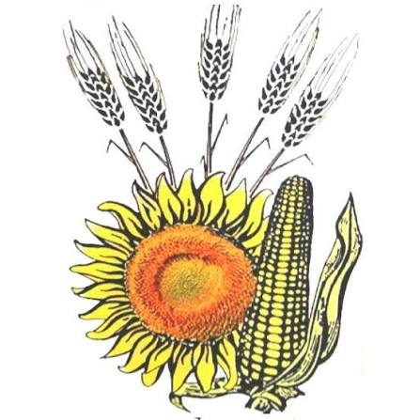
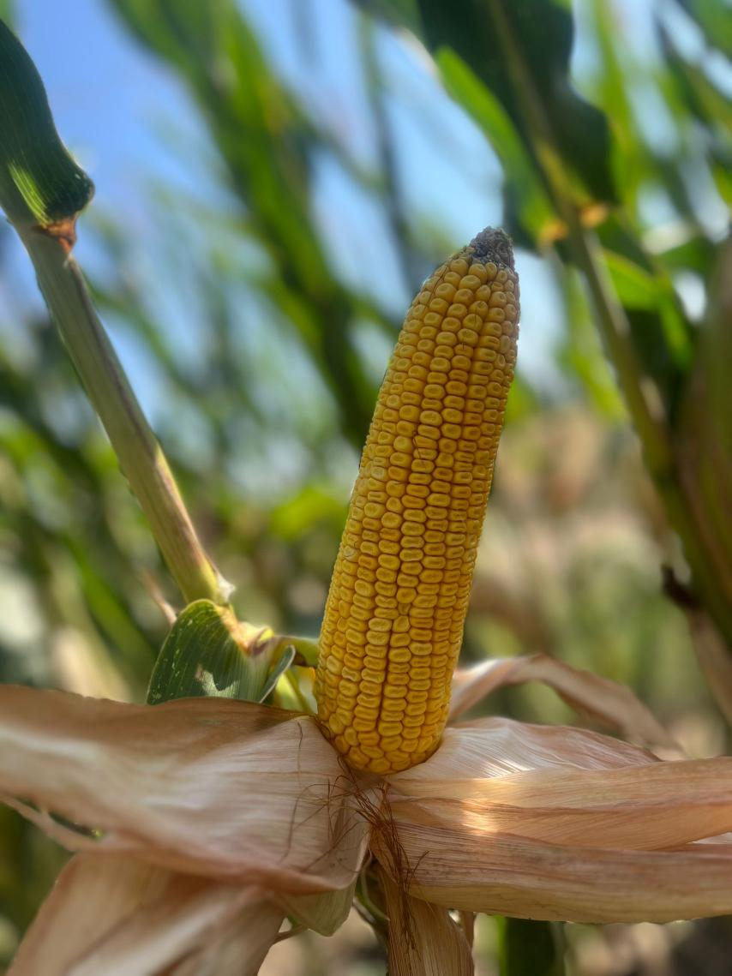
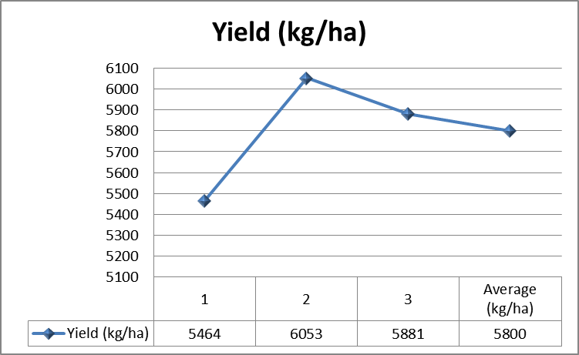
The Influence of Autumn Plowing on Yield Components and Yield of Maize
Bordei Marius*, Partal Elena, Pintilia Sabina, Anton Gabriel, Georgescu Emil
¹National Agricultural Research and Development Institute, Nicolae Titulescu str., no 1, 915200 Fundulea, Călărași County, Romania
²University of Agronomic Sciences and Veterinary Medicine of Bucharest, 59 Mărăști Boulevard, District 1
*E-mail: marius.bordei79@gmail.com
Introduction
The maize plants showed good development, with an average of 52 ears/plant and 5.3% sterile plants. The average ear length was 19.0 cm, with 17.3 kernel rows per ear and 42.3 kernels per row. The average number of kernels per ear was 754, while ear weight averaged 199.9 g and kernel weight per ear 157.5 g.
Grain yield ranged from 5,464 to 6,053 kg/ha, with an average of approximately 5,799 kg/ha.
The aim of the study was to evaluate the effect of autumn plowing on maize growth and yield components. Several morphological and productive characteristics were analyzed.
Results
Materials and Methods
The study monitored: number of ears per plant, percentage of barren plants, ear length, number of kernel rows per ear, kernels per row and per ear, ear weight, kernel weight per ear, thousand-kernel weight (TKW), grain yield, and moisture content. Measurements were carried out in three experimental replications.
Yield components by experimental replication
Replicate | 1 | 2 | 3 | Average
1 | 49 | 54 | 53 | 52
2 | 5 | 7 | 4 | 5.3
3 | 20 | 18 | 19 | 19.0
4 | 16 | 16 | 20 | 17.3
5 | 43 | 44 | 40 | 42.3
6 | 704 | 750 | 808 | 754.0
7 | 180.5 | 200.6 | 218.5 | 199.9
8 | 158.7 | 160.4 | 153.4 | 157.5
9 | 260.1 | 280.0 | 275.0 | 271.7
10 | 84.6 | 84.7 | 84.5 | 84.6
11 | 13.5 | 13.8 | 13.7 | 13.8
Legend
Conclusions
Autumn plowing provided favorable conditions for maize development and contributed to good yield component values. The results indicate that proper soil preparation can support better ear development, grain filling, and stable grain production. Autumn plowing can therefore be considered an important technological practice in maize cultivation.
1. No. of ears/plant
2. % of plants without ears (sterile plants)
3. Ear length (cm)
4. No. of kernel rows/ear
5. No. of kernels/row
6. No. of kernels/ear
7. Ear weight (g)
8. Kernel weight/ear (g)
9. Thousand-kernel weight (TKW) (g)
10. Grain yield (%)
11. Moisture content (MC%)
Keywords
maize, autumn plowing, yield, yield components

