Slide 1


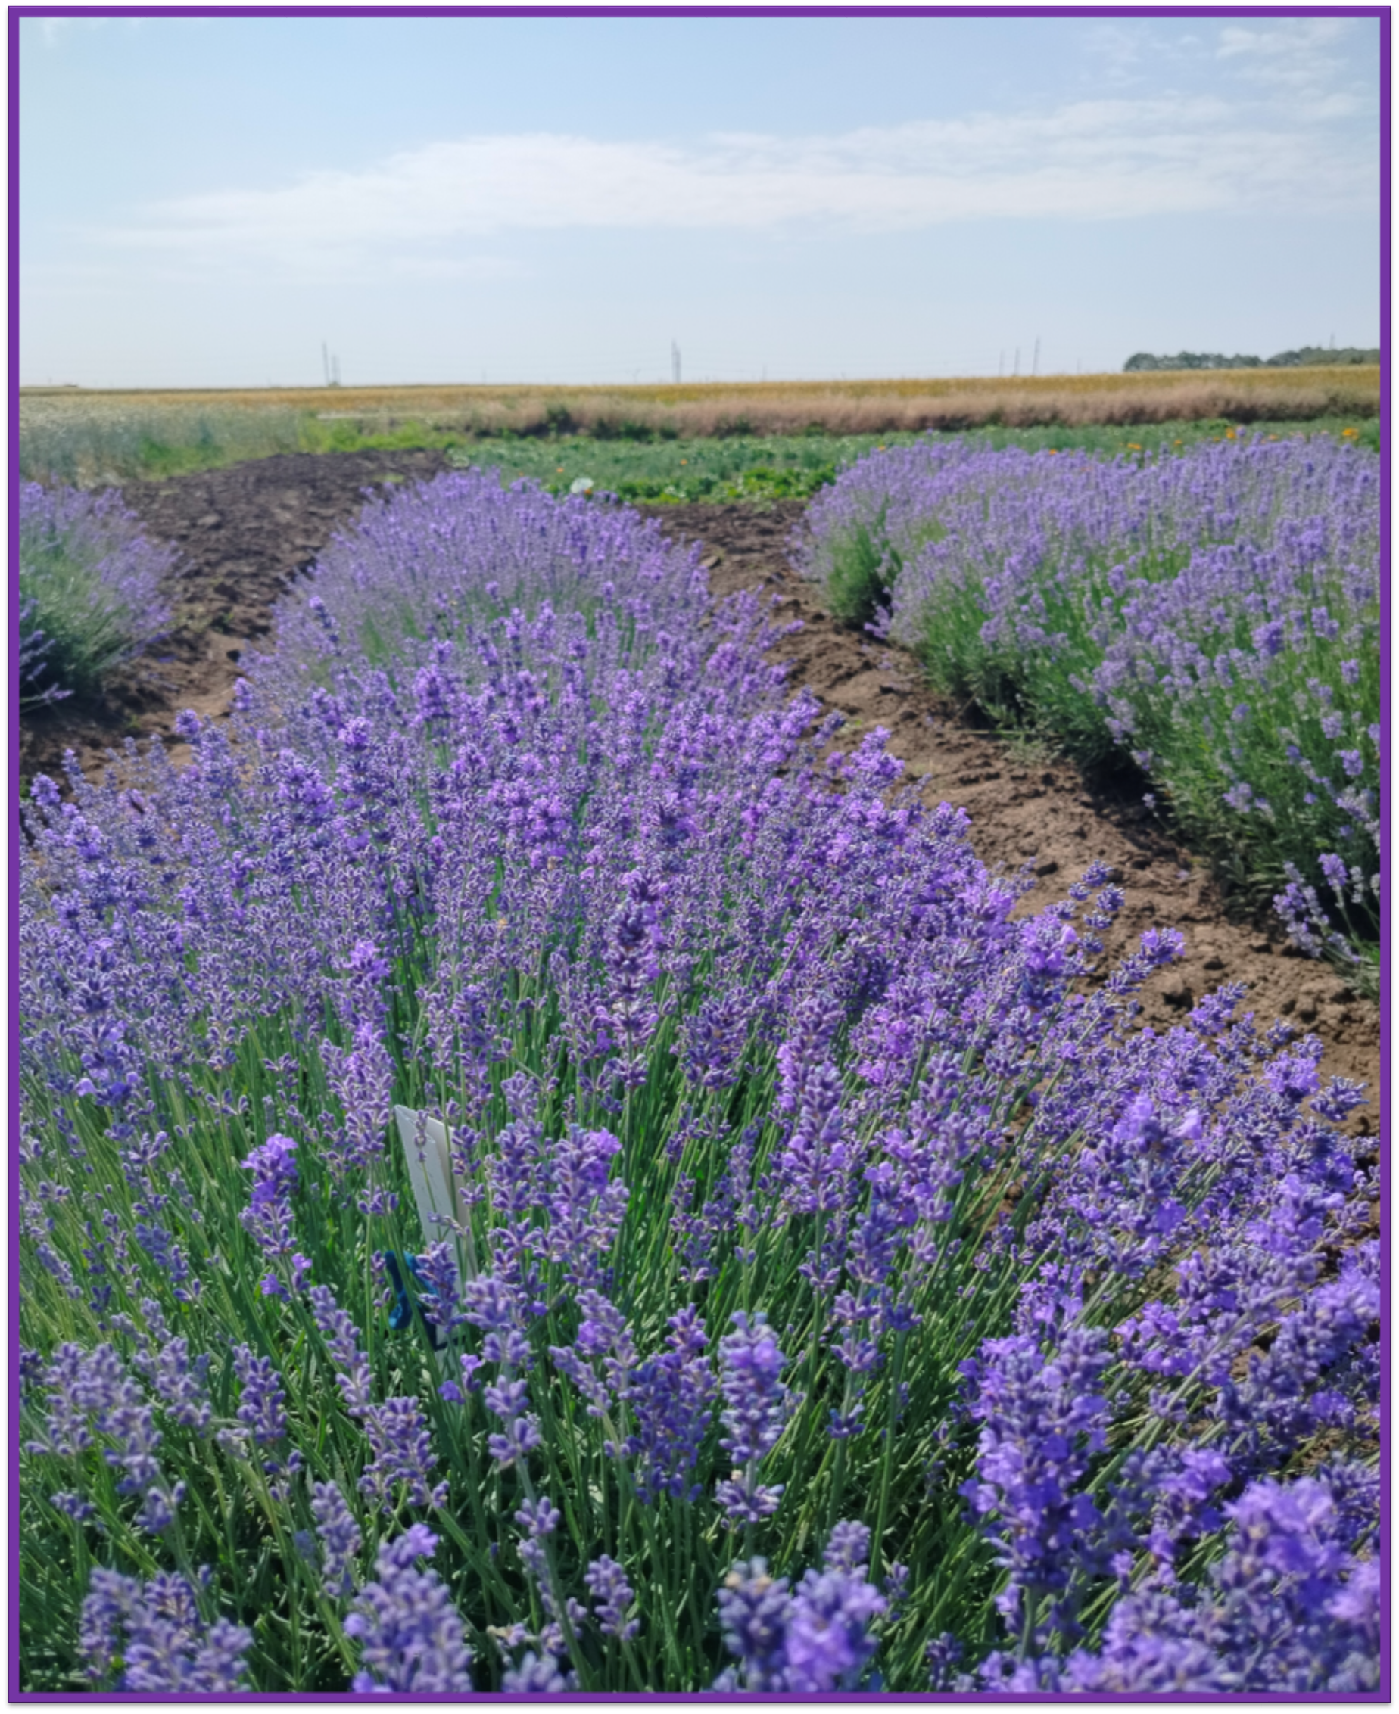
MOLDOVA STATE UNIVERSITY
INSTITUTE OF GENETICS, PHYSIOLOGY AND PLANT PROTECTION
Scientific Research Laboratory of Aromatic and Medicinal Plants
60, Alexei Mateevici str., MD2009, Chisinau, Republic of Moldova
Tel.: +373 690 38 289; E-mail: violeta.butnaras@sti.usm.md
MAIN COMPONENTS OF ESSENTIAL OIL IN PROMISING LAVENDER HYBRIDS
AUTHORS: Violeta BUTNARAS *, Zinaida BALMUS, Ludmila COTELEA
Lavandula angustifolia Mill., one of the most well-known and extensively studiedspecies, is of great importance for the pharmaceutical, medical, and cosmetic industries and is recognized for its high yield of superior-quality essential oil.
The biological material used inthis study consisted of third-year F1 hybrids derived from 4 maternal forms: Fr.1; Fr.5; Fr.8; Cr.13. As a result of the research conducd during 2025 on 5 hybrid genotypes (1Fr.1-3-22; 2Fr.5-3-7; 5Fr.8-3-19; 3Cr.13-3-10; 4Cr.13-3-24), which distinguished themselves by a high essential oil content ranging from 5.526% to 6.176%, the concentration of chemical constituents was also determined. The created and evaluated hybrids also differ in the concentration of their major components. Specifically, the concentration of linalyl acetate varied from 14.17% in the essential oil extracted from the inflorescences of hybrid 5Fr.8-3-19 to 37.180% recorded in the essential oil of hybrid 1Fr.1-3-22.
The concentration of linalool in the essential oil obtained from the inflorescences ranged from 28.31% in hybrid 1Fr.1-3-22 to 69.51% in hybrid 5Fr.8-3-19. The proportion of the main components of the lavender essential oil in the hybrids derived from the Cr.13 form amounted to 75.67% in genotype 4Cr.13-2-24 and 76.07% in 3Cr.13-3-10, including linalool at 45.68% and 46.13%, and linalyl acetate at 29.99% and 29.94%, respectively.
Conclusion: The quality of the essential oil in the evaluated hybrids is high, with a pleasant characteristic lavender fragrance and optimal concentrations of the main chemical components.
Acknowledgments: This study was supported by the research project 011102 Increasing and conservation genetic diversity, agricultural crop breeding in the context of climate change, funded by Ministry of Education and Research.

