Slide 1


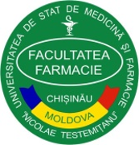
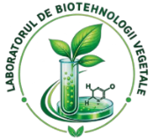
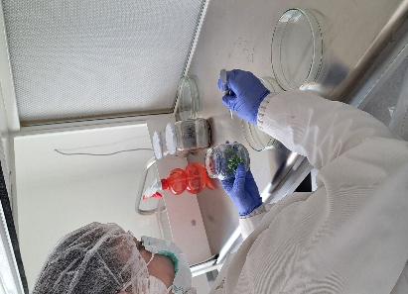
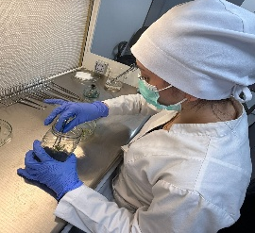
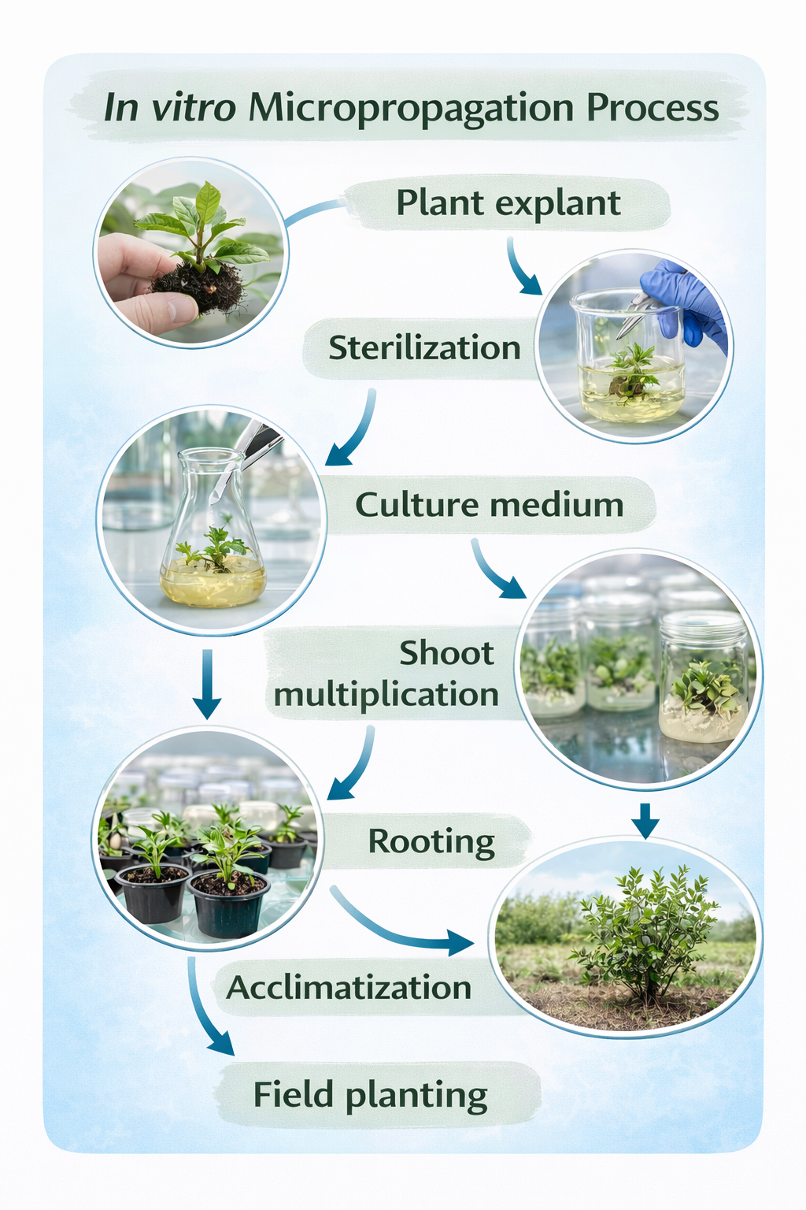
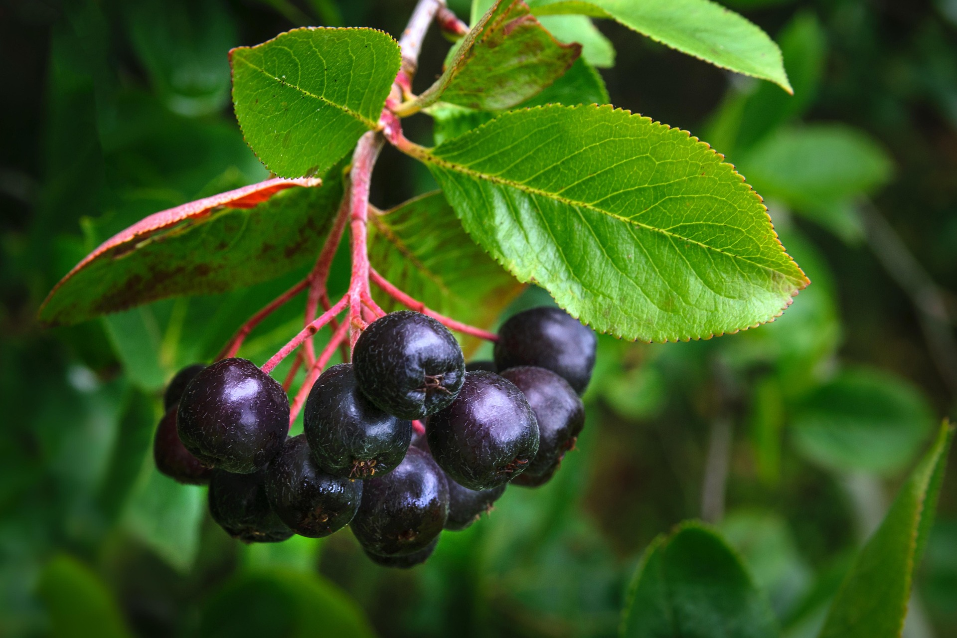
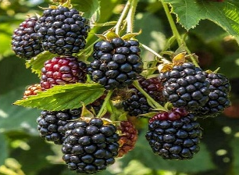
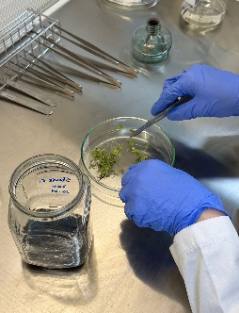
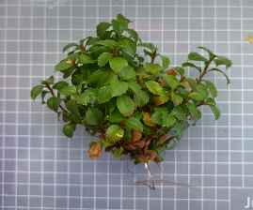
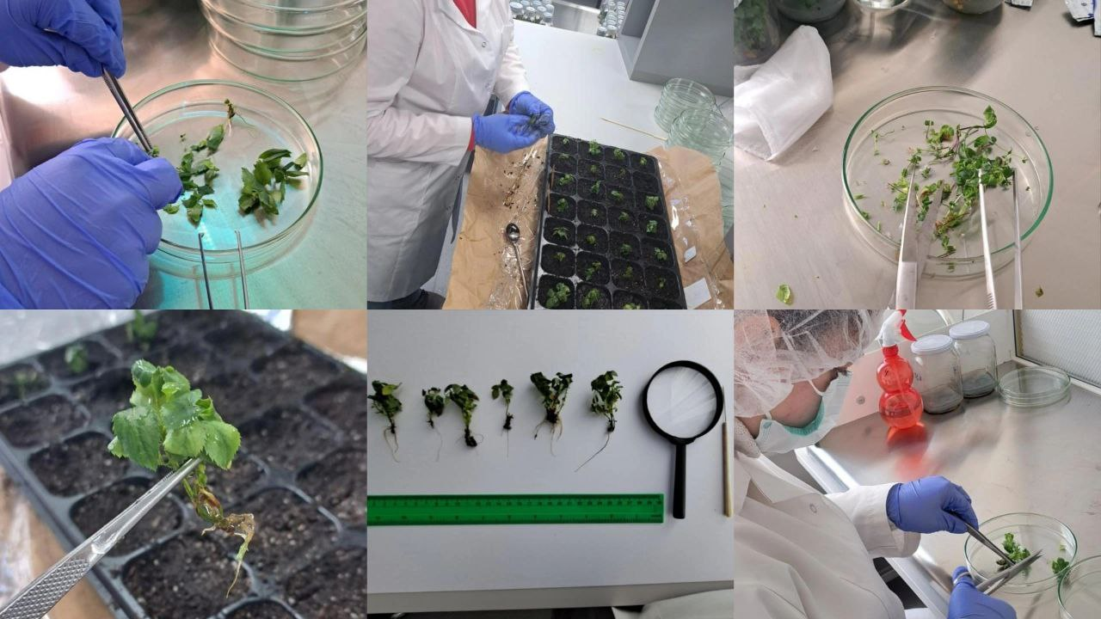
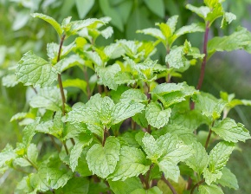
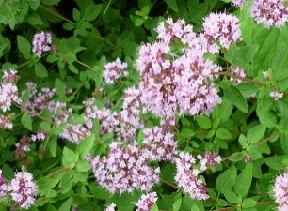
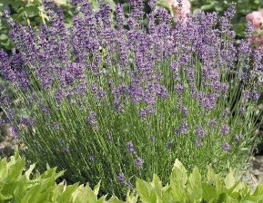
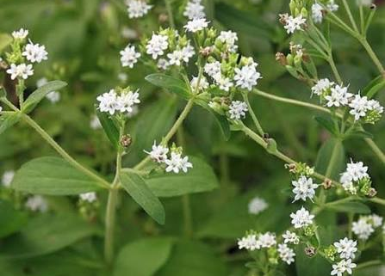
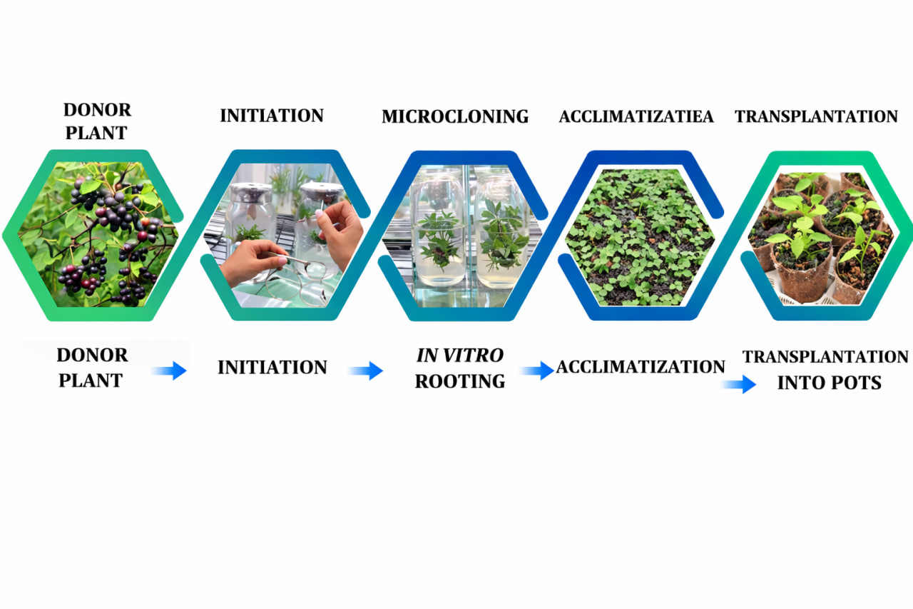
MODERN APPROACHES TO IN VITRO CULTURES OF PROMISING MEDICINAL PLANTS
Tatiana Calalb*, Cornelia Fursenco, Angelica Ohindovschi, Mariana Lozinschi, Iulia Bozbei, Alina Bogdan
Plant Biotechnology Laboratory, Center for Drug Development, Nicolae Testemitanu SUMPh, Chisinau, Republic of Moldova
AIM OF THE STUDY
MATERIALS AND METHODS
RESULTS
CONCLUSIONS
The aim: To test modern
approaches for the initiation of in vitro cultures of MP with pharmaceutical potential and to optimize the factors influencing culture establishment in the Plant Biotechnology Laboratory of the Center for Drug Development, Nicolae Testemitanu SUMPh.
The research included medicinal plant species rich in biologically active compounds of pharmaceutical interest, such as phenolic compounds (Aronia melanocarpa, Rubus fruticosus), volatile oils (Mentha piperita, M. citriodora, Origanum vulgare, Lavandula vera) and natural sweeteners (Stevia rebaudiana). Different explant types, sterilization protocols, nutrient media, hormonal combinations and light conditions were tested to optimize in vitro culture initiation.
Meristematic explants, especially root apex tissues, demonstrated superior viability, lower contamination rates and higher regenerative potential compared to mature leaf tissues. Hydrogen peroxide 10-15% and ethanol 70% showed the best balance between contamination control and explant survival. The MS (1962) medium supplemented with optimized hormonal combinations showed the most favorable results for culture establishment and morphogenesis. BAP stimulated shoot formation and cell division, while IAA promoted root initiation and biomass development. Different sucrose concentrations were evaluated, with 30 g/L identified as optimal for explant adaptation and biomass accumulation in most species. In addition, inoculation techniques, explant positioning and controlled photoperiodic conditions significantly influenced regenerative responses and culture stability during the early stages of cultivation.
Successful initiation of medicinal plant in vitro cultures depends on the optimization of explant selection, sterilization procedures, nutrient media and culture conditions. The optimal parameters were species-specific and closely related to the phytochemical characteristics of each medicinal plant.
ACKNOWLEDGEMENTS
This study was supported by the research project code 080301: “Development, analysis, standardization, and quality control of single-ingredient and combined pharmaceutical products and dietary supplements of synthetic and natural origin” funded by Nicolae Testemitanu SUMPh.

