Slide 1


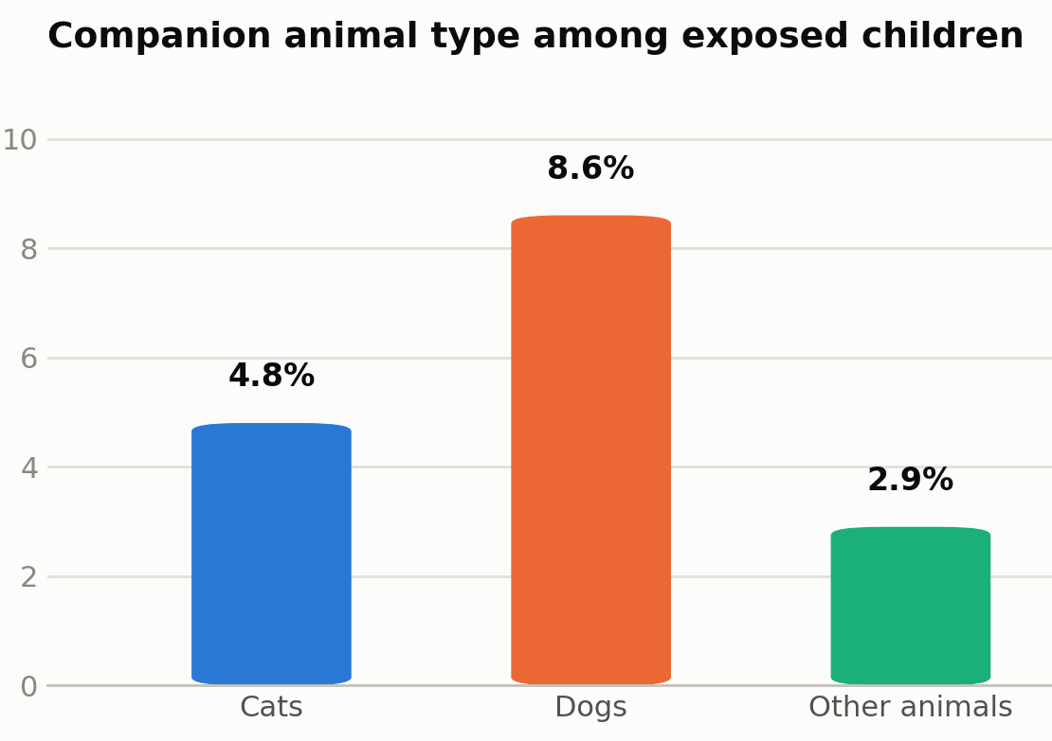
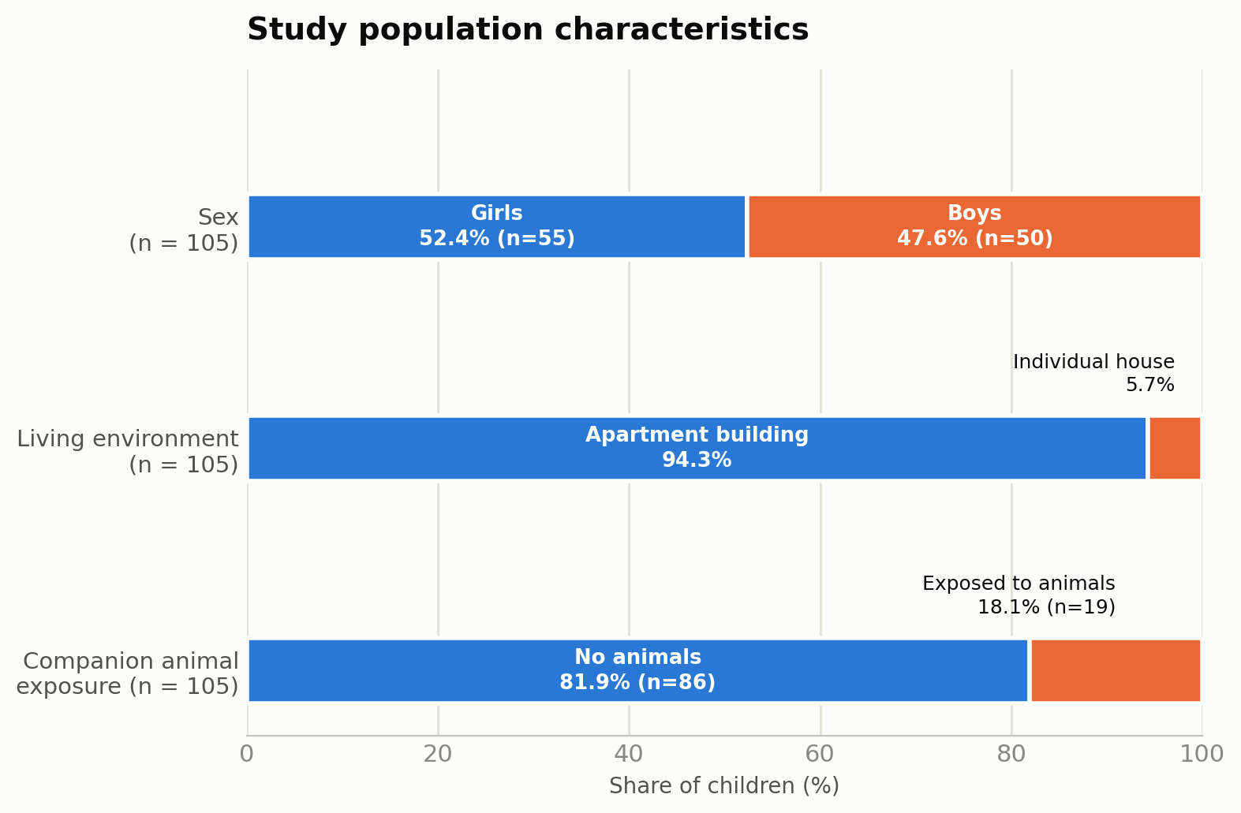
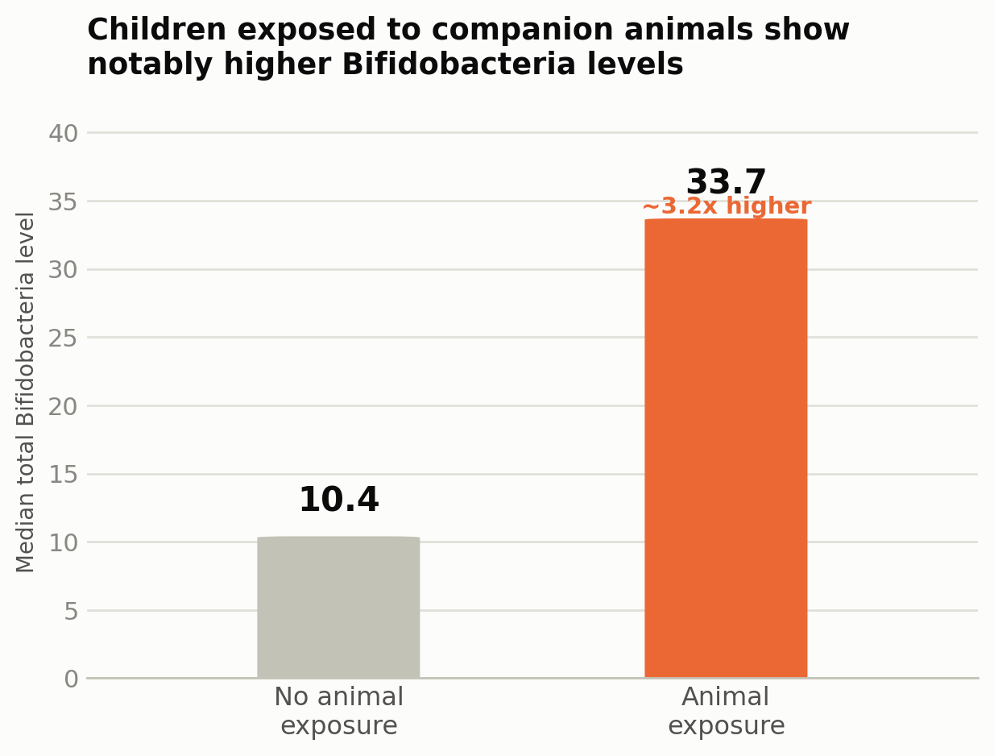


ENVIRONMENTAL FACTORS AND ANIMAL EXPOSURE IN THE DEVELOPMENT OF THE GUT MICROBIOME IN CHILDREN UNDER 3 YEARS OF AGE
Cepraga Victoria^{1,2}, Bogonovschi Livia¹, Grin Olesea^{1,2}, Prof. Revenco Ninel ^{1,2}
State University of Medicine and Pharmacy „Nicolae Testemitanu”, Department of Pediatrics ¹
Institute of Mother and Child, Chisinau, Republic of Moldova ²
Living environment and early microbial exposure are important determinants of gut microbiome development.
Early exposure to companion animals may promote microbial diversity and microbiome maturation through increased contact with environmental microorganisms, potentially supporting immune development.
MATERIAL AND METHOD
BACKGROUND
105 children
Observational analytical cohort study conducted in primary healthcare
Gut microbiome analysis –
Real-Time PCR- bacterial DNA in fecal samples
Statistical analysis
Microsoft Excel 365
RESULTS
The study included 105 children under 3 years of age, comprising 50 boys and 55 girls. Regarding the living environment, 5.7% children lived in individual houses, while 94.3% lived in apartment buildings. In terms of companion animal exposure, 81.9% lived in households without animals, whereas 18.1% children were exposed to companion animals (Fig.1).
Among the exposed children, 4.8% lived with cats, 8.6% with dogs, and 2.9% with other types of companion animals (Fig.2). Comparative analysis of the gut microbiome demonstrated relatively similar total bacterial mass between children exposed and unexposed to companion animals, with median values of 9.4 LG GE/g and 9.45 LG GE/g, respectively.
Child-specific Bifidobacteria were detected in 48 of 86 children without animal exposure and in 11 of 19 children exposed to companion animals. However, children living with companion animals demonstrated notably higher median total Bifidobacteria levels compared to children without animal exposure (33.7 vs. 10.4, respectively), suggesting a potential association between early environmental microbial exposure and the enrichment of beneficial intestinal bacterial taxa (Fig.3).
Fig.1. Type of Companion Animal
Among Exposed Children
Fig.3. Study population characteristics
Fig.2. Bifidobacterium levels
CONCLUSIONS
Early exposure to companion animals may contribute to gut microbiome development and immune maturation.
Higher Bifidobacteria levels in exposed children suggest a potential beneficial role of early microbial exposure in intestinal homeostasis and immune development.
KEYWORDS
Gut microbiome; Early-life exposure to pets;
Environment; Children 0-3 years old.

