Slide 1


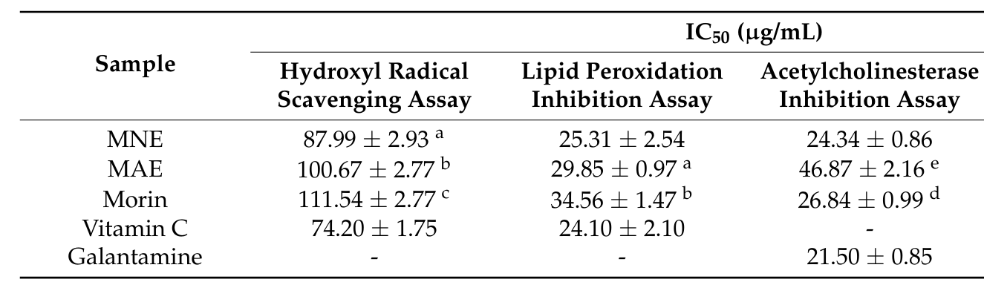
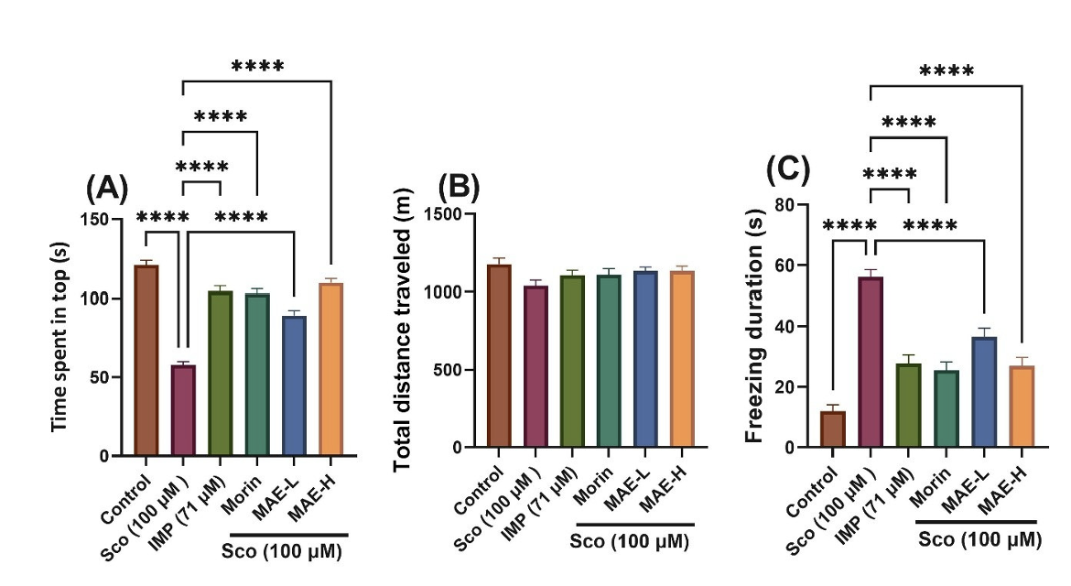
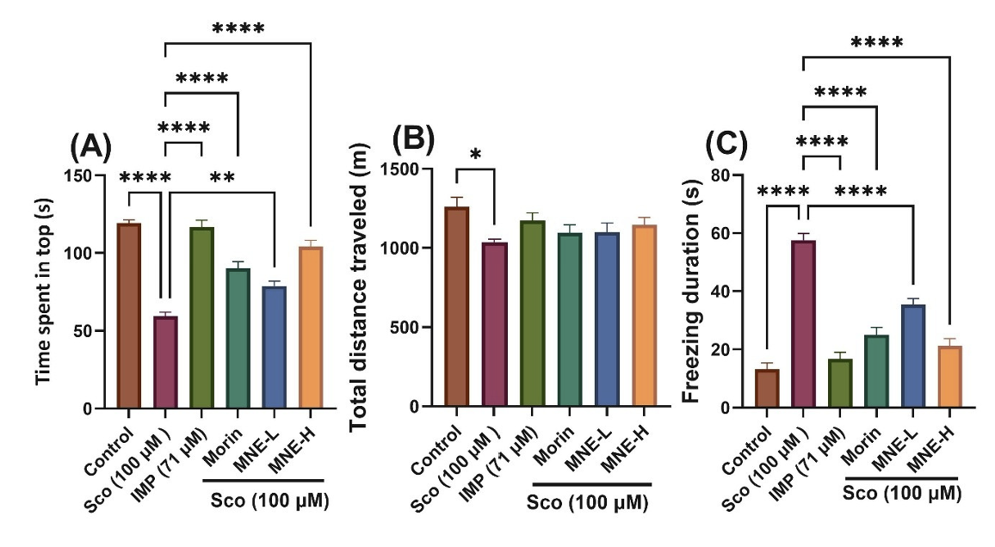
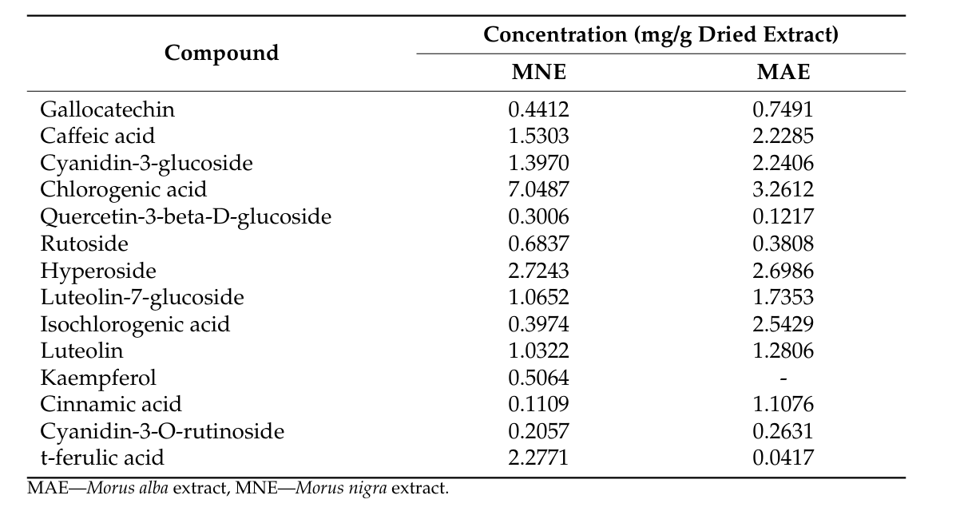
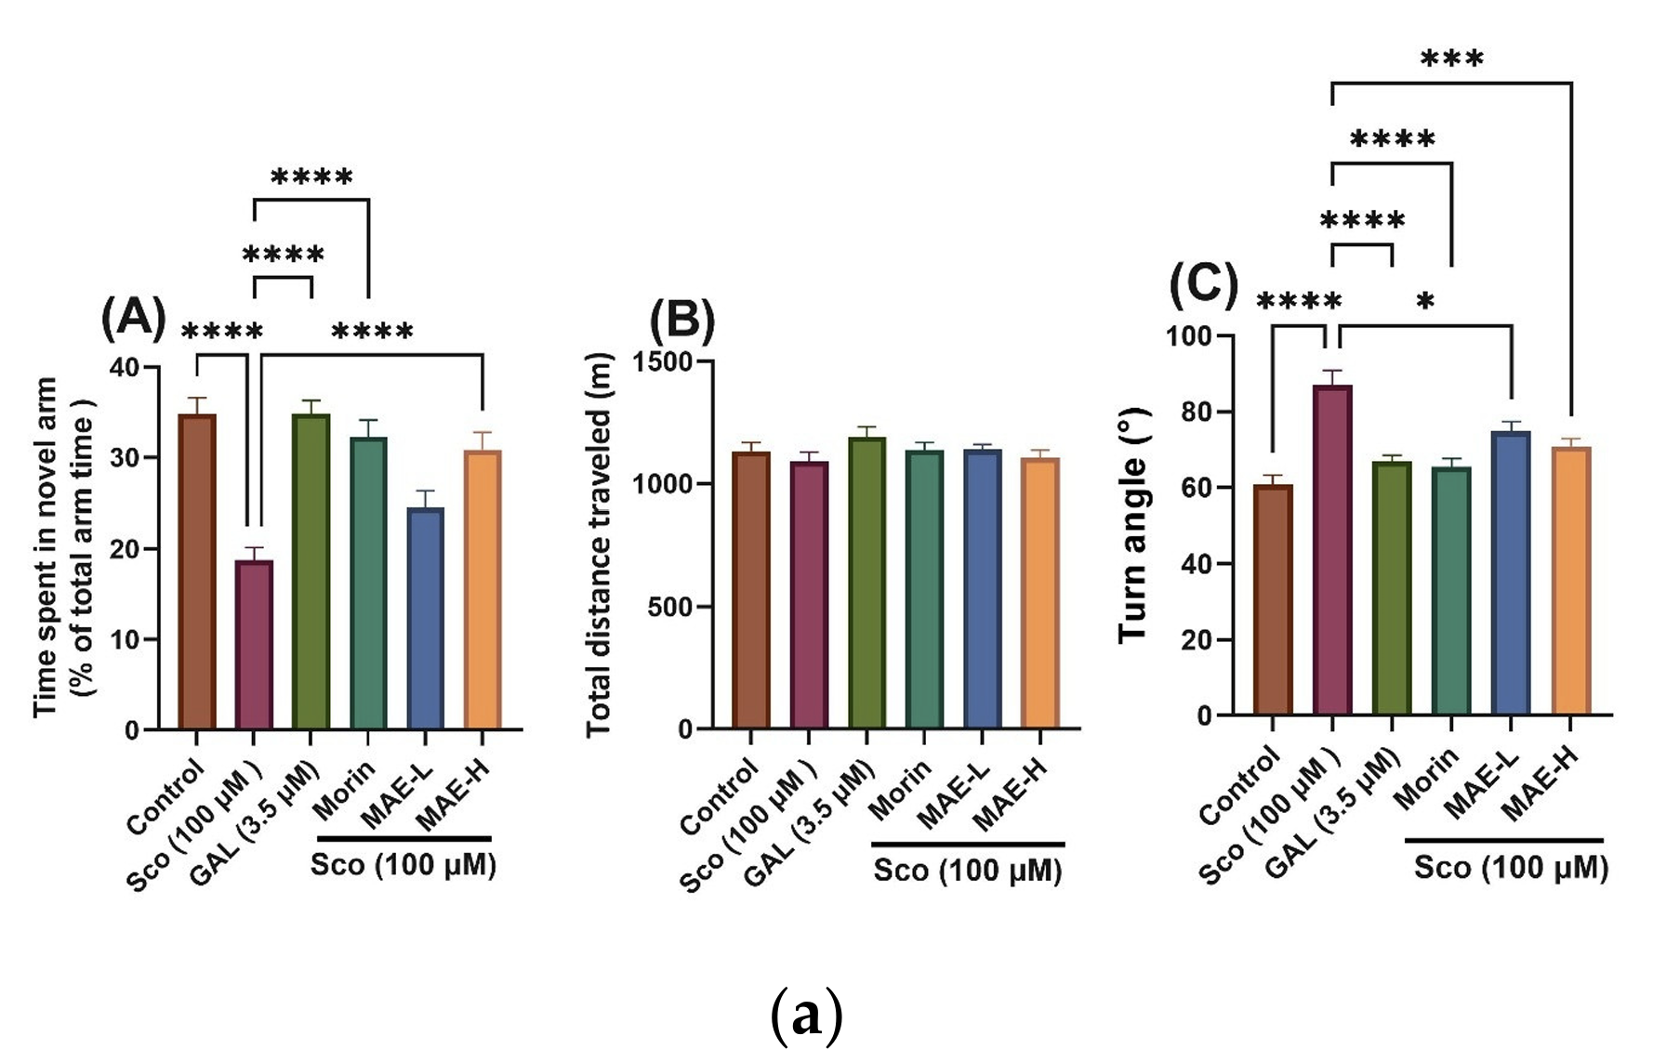
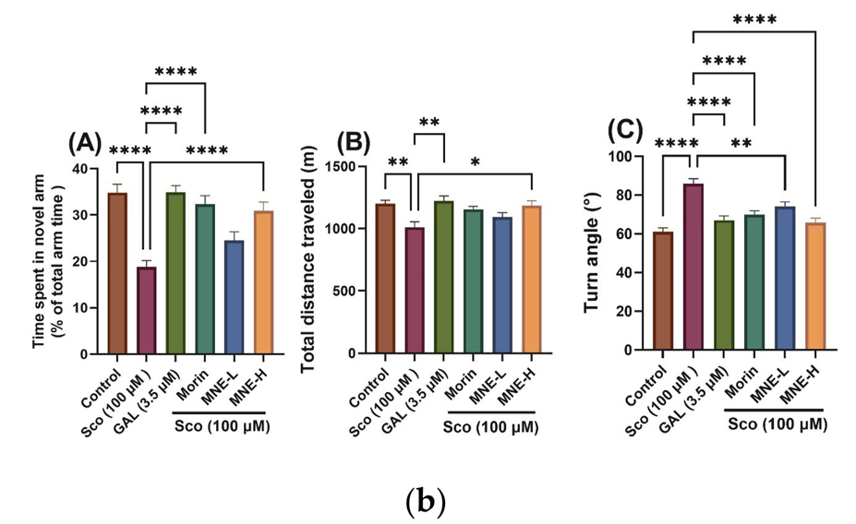
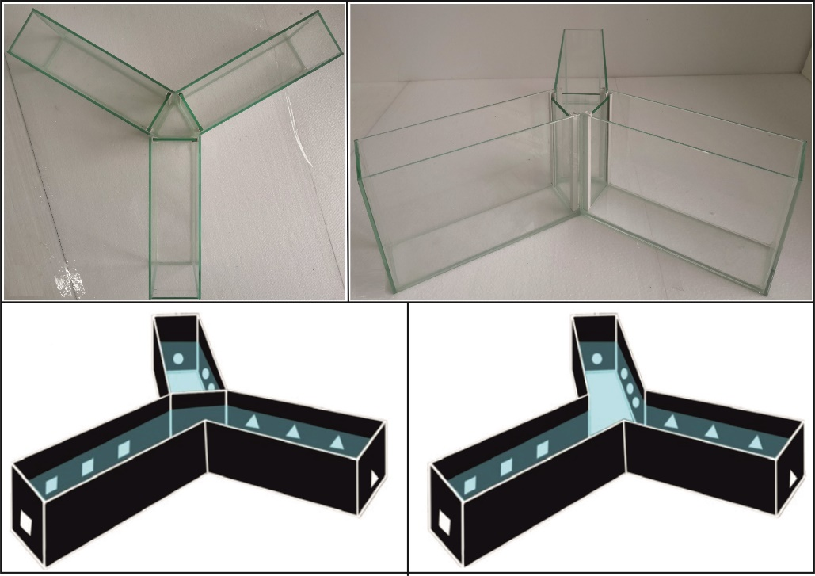
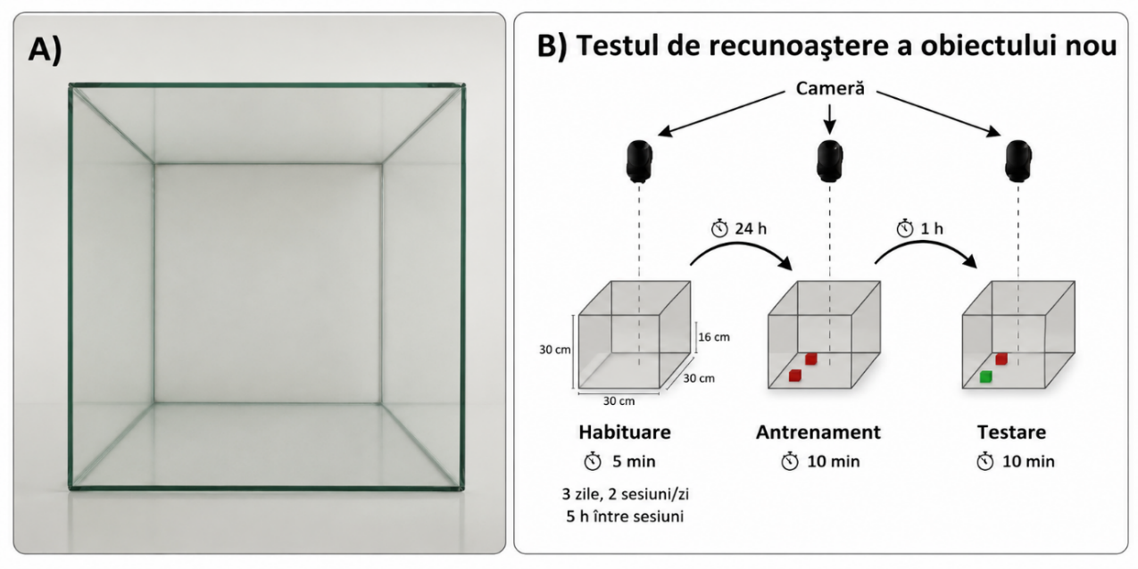
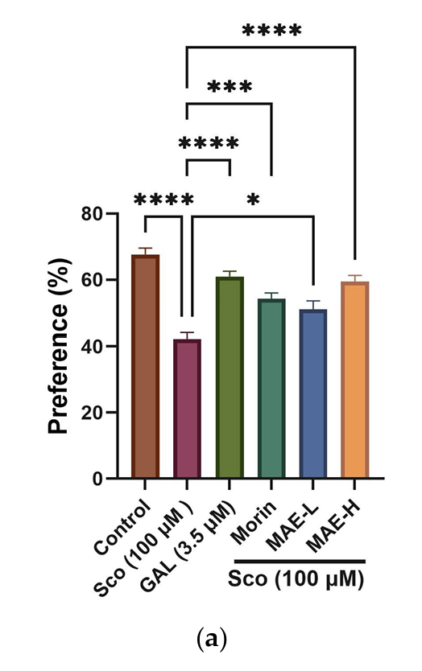
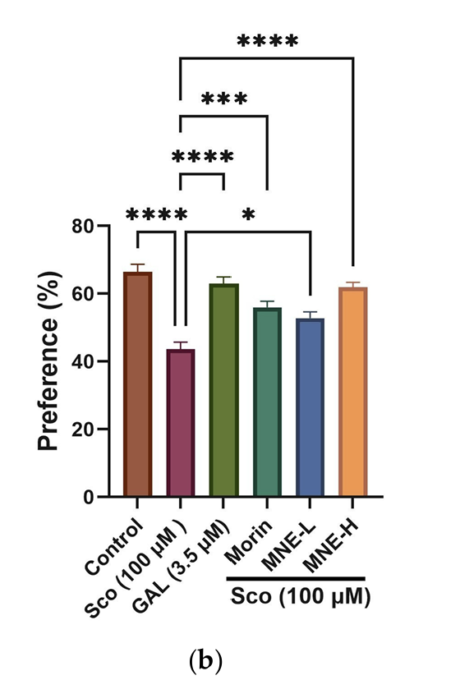
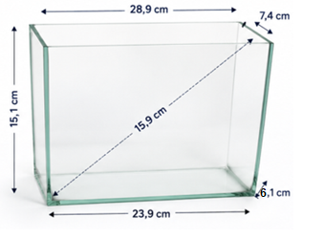
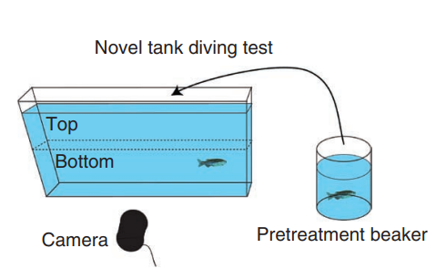
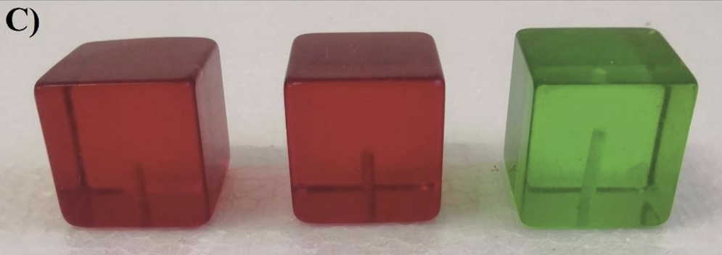


NATURAL SCIENCES IN THE DIALOGUE OF GENERATIONS, IX EDITION
Bioactive Potential of Morus Alba and Morus Nigra Extracts: Neuroprotection, Antioxidant Activity, and Cholinesterase Inhibition
Alexandra-Mara Cimpanu¹ Cornelia Geanina Mircea² Lucian Hritcu¹
¹ Department of Biology, Alexandru Ioan Cuza University of Iași, Romania ² Faculty of Pharmacy, Grigore T. Popa University of Medicine and Pharmacy, Iași, Romania
INTRODUCTION
PHYTOCHEMICAL PROFILE AND IN VITRO BIOACTIVITY
BEHAVIOURAL RESULTS
Oxidative stress and cholinergic dysfunction are associated with cognitive decline. Morus alba and Morus nigra leaves are rich in phenolic compounds with reported antioxidant activities. However, their neuroprotective effects remain insufficiently explored.
The aim of this study was to evaluate the antioxidant, acetylcholinesterase-inhibitory, and neuroprotective effects of both extracts using in vitro assays and a zebrafish model of scopolamine-induced cognitive impairment.
Table 1. IC₅₀ values for antioxidant and AChE assays.
NOVEL TANK DIVING TEST
AIM OF THE STUDY
Table 2. Major phenolic compounds quantified in MAE and MNE.
Figure 4. Effects of MAE, MNE, morin and imipramine on anxiety-like behaviour in the Novel Tank Diving Test.
MATERIALS & METHODS
Y-MAZE
1
Extract preparation & profiling
5 g of leaves extracted with ethanol:water (70:30) under reflux for. 60 min, followed by RP-UHPLC-PDA profiling.
2
In vitro assay
MNE showed IC₅₀ values close to those of vitamin C for lipid peroxidation inhibition and galantamine for AChE inhibition.
Antioxidant activity was evaluated by hydroxyl radical scavenging and lipid peroxidation assays, while cholinesterase activity was assessed using the AChE assay.
Figure 5. Effects of MAE, MNE, morin and galantamine on Y-maze performance, assessed by time spent in the novel arm (A), total distance travelled (B) and turn angle (C).
METHODS
4
Behavioural testing
NOVEL OBJECT RECOGNITION
3
Zebrafish exposure
Figure 6. Effects of MAE, MNE, morin and galantamine on recognition memory in the Novel Object Recognition test.
Zebrafish were exposed to MAE, MNE (1 and 10 μg/L) and morin (20 μM) for 1 h/day over 8 consecutive days, followed by scopolamine exposure (100 μM) 30 min before behavioural testing.
Figure 1. Novel Tank Diving Test (NTT) setup for the assessment of anxiety-like behaviour in zebrafish.
Figure 2. Y-maze test used to assess spatial novelty preference and memory performance in zebrafish.
Figure 3. Novel Object Recognition (NOR) test used to assess recognition memory in zebrafish.
Mean ± SEM; Tukey post hoc. Y-maze/NTT: n = 12/group; NOR: n = 10/group.
CONCLUSIONS
MNE exhibited stronger in vitro antioxidant and AChE-inhibitory activities than MAE. Both extracts attenuated scopolamine-induced memory impairment and anxiety-like behaviour in zebrafish.
FULL ARTICLE
REFERENCE & ACKNOWLEDGEMENTS
Nani Pohrib E, et al. Antioxidants. 2026;15:510. doi:10.3390/antiox15040510

