Slide 1


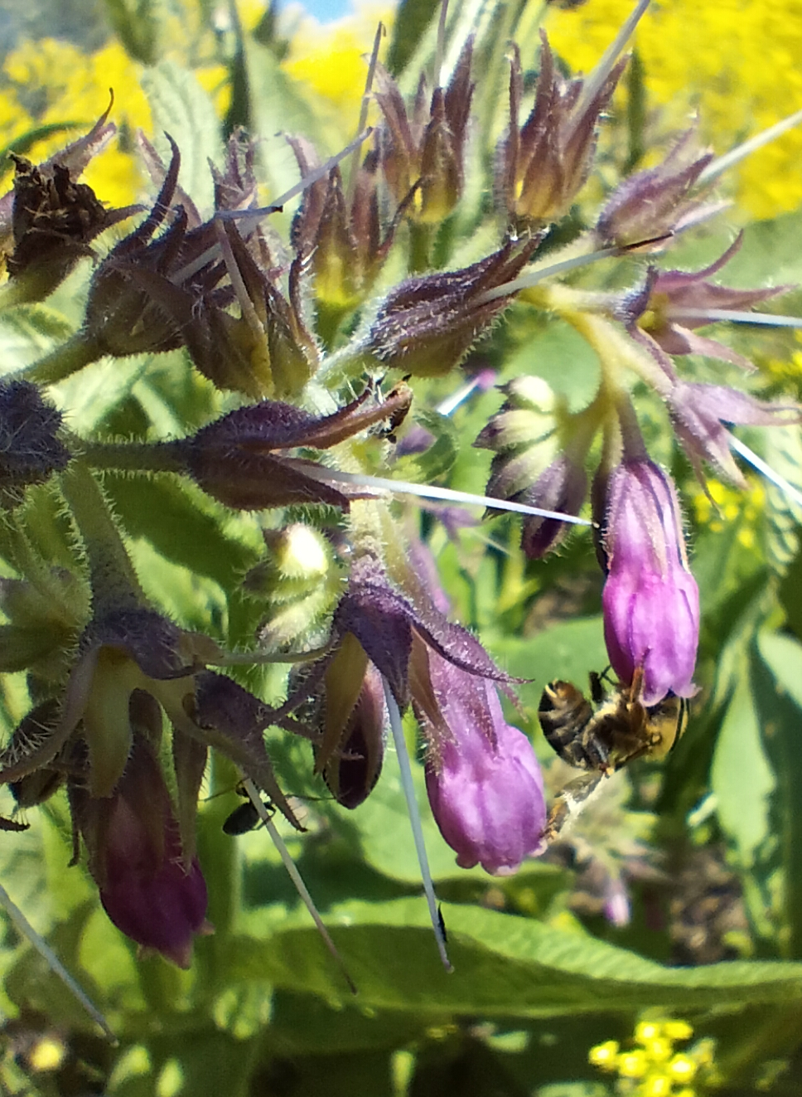
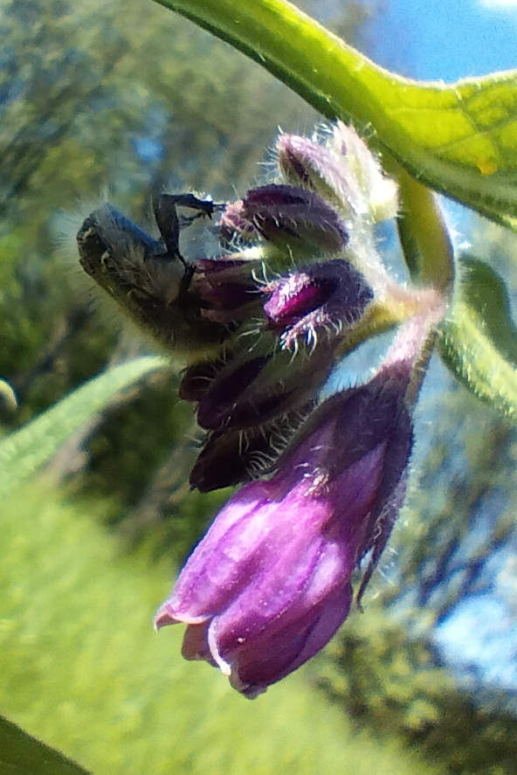
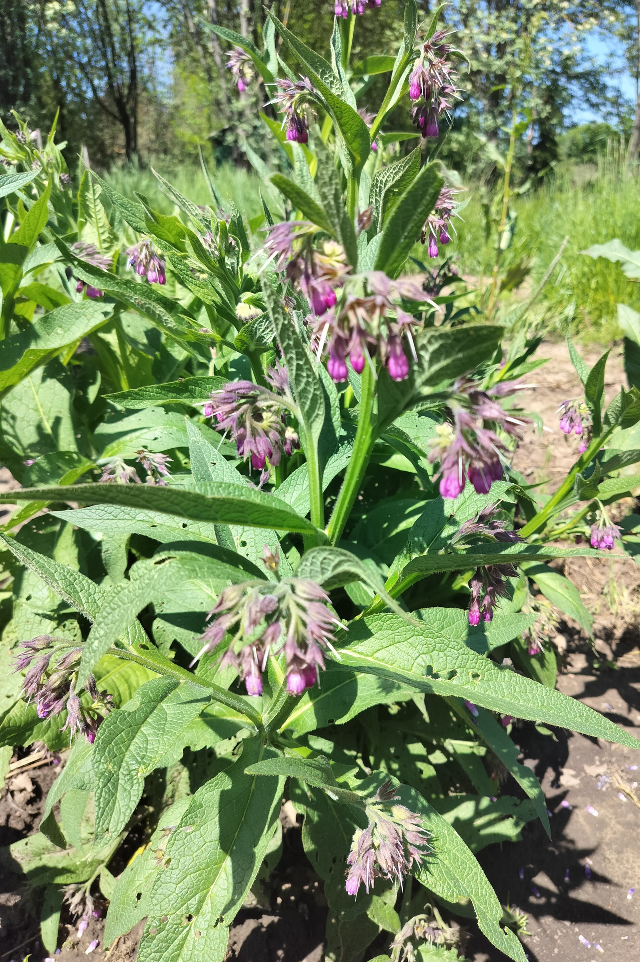
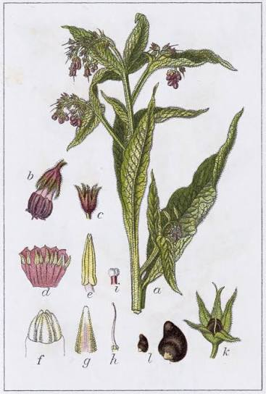
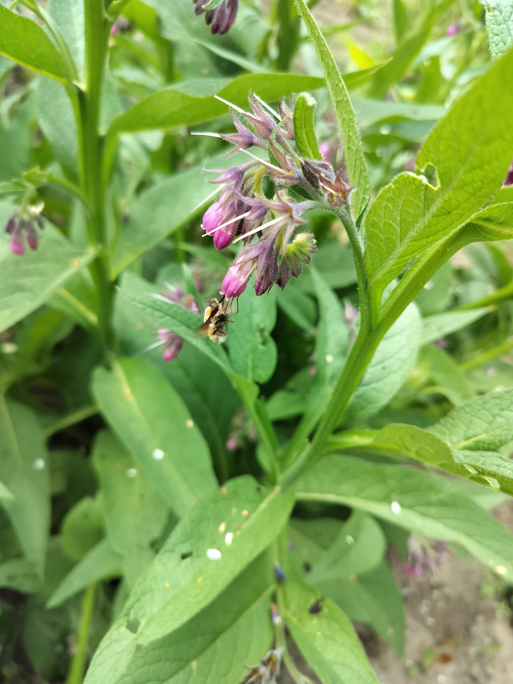
FLOWERING CHARACTERISTICS OF SYMPHYTUM OFFICINALE L.
UNDER CLIMATIC CONDITIONS OF THE REPUBLIC OF MOLDOVA
Cîrlig Natalia, https://orcid.org/0000-0001-7712-865X
Moldova State University, “Alexandru Ciubotaru” National Botanical Garden (Institute), nataliacirlig86@gmail.com
Symphytum officinale L. (Boraginaceae) – commonly known as comfrey (syn. Symphytum peregrinum Lebed.), is an herbaceous perennial with erect, branched stems. It possesses a short, thick and branched rhizome. The leaves are ovate-lanceolate, acuminate, with decurrent base. The lower leaves are large and petiolate, but the upper leaves are smaller and sessile, with decurrent bases. The entire plant is covered with short, setose pubescence. The flowers are redish-purple, arranged in scorpioid cymes. The calyx is campanulate, and the corolla is tubular, longer than the calyx and divided into five lobes. The fruits are ovoid, black nutlets. The research was conducted at the “Alexandru Ciubotaru” National Botanical Garden (Institute) of MSU, during the growing seasons of 2024-2025. The phenological observations were focused on the flowering stage, and the presence of pollinating and melliferous insects was analyzed. The flowering is prolonged and staggered, lasting from May to August. The biology of flowering was investigated by analyzing flowering shoots in mid-May. During this period, the shoots reach a height of 82-84 cm and develop 7-9 lateral branches bearing flowers (Table 1). Each plant produces about 20-25 inflorescences, with 2-6 flowers open simultaneously. Depending on shoot length and inflorescence size, the number of flower buds varies between 9.8±2.50 and 18.4 ±1.87, contributing to the extended flowering period and nectar availability for insects. The flowers are visited by insects throughout the day, which indicates a high potential for honey production, with estimated yields of 160-180 kg of honey per hectare. The nectaries are located at the base of the corolla and are protected by stiff hairs, which hinder access for some insects. Bumblebees, in order to access the nectar, often perforate the base of the corolla; these openings may subsequently be used by other insects, including honey bees.
Table 1. The biology of flowering in S. officinale plants in May, 2025
 | Flower buds |  |  |  | Open flowers |  |  |  | Wilted flowers
SP | Min. | Max. | M. | S_{x} | Min. | Max. | M. | S_{x} | Min. | Max. | M. | S_{x}
I | 10 | 24 | 18,4 | ±1,87 | 2 | 4 | 3,14 | ±0,42 | 2 | 10 | 2,7 | ±1,28
II | 4 | 20 | 9,8 | ±2,50 | 2 | 11 | 5,1 | ±1,04 | 3 | 6 | 4,3 | ±0,79
III | 8 | 24 | 12,5 | ±1,99 | 1 | 6 | 4,2 | ±0,42 | 2 | 10 | 4,9 | ±0,81
Pollinating insects on the flowers of Symphytum officinale L.
Note: I, II, III – analysed flower stalks, SP- statistical parameters; Min. – minimum values; Max. – maximum values; M. – average, Sx – standard error
Acknowledgments: The research was carried out in the framework of the subprogram: 010102 Moldova State University, “Alexandru Ciubotaru” National Botanical Garden (Institute),
Symphytum officinale L. in the GBNI collection, flowering stage, May.
https://powo.science.kew.org/taxon/urn:lsid:ipni.org:names:77225850-1

