Slide 1
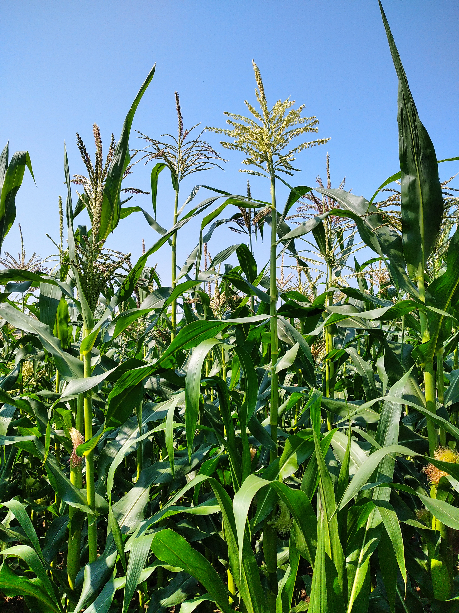
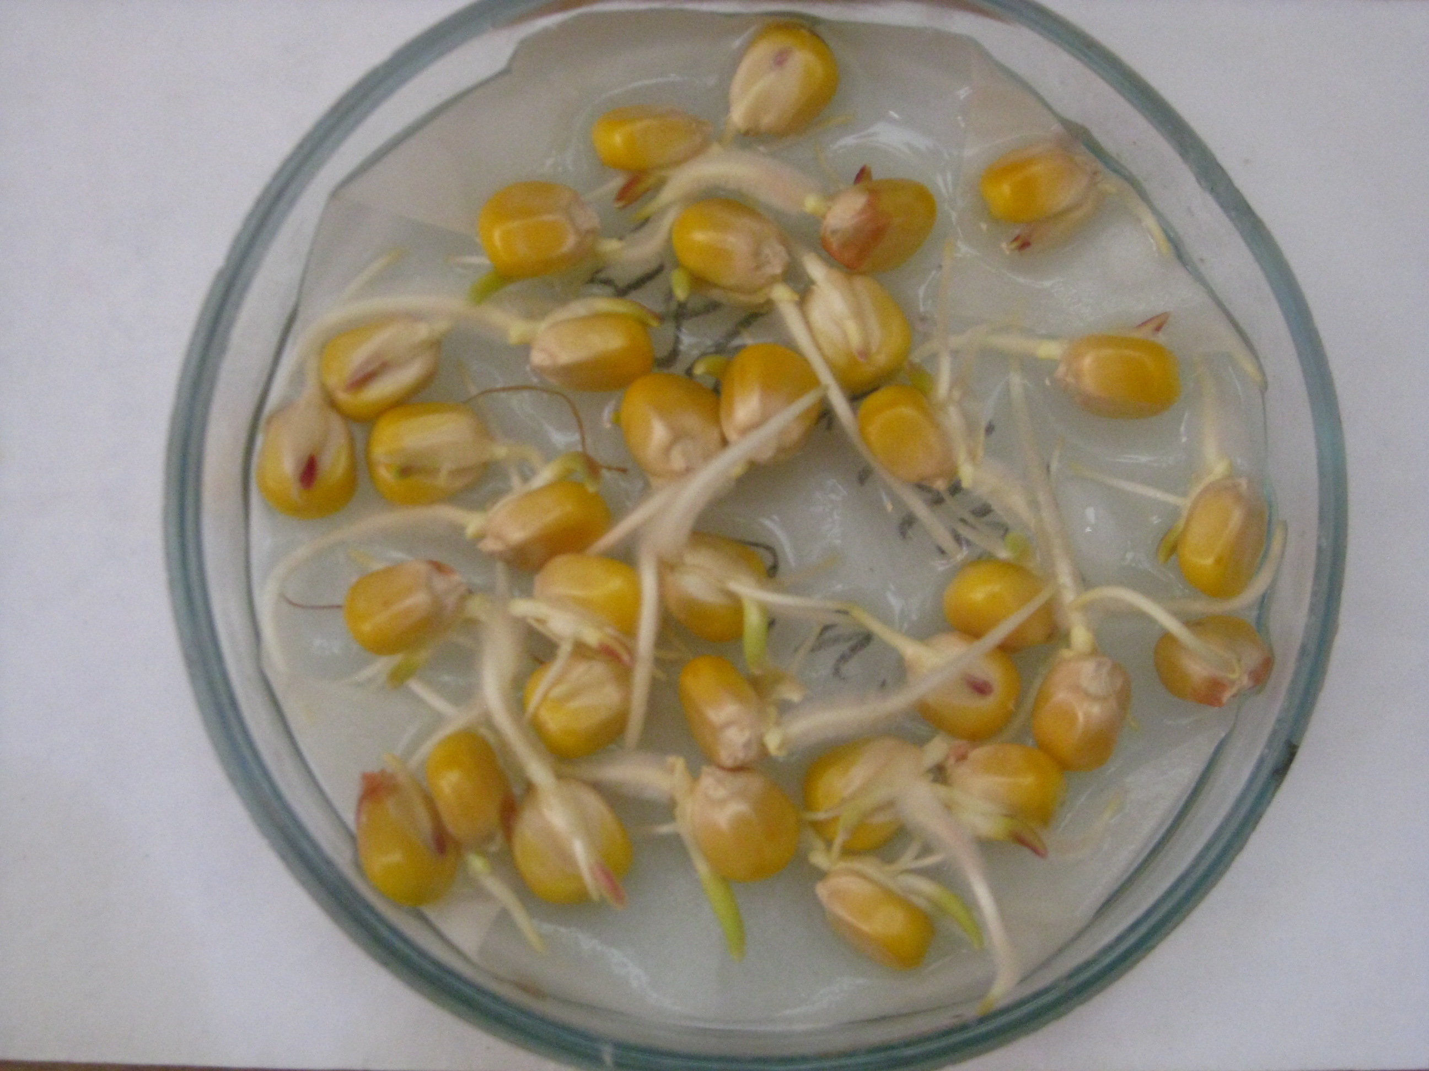
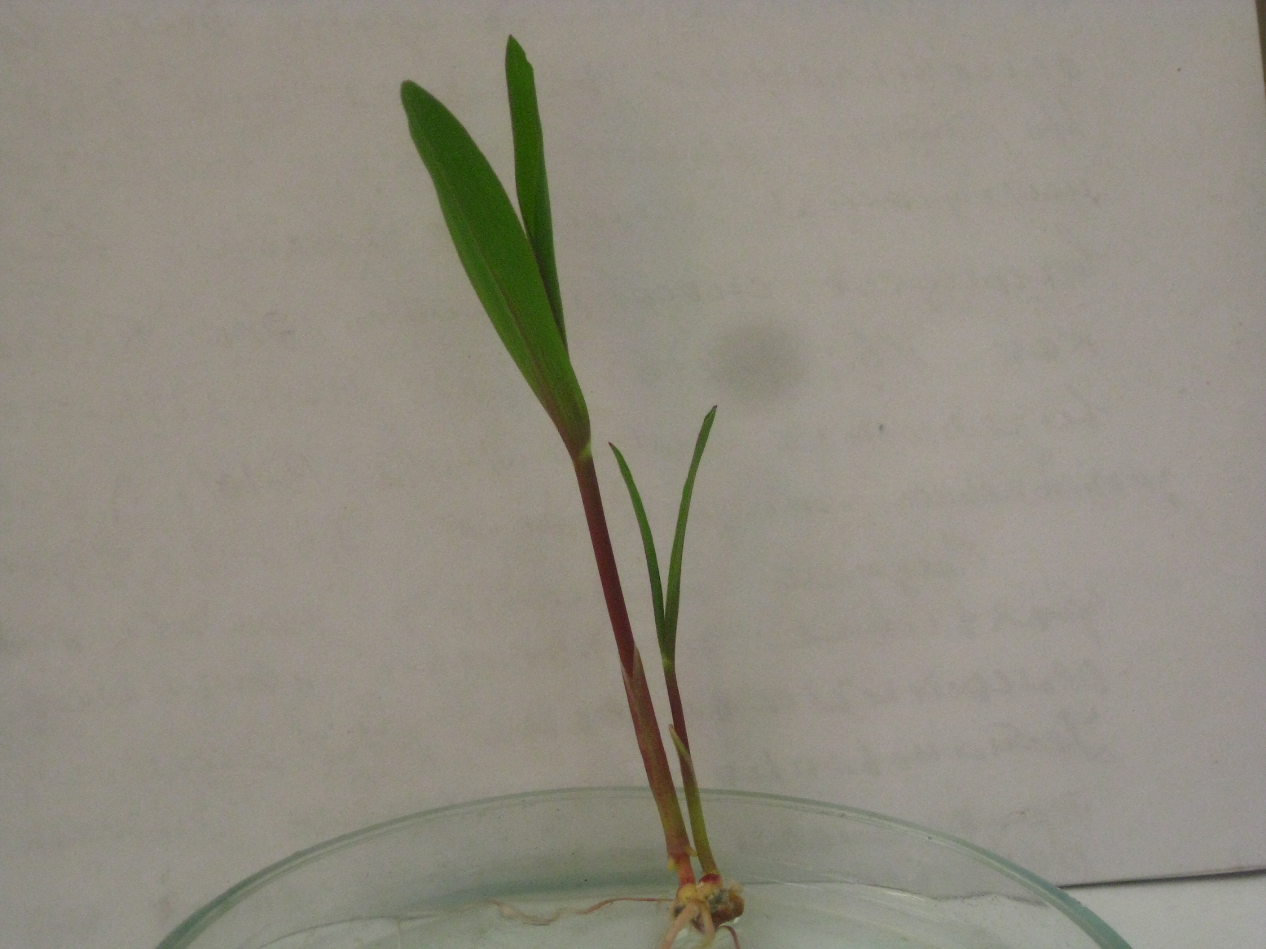
MAIZE SEED GERMINATION UNDER DROUGHT AND SALT STRESS.
Oxana Climenco, Moldova State University, Institute of Genetics, Physiology and Plant Protection
In general, research in the field of corn breeding for drought and salinity resistance forms the basis for obtaining stress-resistant and high-yielding hybrids of this crop. In the work presented here, the aim was to identify corn genotypes resistant to osmotic stress and chloride salinization at the seed germination stage. As the starting material, 14 corn genotypes were used (2 inbred lines, 7 three-line hybrids, 5 complex hybrid combinations in which the paternal components were represented by double, three-line, and simple hybrids, and as the maternal components were used backcross hybrids).
Results and conclusions:The effect sizes of the factors for the traits “shoot length” and “root length” were higher under salinity conditions. The magnitude of the interaction effect of the factors “genotype” × “stress” on the trait “shoot length” was significantly lower than the corresponding measure for the trait “root length”. Under osmotic stress conditions, the highest effect sizes of the factors were observed for the trait “root length”.
Methods: Seeds were germinated in the control variant (water), in osmotic solution of 1.96 MPa, and in 3% NaCl solution.The values of the traits “shoot length”(SL) and “root length”(RL) were determined. Correlation and two-factor analysis of variance were used to process the obtained data.
Correlation analysis of the values of these traits in control and stressful conditions revealed the presence of significant and only positive relationships (table). Between the traits “shoot length” and “root length” in control and under chloride salinity, the correlation coefficient values were at the same level (r=0.7***), but under drought stress, the strength of the correlation was quite low (r=0.36*). The best average values for the traits “shoot length” and “root length” were observed in a three-line hybrid including lines from early, medium, and late flowering groups
Table. Values of correlation coefficients between the traits “shoot length” (SL) and “root length” (RL) under different conditions
 | SL osm | RL osm | SL control | RL control | SL NaCl
RL osm | 0.3573* | -
SL control | 0.3574* | -
RL control | 0.5392*** | - | 0.7177***
SL NaCl | 0.4477** | - | 0.7017*** | 0.6011***
RL NaCl | 0.3264* | - | 0.5264*** | 0.5558*** | 0.6775***
**--p<0.05, **-p<0.01, ***-p<0.001
Acknowledgments: This study was supported by the research subprogram 011102 “Increasing and conservation genetic diversity, agricultural crop breeding in the context of climate change”, funded by Ministry of Education and Research of the Republic of Moldova.

