Slide 1


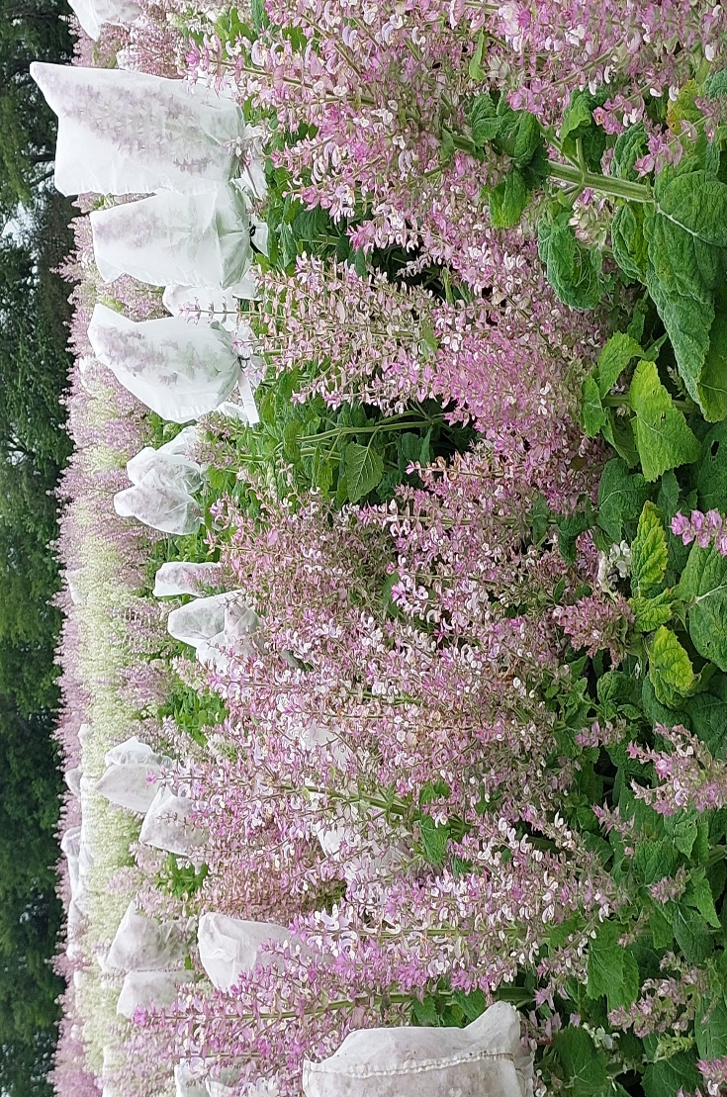
MOLDOVA STATE UNIVERSITY
INSTITUTE OF GENETICS, PHYSIOLOGY AND PLANT PROTECTION
Scientific Research Laboratory of Aromatic and Medicinal Plants
60, Alexei Mateevici str., MD2009, Chisinau, Republic of Moldova
Tel.: +373 796 53 009; E-mail: ludmila.cotelea@sti.usm.md
RESULTS OBTAINED IN THE EVALUATION OF ESSENTIAL OIL CONTENT AND ITS QUALITY IN F₇-F₈ HYBRIDS OF SALVIA SCLAREA
AUTHORS: Ludmila COTELEA*, Zinaida BALMUS, Violeta BUTNARAS
AIM: Creating of the original breeding material of Salvia sclarea L.; breeding of new varieties and increased productivity
The genetic material, obtained over several years of research, is represented by 25 simple, triple, double, stepped and complex F₇-F₈ hybrids of Salvia sclarea. These genotypes have recorded remarkable indices of quantitative character values. This is confirmed primarily by the creation of hybrid genotypes with remarkable indices of quantitative character values. The height of the plants recorded high values, their indices being from 100 cm to 141 cm. It is important that the share of the inflorescence length constitutes over 50% of the plant height, which promises high productivity. The inflorescences of the evaluated hybrids have a length of over 58 cm. Thus, in some hybrids they are 70.2 cm, and the longest inflorescences were attested in the hybrid [(M-44S₄ x L-15)F₁ x L-15)F₇ x (K-36 x 0-41)F₂ x 0-19)B₅)]F₇ - 74.7 cm. In this hybrid, the inflorescences are compact, with many branches 21.0 of the first degree and 39.2 branches of the second degree.
Five exceptional hybrids were selected and identified, for the most important character, they synthesize and accumulate 1.424-2.834% (dry matter) of essential oil. The results of gas chromatographic analysis of the essential oil in the complex hybrids [(S.s.Turkmen/N)S₇ x (K-36 x0-41)F₂ x 0-19)F₁ x 0-22)B₄ x L-15)F₈]F₇ with the essential oil content of 1.810% (dry matter) and [(0-57 S₅ x 0-21)F₂ x Dacia 50 Ian)]F₈ - 2.834% (dry matter), demonstrated that the concentration of the main component, on which the quality of the oil depends - linalyl acetate is 52.26% and 58.02% respectively.
Conclusion: The research resulted in the selection of S. sclarea hybrids with very high essential oil content –1.424-2.834% (dry matter). The results of gas chromatographic analysis of the essential oil in two complex hybrids demonstrated that the concentration of the main component meets the requirements of the European Pharmacopoeia. The selected hybrids represent a valuable material for the development of high-performance varieties of Salvia sclarea L.
Acknowledgments: This study was supported by the research project 011102 Increasing and conservation genetic diversity, agricultural crop breeding in the context of climate change, funded by Ministry of Education and Research

