Slide 1


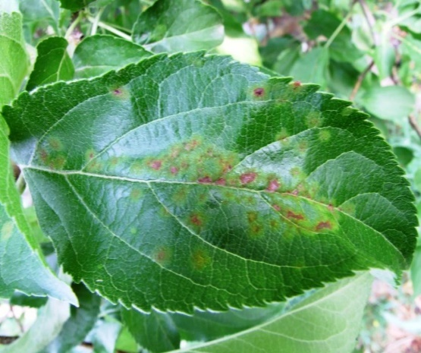


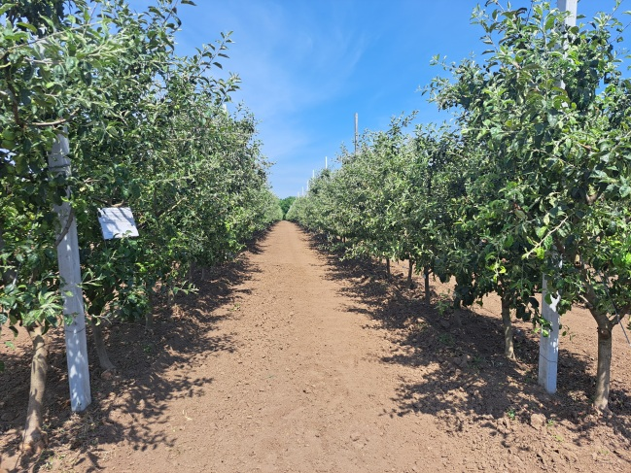
AIM OF THE STUDY
BIOLOGICAL CONTROL AGENTS AGAINST
VENTURIA INAEQUALIS WINT. ON APPLE
Curiev Loredana*, Pinzaru Boris
ORCID: 0000-0002-1927-8358; 0000-0001-7323-4770
Moldova State University, Institute of Genetics, Physiology and Plant Protection, Chisinau, Republic of Moldova
*Corresponding author: loredana.curiev@sti.usm.md
To determine the biological efficacy of the biopreparations Rizoplan and Trichodermin SC against Venturia inaequalis Wint., the causal agent of apple scab.
CONCLUSIONS
RESULTS
Rizoplan + Trichodermin SC at 7 L/ha demonstrated the highest biological efficacy (86.7%) against apple scab.
The combined treatment at 10 L/ha reached 86.4%, comparable with Luna Sensation SC 500 (86.5%).
Both biological preparations demonstrated high efficacy against Venturia inaequalis under the 2024 experimental conditions
The results indicate potential for Rizoplan and Trichodermin SC in biological apple scab management.
MATERIALS AND METHODS
Experimental conditions
Biological control agents
• Experimental plot of the Institute of Genetics, Physiology and Plant Protection, MSU
• Apple cultivar: Reinette Simirenko
• Vegetation period: 2024
• Experimental design: 8 variants
• 3 repetitions per variant
• 3 trees per repetition
RIZOPLAN
Contains live bacteria
Pseudomonas fluorescens
TRICHODERMIN SC
Contains the fungus
Trichoderma lignorum
CNMN-FD-14 (M-10)
Treatment | Rate (L/ha) | Biological efficacy (%)
Rizoplan | 7 | 84.8
Rizoplan | 10 | 86.2
Trichodermin SC | 7 | 84.3
Trichodermin SC | 10 | 85.5
Rizoplan + Trichodermin SC | 7 | 86.7
Rizoplan + Trichodermin SC | 10 | 86.4
Luna Sensation SC 500 (chemical standard) | 0.35 | 86.5
Chemical standard
LUNA SENSATION SC 500
Application rate: 0.35 L/ha
ACKNOWLEDGMENTS
Acknowledgment. The research was carried out within the framework of subprogram 011103,
“Development of environmentally friendly means for reducing the impact of harmful organisms on
agricultural crops under climate change conditions”, funded by the National Agency for Research
and Development and the Ministry of Education and Research..
86.7%
86.4%
86.5%
Highest efficacy
Rizoplan + Trichodermin SC
7 L/ha
Combined treatment
Rizoplan + Trichodermin SC
10 L/ha
Chemical standard
Luna Sensation SC 500
0,35 L/ha
The National Conference with International Participation
“NATURAL SCIENCES IN THE DIALOGUE OF GENERATIONS” (IXth th Edition)
21-22 September, Chisinau, Republic of Moldova, 2026
Apple scab symptoms
(Venturia inaequalis)
Experimental plot
(var. Reinette Simirenko)

