Slide 1


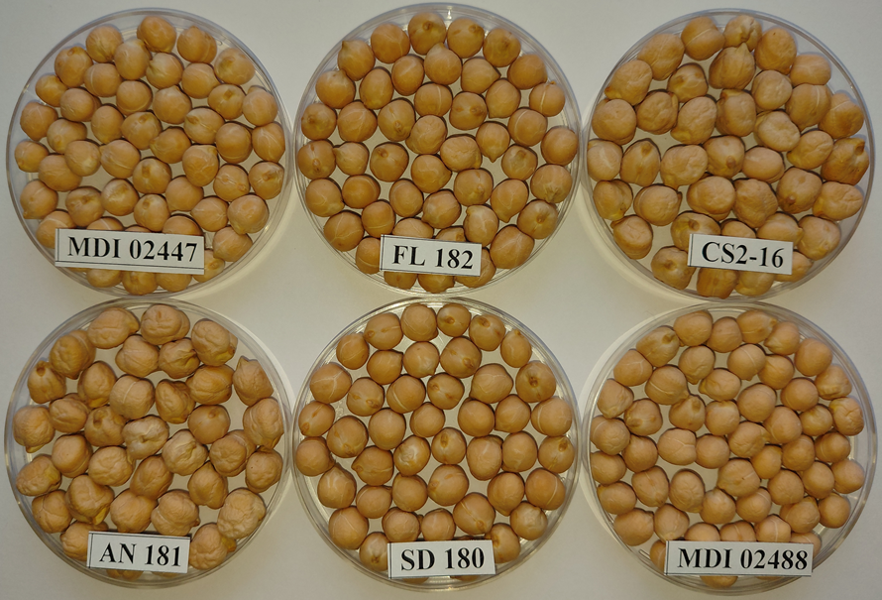
MOLDOVA STATE UNIVERSITY
INSTITUTE OF GENETICS, PHYSIOLOGY AND PLANT PROTECTION
Laboratory of Plant Genetic Resources
60, Alexei Mateevici str., MD 2009, Chisinau, Republic of Moldova
MAIN BIO-AGRONOMOCAL CHARACTERISTICS LOCAL ACCESSIONS OF CHICKPEA
Authors: Curșunji Dmitri, Ganea Anatolie
Moldova State University, Institute of Genetics, Physiology and Plant Protection
E-mail: dmitri.cursunji@sti.usm.md, anatolie.ganea@sti.usm.md
The purpose of studies was: characterization accessions of chickpea for characters 100-seed weight, plant height, classification by ripening periods and identify accessions with the best performance of grain weight per plant
Keywords: chickpea, 100-seed weight, plant height, maturity, grain weight per plant
Materials and methods
Twenty-seven local accessions were evaluated for characters: seeds size, plant height, time of ripening and productivity in 2023-2024(in rain fed condition). Sowing were laid out randomized in 2 replications, each of aria 2.2 m², as check for productivity was used v. Ichel, and 2 checks (MDI 02414 and MDI 02405) for early and late time maturity, respectively. Hundred seed weight were measured 4 times, plant height 13-15 measuring for each replication. Time of ripening noted when all plants of accession become dried.
Result of studies
All accessions were divided into 3 groups on basis seed-size. In first group as middle-sized seeds were included 9 accessions (33.3%): those 100-SW ranged within 26.5 g (MDI 02488) - 29.4 g (MDI 02460) and PH within 38.8 cm (MDI 02451) - 64.2 cm (MDI 02462). By ripening they а distributed: 3 as early-medium, 4 mediums and 2 late time one. By grain weight per plant (mean for both years) should be noted 3 accessions: MDI 02488 (8.25 g), MDI 02451 (8.1 g) and OR1-2b (8.0 g) compared to v. Ichel that had 8.5 g per plant.
a. middle-size seeds accessions, 33,3%
b. middle-large seeds accessions, 18,5%
c. large size seeds accessions, 48,2%
early - medium time of ripening, 22,2%
medium time of ripening, 40,7%
late time of ripening, 14,8%
medium-late time of ripening, 22,2%
tall plants, 18,5%
medium-height tall plants, 81,5%
Second group, consisted of 5 accessions (18.5%) - as middle-large sized one those 100-SW varied from 30.5 g (MDI 02420) to 33.0 g (SD180) and PH from 45.9 cm (CS2-3a) to 63.7 cm (MDI 02419). By plant maturity: 3 accessions evaluated as medium- late and 2– being late time one. By character GWP were selected 2 accessions viz.: MDI 02420(8.3g) and SD180(8.15g). In this group can be included v. Ichel having 100-SW- 32.2 g, PH – 61.8 cm, being late time of maturity. Third group comprised 13 accessions (48.2%) - consisting of large-sized seeds, which 100-SW ranged from 36.9 g (CS1-18c) to 42.8 g (SD1-1), PH one within the limits of 39.6 сm (OR1-12) – 45.5 cm (CS1-22).
Regarding to PH variability (among accessions) coefficient of variation in this group had value 4.3%, which significant less than in group1 (CV=20%) and group 2 (15.6%). By maturity, 3 accessions were characterized as early-medium, 7 and 3 as medium and medium – late time one. Grain weight per plant should be noted accessions CS2-3b (8.37 g), AN181 (8.3 g), which did not differ significantly from v. Ichel (8.5g ) as well as accessions REZ2-9 (8.0 g) and CS1-18c (7.9 g). Seeds coat pigmentation: most of accessions (23) are light beige, beige- 3 and 1 (REZ2-9a) – light rose. Variability of 100-SW of all accessions is CV=16.0%, that proportionate with one of PH(CV=17.5).
Conclusion: by character seeds size were predominated large-sized accessions(13), followed by middle-sized (9) and least group is constituted of middle- large sized (5) one. Accessions with medium tall of plant (22) predominated over taller (5). Regarding time of ripening – 11 accessions had medium, by 6 each E-M & M-L and 4 late time one. Nine accessions were selected by performance grain weight per plant: MDI 02488, MDI 02451, OR1-2b, MDI 02420, SD180, CS2-3b, AN181, REZ2-9(8.0g) and CS1-18c.
Acknowledgments. This research was supported by the Subprogram 011102 “Increasing and conservation genetic diversity, agricultural crop breeding in the context of climate change”, funded by the Ministry of Education and Research of the Republic of Moldova.
Aspect of seeds of some local accessions
IGFPP, Republica Moldova, Chişinău, str. Pădurii, 20, MD-2002.
Tel.: (+373 22) 77-04-47, Fax: (+373 22) 55-61-80, E-mail: institut.gfpp@gmail.com; Web: igfpp.usm.md

