Slide 1


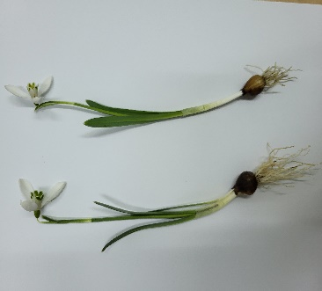
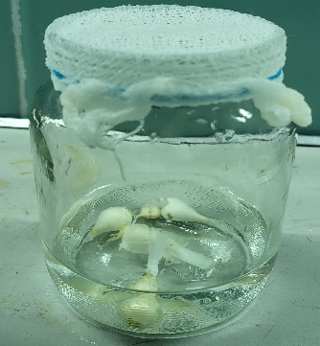
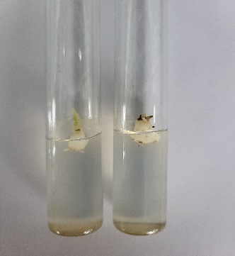
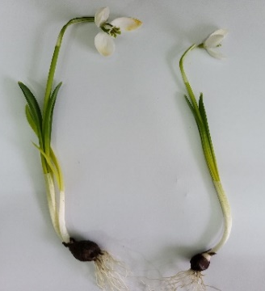
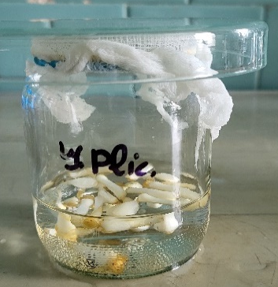
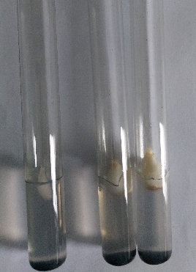
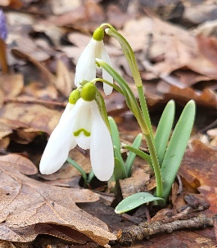
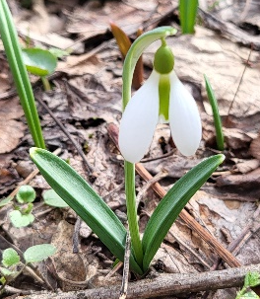
EX SITU CONSERVATION OF GALANTHUS SPECIES BY IN VITRO TECHNIQUES
IN THE REPUBLIC OF MOLDOVA
Melania GHEREG, Nina CIORCHINĂ, Veaceslav GHENDOV, Maria TABĂRA, Raisa CHIȚAN
„Alexandru Ciubotaru” National Botanical Garden (Institute), Moldova State University, Chisinau, Republic of Moldova
E-mail: melania.ghereg@gb.usm.md
INTRODUCTION
The present study performs a comparative analysis of in vitro regeneration protocols for two species with protection status in the Republic of Moldova: G. nivalis (VU) and G. plicatus CR), with the objective of optimizing micropropagation techniques for ex situ germplasm conservation (Fig. 1.A,B).
MATERIALS AND METODS
The use of mercuric chloride (HgCl₂) ensured an optimal sterilization efficiency of 42.5% for the species G. plicatus M. Bieb. and 37.5% for the G. nivalis L. The effect of different cytokinins was evaluated: 6-benzylaminopurine (BAP), kinetin, 2-isopenteniladenine (2iP) in combination with auxin (naphthaleneacetic acid – NAA) and sucrose concentrations on the in vitro multiplication of G. nivalis (Fig. 2) and G. plicatus bulbs (Fig. 3).
Fig. 2. Galanthus nivalis in vitro culture
Fig. 3. Galanthus plicatus in vitro culture
A
B
RESULTS AND CONCLUSIONS
The results showed that the highest number of bulbs was obtained on the medium with kinetin and 2iP hormone, but they presented reduced sizes and vitrification phenomena. The best quality and efficiency of multiplication was recorded on the medium with 3.0 mg/L BAP and 0.5 mg/L NAA, where 25% of the bulbs reached a diameter over 5 mm, being suitable for acclimatization. Increasing the sucrose concentration determined a reduction in the number of bulbs formed, the optimal value being 20 g/L. The study's conclusions highlight that the success of conservation through in vitro culture depends on the adaptation of hormonal and mineral balance depending on the plant's specifics. Thus, micropropagation represents an efficient method for the rapid production of biological material, essential for future programs to repopulate degraded ecosystems.
Fig. 1. A - Galanthus nivalis, B - G. plicatus
AIM OF THE STUDY
The research aimed to optimize the critical stages of in vitro culture, in particular the sterilization of biological material and the induction of bulb proliferation.
Acknowledgments. The research was conducted within the project: 20.80009.7007.19 (2020-2023) „The introduction and development of technologies for propagation and cultivation of new species of woody plants by conventional techniques and tissue culture” and the subprogram 010101 „Research and ex situ and in situ conservation of plant diversity in the Republic of Moldova” (2024-2027).

