Slide 1

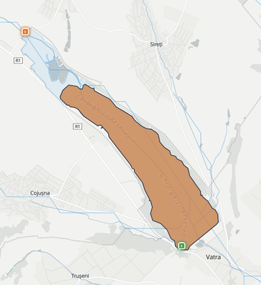
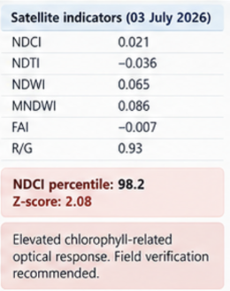
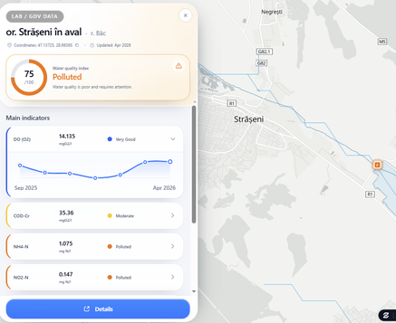
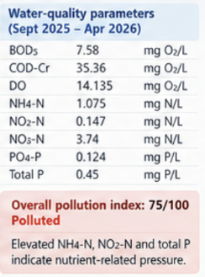
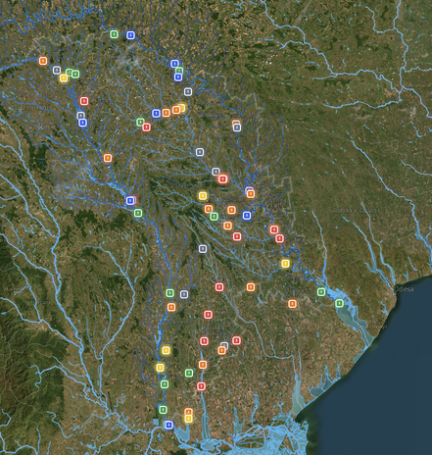
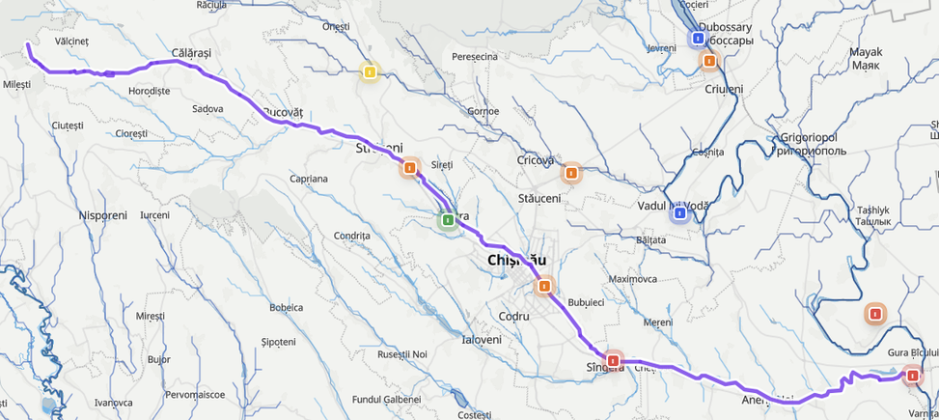

GIS DATA AND DIGITAL TOOLS FOR SURFACE WATER POLLUTION MANAGMENT
PELIN Bogdan, Moldova State University, Chisinau, Republic of Moldova
E-mail: pelin.bogdan@usm.md
1.
BACKGROUND
4.
MATERIALS AND METHODS
  5. CASE STUDY 1 - GHIDIGHICI RESERVOIR
Surface-water monitoring often relies on fragmented spatial, field and laboratory datasets. Integrating these sources within GIS can improve spatial interpretation, temporal analysis and identification of pollution-sensitive areas.
  Field monitoing
  2. GIS database
  Water-quality measurements
  Side observation
  Photographs
  Digital site profiles
  Web-based platform
  Spatial vizualization
The main pressure is chlorophyll-related rather than turbidity-driven. The high NDCI anomaly suggests enhanced phytoplankton activity, while no comparable surface-bloom signal is evident. Field validation of chlorophyll-a and nutrients is recommended.
2.
AIM OF THE STUDY
  4. Integrated analysis
  3. Sentinel-2 screening
To integrate GIS, Sentinel-2 optical indicators and in-situ water-quality measurements into a digital framework for spatial assessment, monitoring and management of surface-water pollution.
  Pollution Assessment
  Monitoing prioritisation
  Managment support
  NDCI
  NDWI
  FAI
  NDTI
  MNDWI
  R/G
*Satellite indices provide optical screening signals and do not replace field or laboratory measurements.
3.
STUDY AREA
  6. CASE STUDY 2 - STRASENI DOWNSTREAM
Regional monitoring map (R. Moldova)
Bic river corridor - central Moldova
Persistent nutrient pressure is evident from elevated NH4-N, NO2-N and total phosphorus, accompanied by moderate organic loading. High DO indicates that oxygen depletion is not currently dominant. The nitrogen pattern suggests recent inputs or incomplete nitrification, supporting upstream source tracking and repeated monitoring.
  7. CONCLUSION
GIS integration identified two contrasting pressure patterns: episodic phytoplankton-related change at Ghidighici Reservoir and persistent nutrient/organic pressure at Strășeni downstream. Combining Sentinel-2 screening with in-situ monitoring improves pollution interpretation, supports targeted field verification, and helps prioritize source-oriented management actions.
Acknowledgments: The author acknowledge the support of ZIUZEA SRL and the use of its GIS-based digital monitoring tools and platform for data visualization and surface-water quality assessment. (https://ziuzea.com/en/knowledge-hub/installations)

