Slide 1


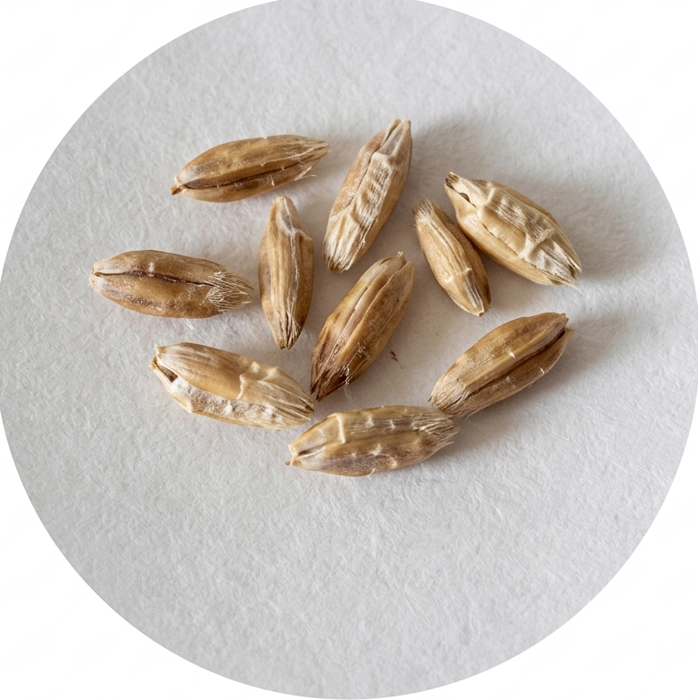
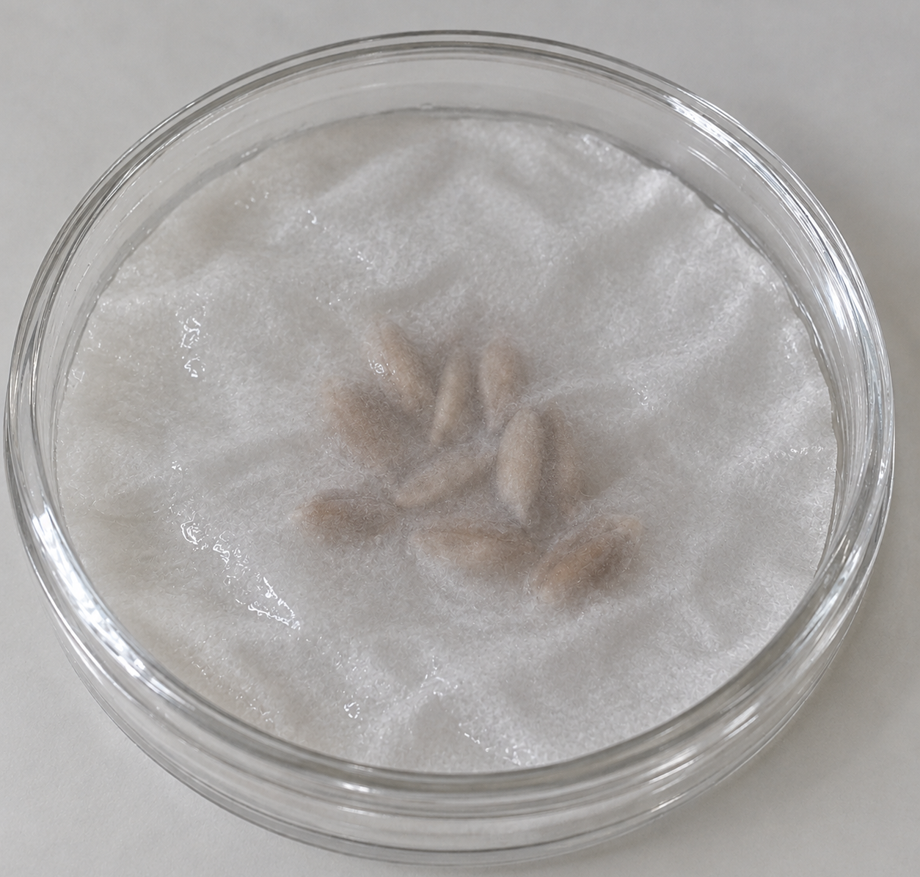
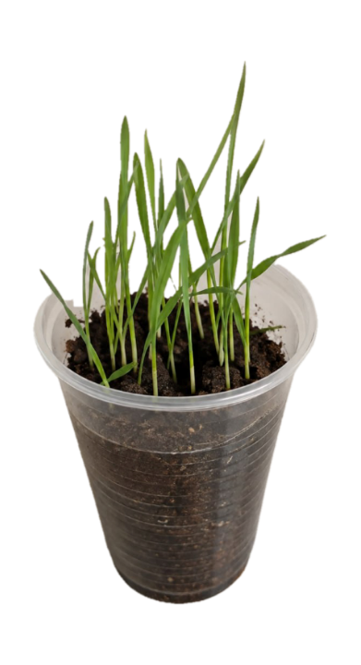
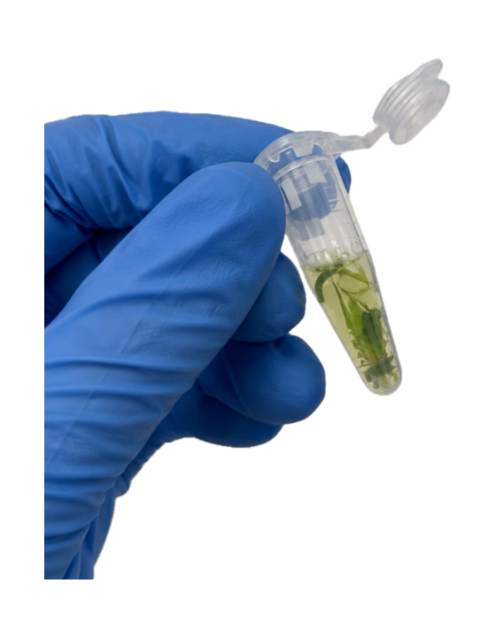
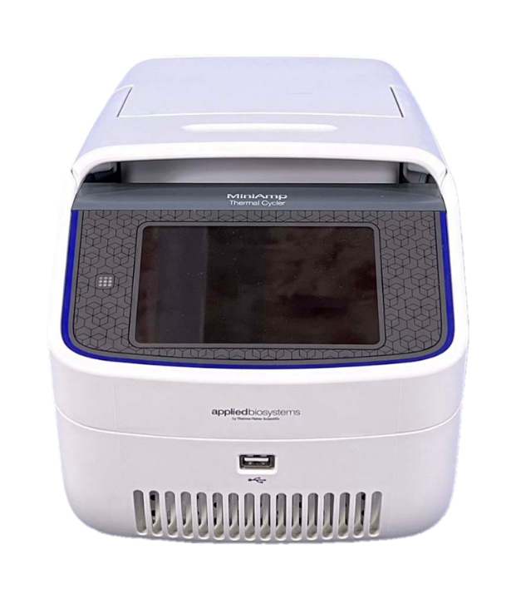
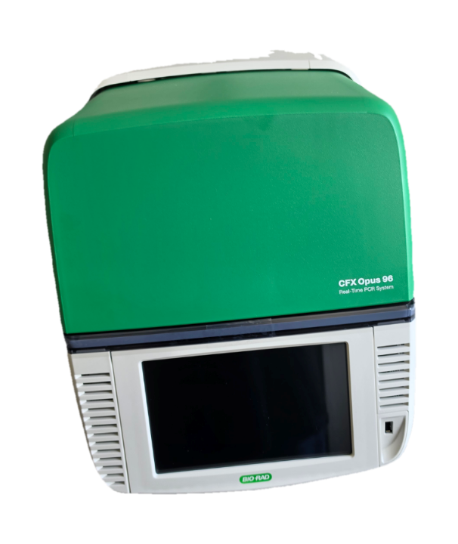
PRE-SOWING T-2 AND DON MODULATE TRITICALE RESISTANCE TO FUNGAL PATHOGENS
Golovсova Svetlana, Grăjdieru Cristina
Laboratory of Molecular Genetics, Institute of Genetics, Physiology and Plant Protection, Moldova State University.
Materials and Methods:
Aim of the Study:
To evaluate the effect of pre-sowing T-2 toxin and deoxynivalenol (DON) on triticale resistance to Alternaria spp. and Fusarium spp.
Seed treatment
Conclusions:
Results:
Subphytotoxic mycotoxin doses modulate triticale resistance to fungal pathogens
The direction depends on the interaction between plant genotype, mycotoxin type and concentration, and pathogen taxonomy.
These findings may support phytosanitary risk assessment and screening for resistance in Moldovan triticale breeding programs.
Cultivars:
Ingen‑93
Ingen‑40
Ingen‑54
Toxin conc. (μg/L):
T-2 (0.05 and 0.01)
DON (5 and 10)
T-2 + Ingen-54
(0.05 μg/L)
Relative DNA
content of Alternaria
DNA extraction
(t = 2,66; p < 0,05)
ISO 21571:2005
Nested Multiplex
PCR
DON + Ingen-40
(5 μg/L)
Real-time PCR
Relative DNA
content of Fusarium
Acknowledgments:
This study was supported by the research project 122N921/ 23.80013.5107.4TR, subprogram 011101 “Genetic and biotechnological approaches to agroecosystem management under conditions of climate change”
Statistical analysis
(t = 3,80; p < 0,05)

