Slide 1
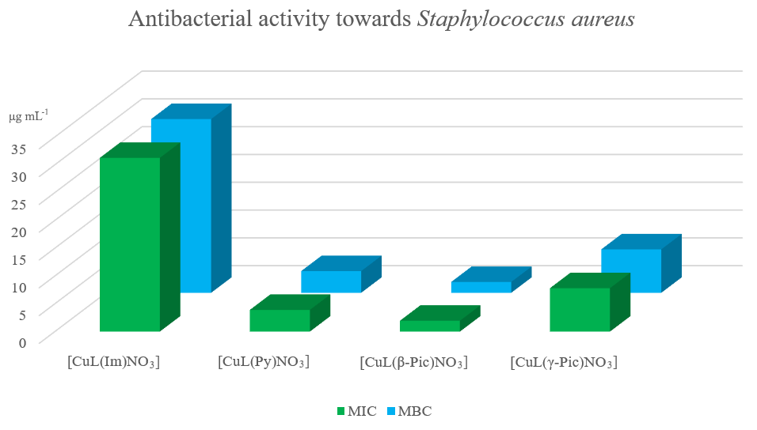
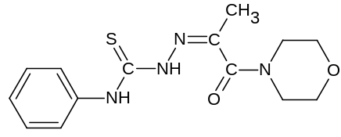
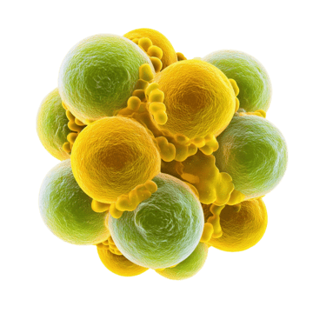
ANTIBACTERIAL MIXED-LIGAND CU(II) COMPLEXES WITH 4-PHENYLTHIOSEMICARBAZONE
Ianina Graur^{1,}*, Vasilii Graur¹, Victor Tsapkov¹, Greta Balan², Carolina Lozan-Tirsu², Aurelian Gulea¹
¹Laboratory of Advanced Materials in Biopharmaceutics and Technics, Institute of Chemistry, Moldova State University, Chisinau, Republic of Moldova
²Department of Preventive Medicine, State University of Medicine and Pharmacy “Nicolae Testemitanu”, Chisinau, Republic of Moldova
*E-mail: ulchina.ianina@usm.md
INTRODUCTION
METHODS
Mixed-ligand copper(II) complexes containing thiosemicarbazone ligands have attracted considerable attention due to their diverse biological properties, including antimicrobial activity. The investigation of their antibacterial activity against Staphylococcus aureus is particularly important because this Gram-positive pathogen is responsible for a wide range of community- and hospital-acquired infections and has developed resistance to many conventional antibiotics.
A series of mixed-ligand copper(II) complexes was obtained by reacting the [CuLNO₃] with various N-heteroaromatic bases in ethanol using a 1:1 molar ratio: [CuL(Im)NO₃], [CuL(Py)NO₃], [CuL(β-Pic)NO₃], [CuL(γ-Pic)NO₃] and complexes were characterized by elemental analysis, FTIR spectroscopy, and molar conductivity studies.
RESULTS AND DISCUSSIONS
The antibacterial properties were evaluated against Staphylococcus aureus (ATCC 25923). The activity was found to depend on the nature of the N-heteroaromatic base coordinated to the metal center and increased in the following order: β-Pic > Py > γ-Pic > Im. The highest antibacterial activity was observed for complex [CuL(β-Pic)NO₃], with MIC and MBC values of 1.953 μg mL⁻¹ and 1.953 μg mL⁻¹ respectively.
Fig. 1. The structure of HL.
Acknowledgments: This study was supported by the research project 010602 “Synthesis and Study of New Materials Based on Coordination Compounds with Polyfunctional Ligands and Useful Properties in Medicine, Biology, and Technology”, funded by The Ministry of Education and Research of the Republic of Moldova.

