Slide 1



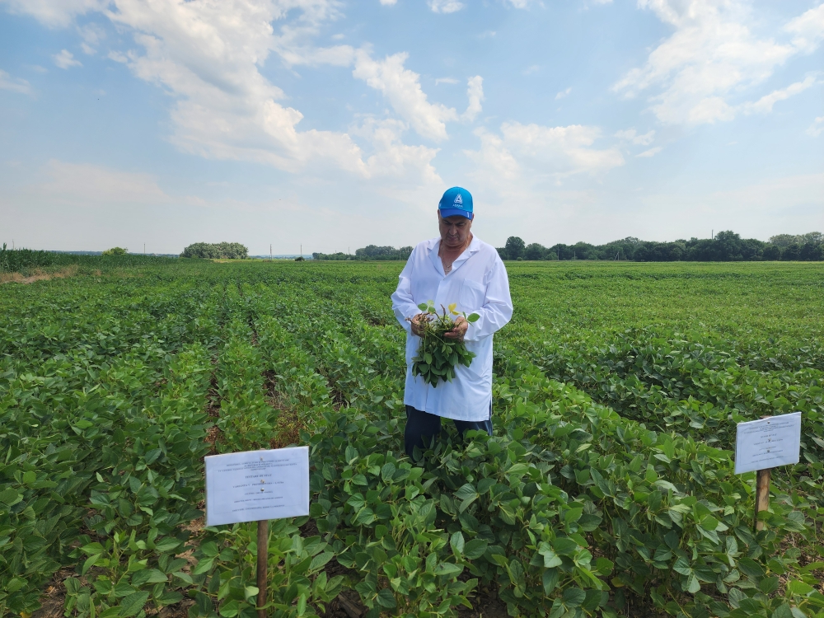
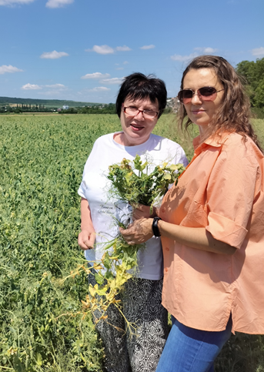
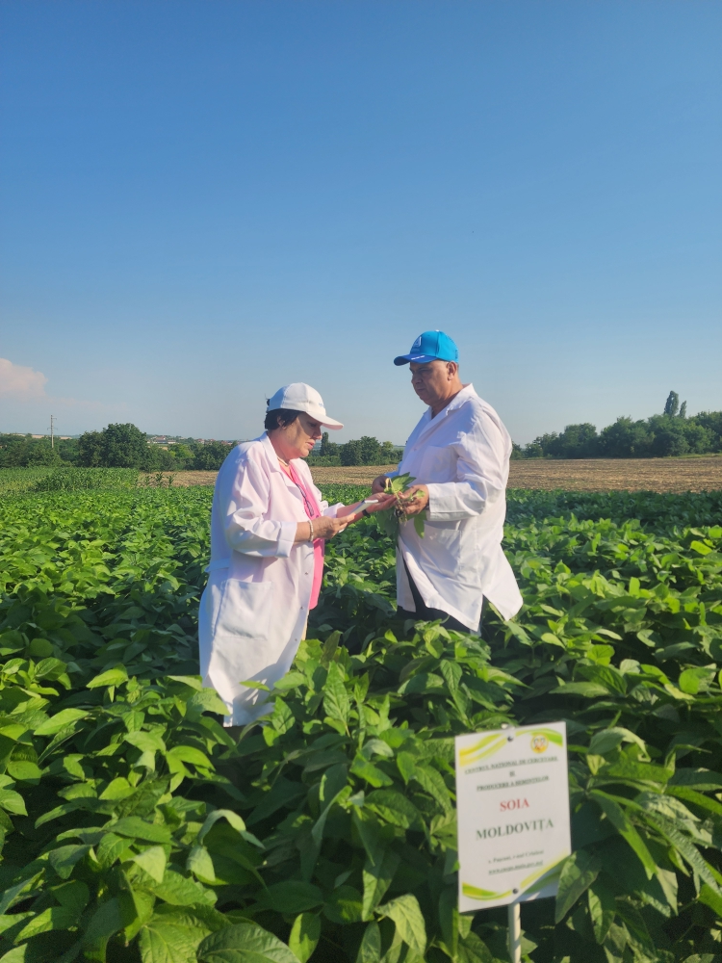
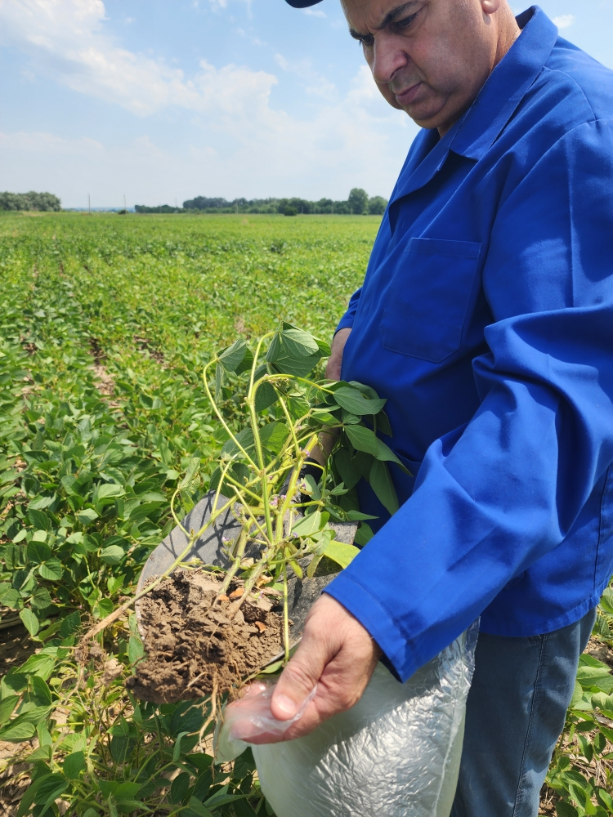
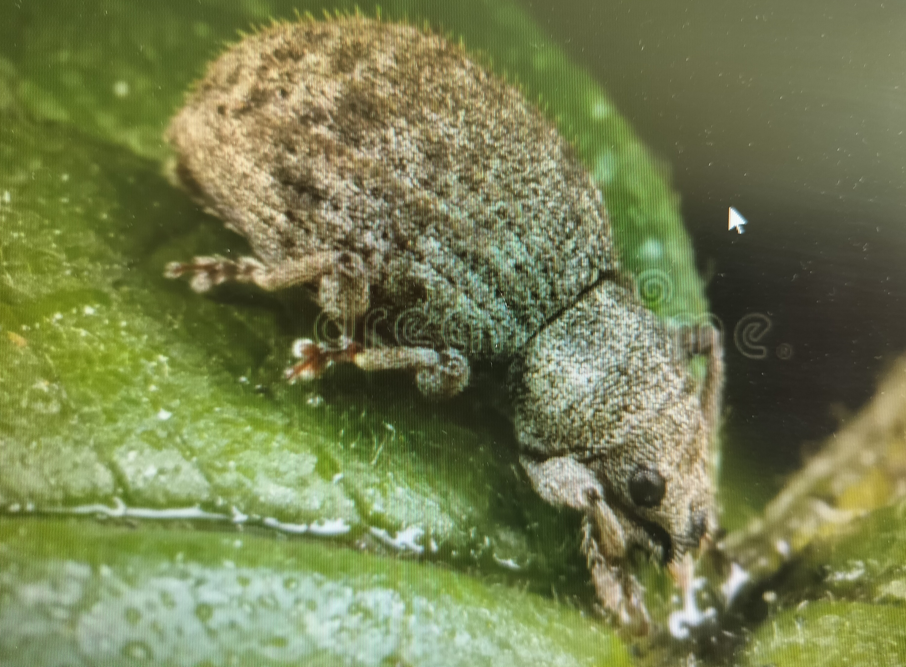
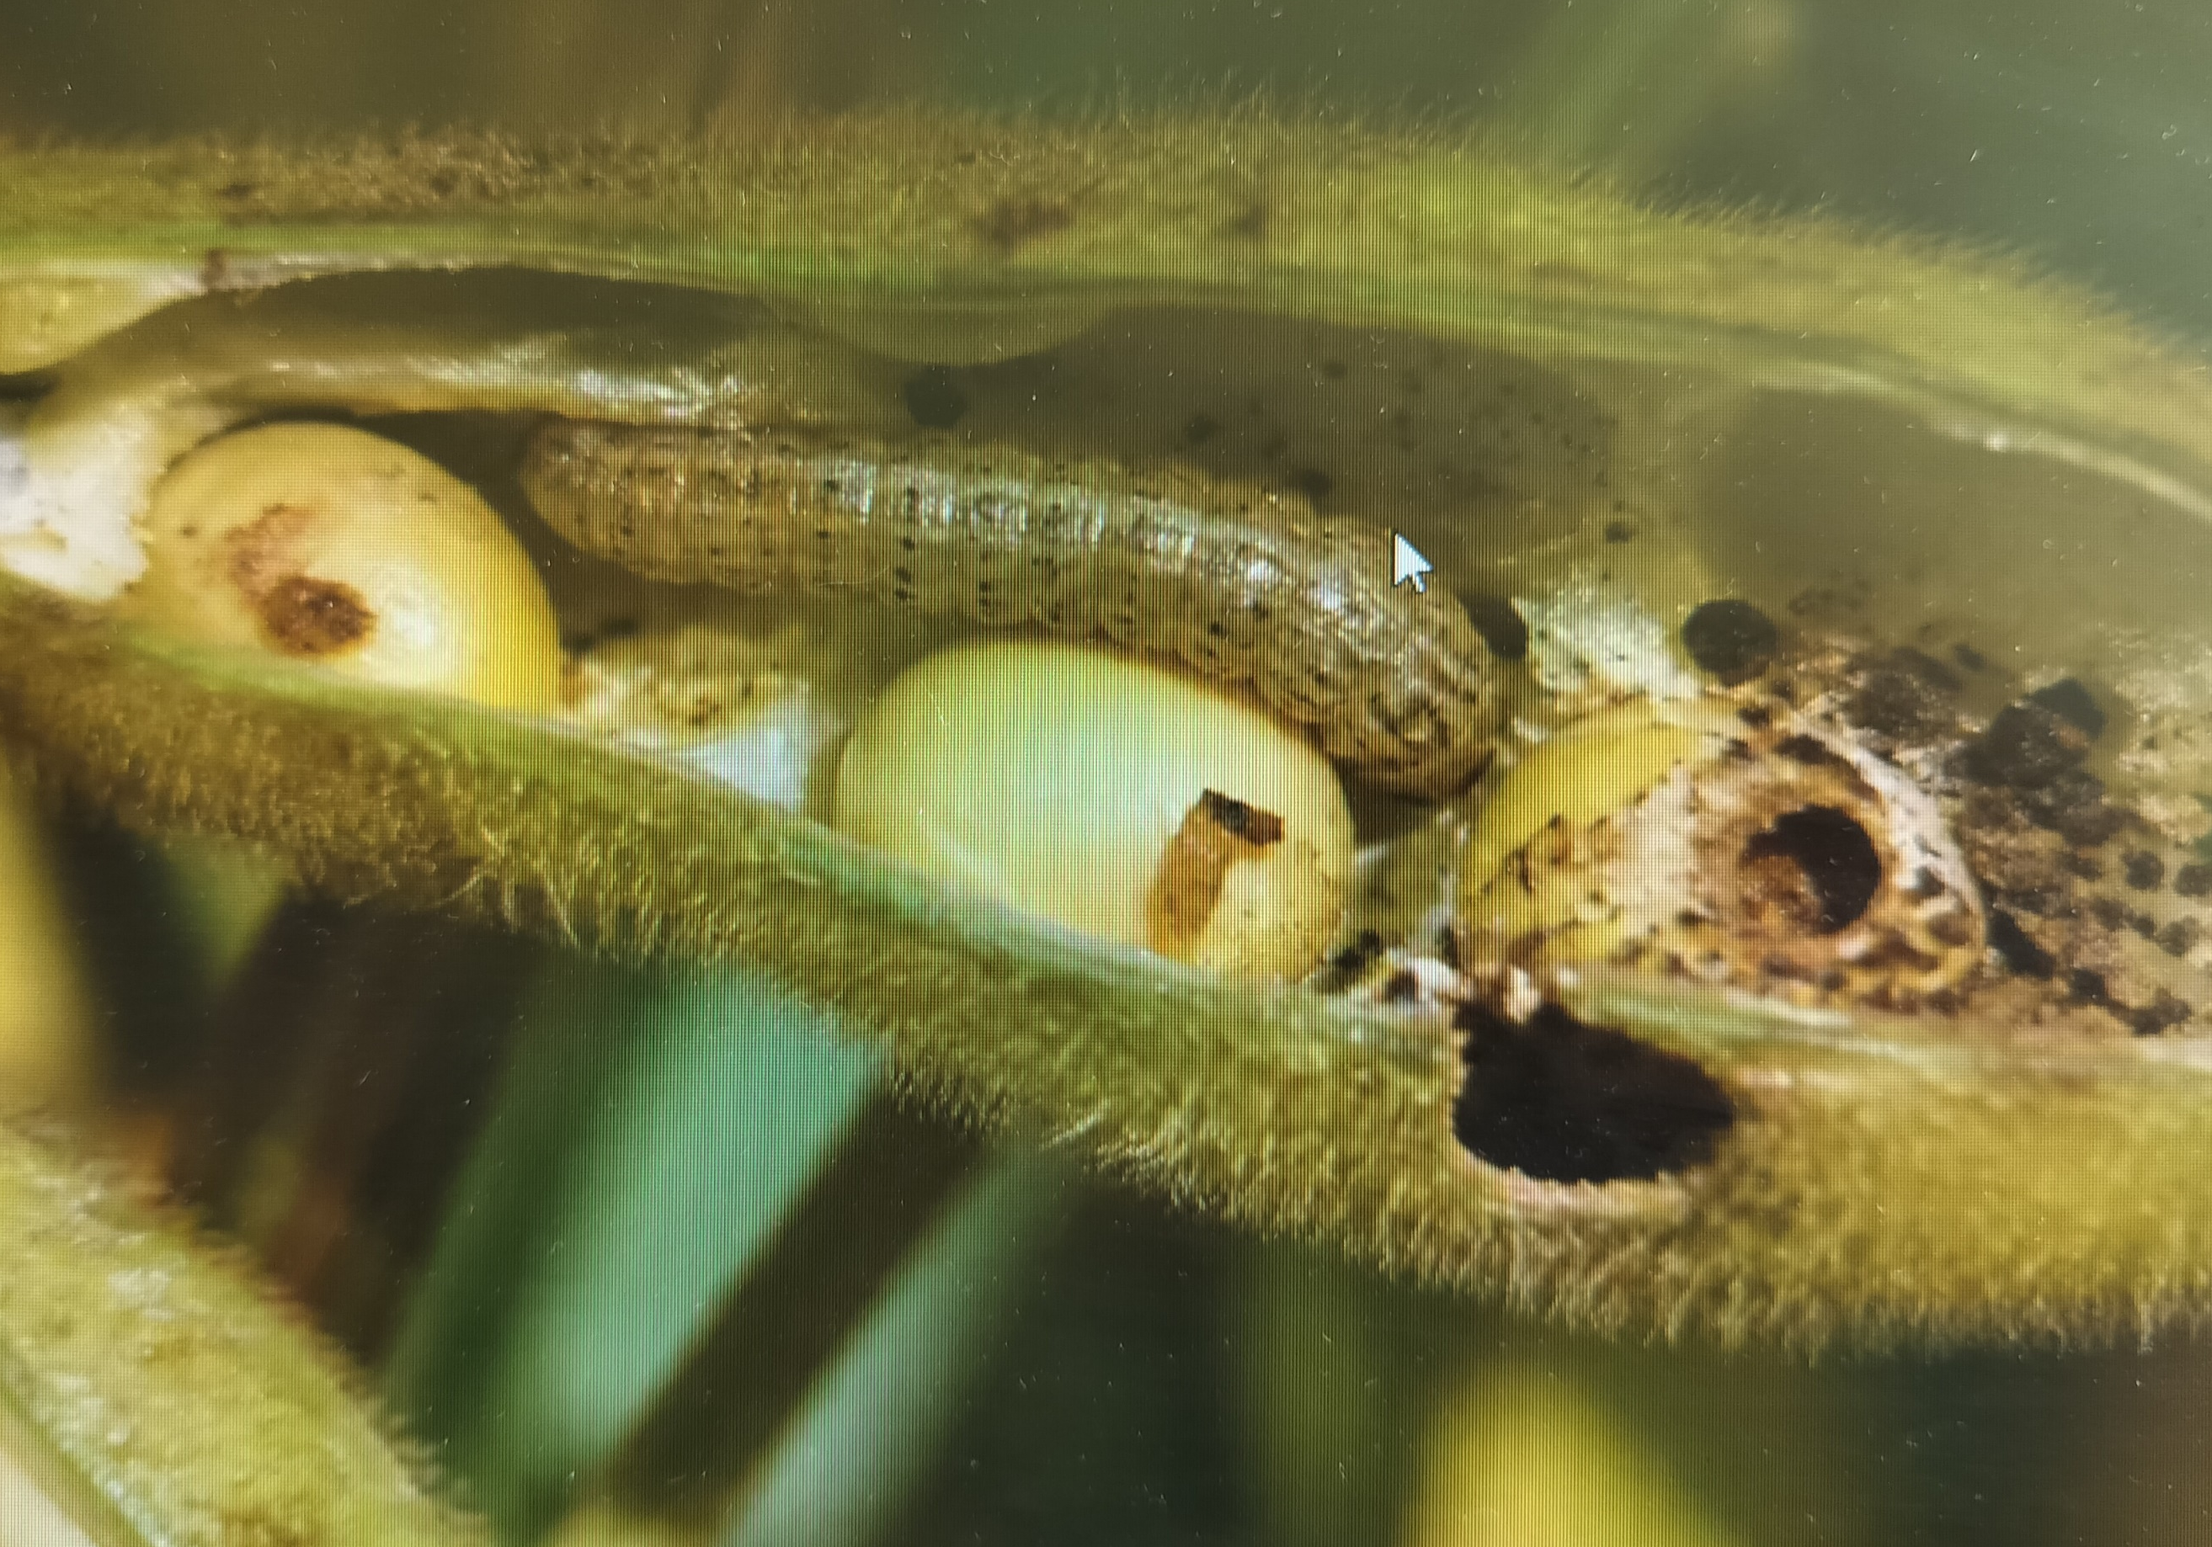
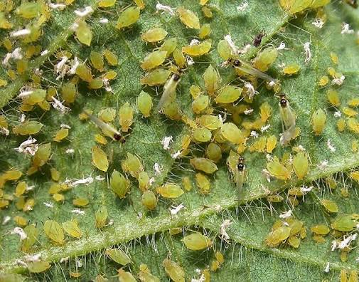
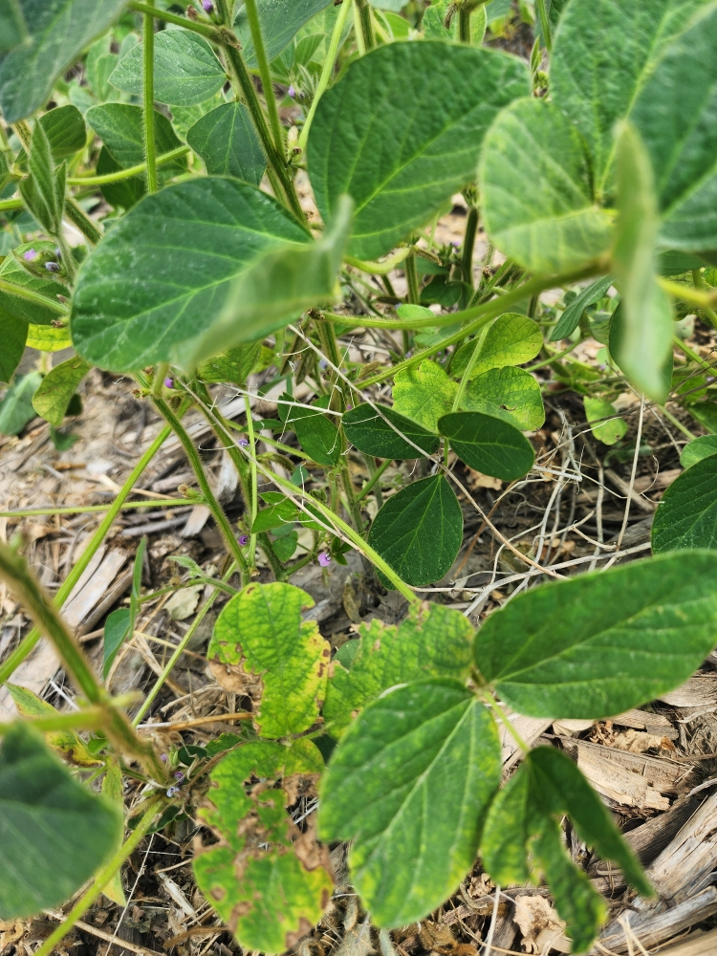
RESEARCH ON INVASIVE INSECT COMPLEXES IN SOYBEAN CROP IN THE
ENVIRONMENTAL CONDITIONS OF THE REPUBLIC OF MOLDOVA
¹Alexei BIVOL, ¹Stefan RUSU, ²Natalia CÎRLIG, ¹Elena IURCU-STRĂISTARU
¹Moldova State University, Institute of Zoology, 1 Academiei str.,² “Alexandru Ciubotaru” National Botanical Garden (Institute), 18 Padurii str.iurcuelenastraistaru@gmail.com
Based on the actuality of the topic and the goal set by us, we have established the following objective for the research: making records of biological and phytosanitary control establishing the degree of phytosanitary impact, highlighting the response reactions and the most invasive species of pests in the studied crop species.
Results: Phytosanitary monitoring, conducted across different phenological stages of the crop, revealed the presence of 15 particularly harmful invasive insect species from 4 orders and 8 families. The most notable ones, based on assessments of population density, frequency, and intensity of crop damage, were coleopteran insects detected in the soil since the germination phase. These include the wireworm larvae of click beetles: Agriotes lineatus L. and Agriotes ustulatus L., such species as Agrotis segetum Schiff. and Autographa gamma L. As the crop matures, weevil species like Sitona lineatus L. and Tanimecus dilaticollis L. become prevalent. In later growth stages, adult plants are attacked by several aphid species - Myzus persicae Sulzer, Aphis fabae and Aphis gossypii, as well as by flies (Liriomyza huidobrensis L., Liriomyza trifolii L., Delia platura L.), pea thrips (Kakothrips robustus Uzel), and the soybean moth (Helicovepra armigera, Cydia nigricana Fabr, Etiella zinckenella).
Table 1. The diversity of parasitic and beneficial insect species detected on soybean plants during the growing season and the infestation levels compared by regions, Republic of Moldova, 2024-2025
Species |  | Numerical density of pests detected in 10 samples – 100 analysed plants |  |  |  |  | (F) Frequency % | (I) Intensity %
 |  | May - June |  |  | August - September
 |  | Larvae |  | Adults | Larvae | Adults | % | %
Click beetle (wireworms – larvae of the genus Agriotis spp., fam. Elateridae |  | 4 |  | 3 | 2 | 3 | 10-15 | 10-12
Broad-nosed weevil (Tanymecus spp, fam. Curculionidae |  | 3 |  | 6 | - | - | 15-25 | 15-18
Cutworms – species of fam. Noctuidae: Agrotis segetum Schif., Autographa gamma L., Helicoverpa armigera |  | 3 |  | 7 | 12 | 17 | 15-25 | 13-17
Seedcorn maggot - Delia platura, fam. Anthomyidae |  | - |  | 5 | 11 | 12 | 7-10 | 5-7
Caterpillars of the Painted Lady - Vanessa cardui, fam. Nymphalidae |  | - |  | 3 | 3 | 5 | 10-13 | 8-10
Tobacco thrips - Thrips tabaci |  | - |  | 2col/pl | 3col/pl | 3col/pl | 12-15 | 10-12
Pod borer moth - Etiella zinckenella, fam. Pyralidae |  | - |  | - | 7 | 10 | 25-30 | 17-20
Soybean aphids, fam. Aphididae Aphis glycines |  | 1 |  | 3col /pl. | 5col /pl. | 5col / pl. | 25-30 | 20-25
Entomophagous insects
Trichogramma evanescens | 0 |  | 0 |  | 16 | 14 | - | -
Aphelinus flavipes | 10 |  | 13 |  | 12 | 17 | - | -
Coccinella spp. | 2 |  | 7 |  | 11 | 10 | - | -
Figure 1. Phytosanitary surveys on a soybean field affected by multiple pests during different growth stages, with soil sampling for laboratory analysis, July-August 2025. Central Zone, Republic of Moldova.
Figure 2. Tanymecus dilaticollis, Etiella zinckenella, Aphis gossypii, infestations by Helicoverpa armigera Helicovepra armigera,
Conclusion. The results of this research, carried out in the north, central and south-eastern regions of Moldova, contribute to understanding the parasitic impact on soybean crops and support the development of forecasts and integrated pest management strategies.
Acknowledgments: The research was carried out in the framework of the subprogram: 010701 and 010102 of Moldova State University.

