Slide 1



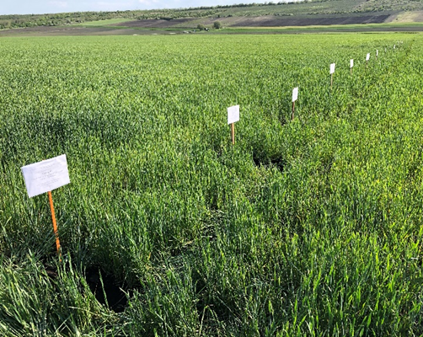
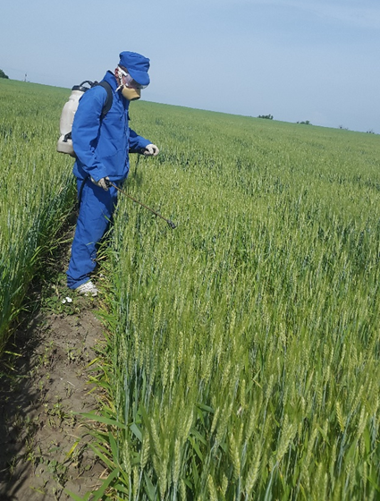
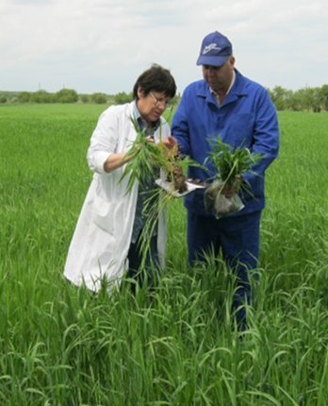
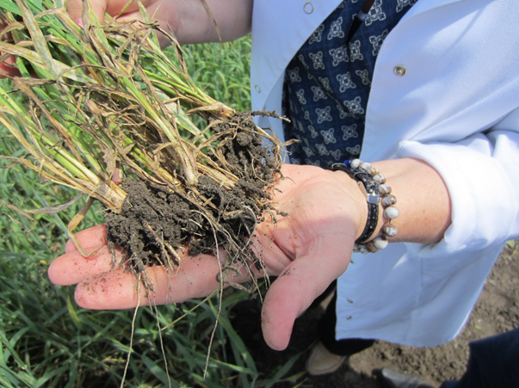
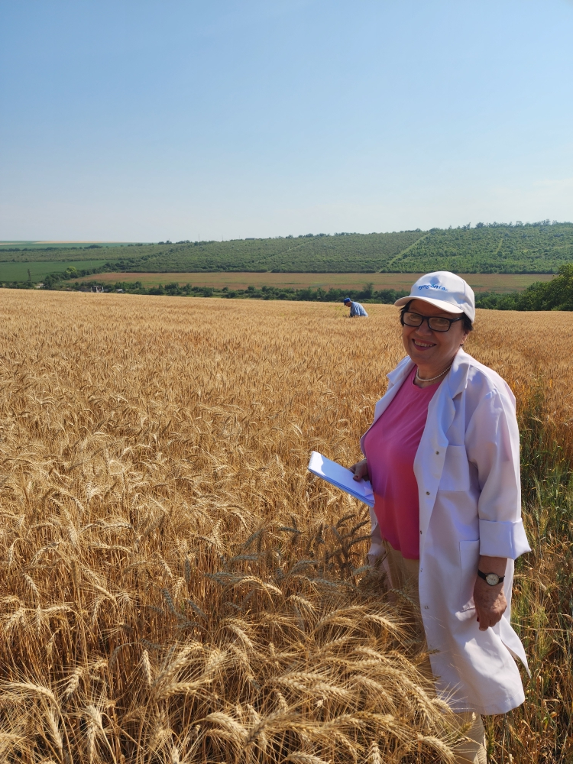
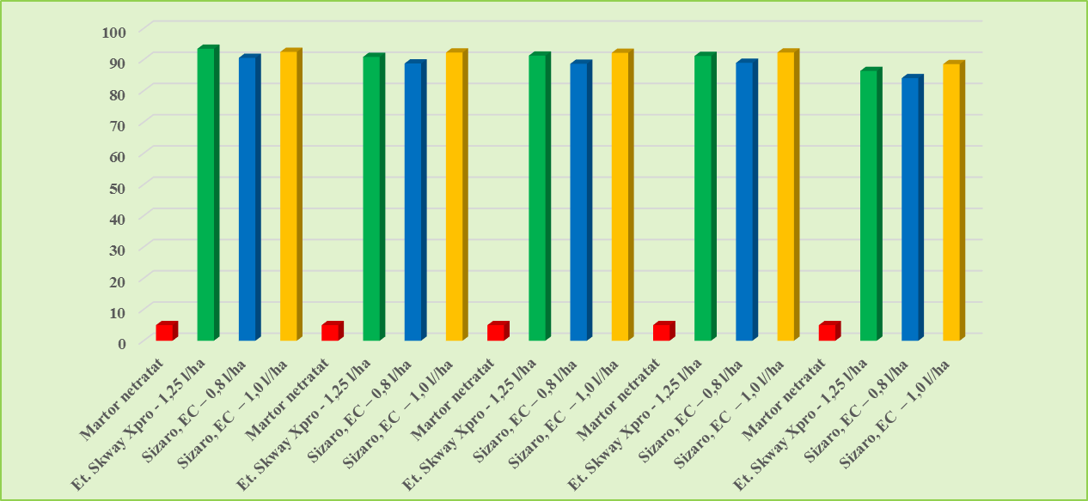
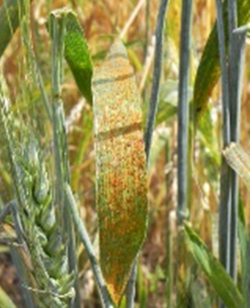
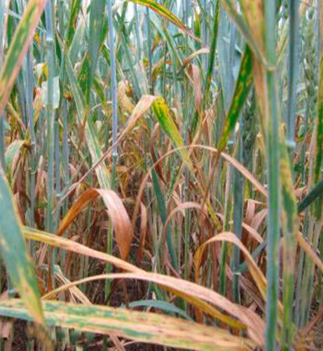
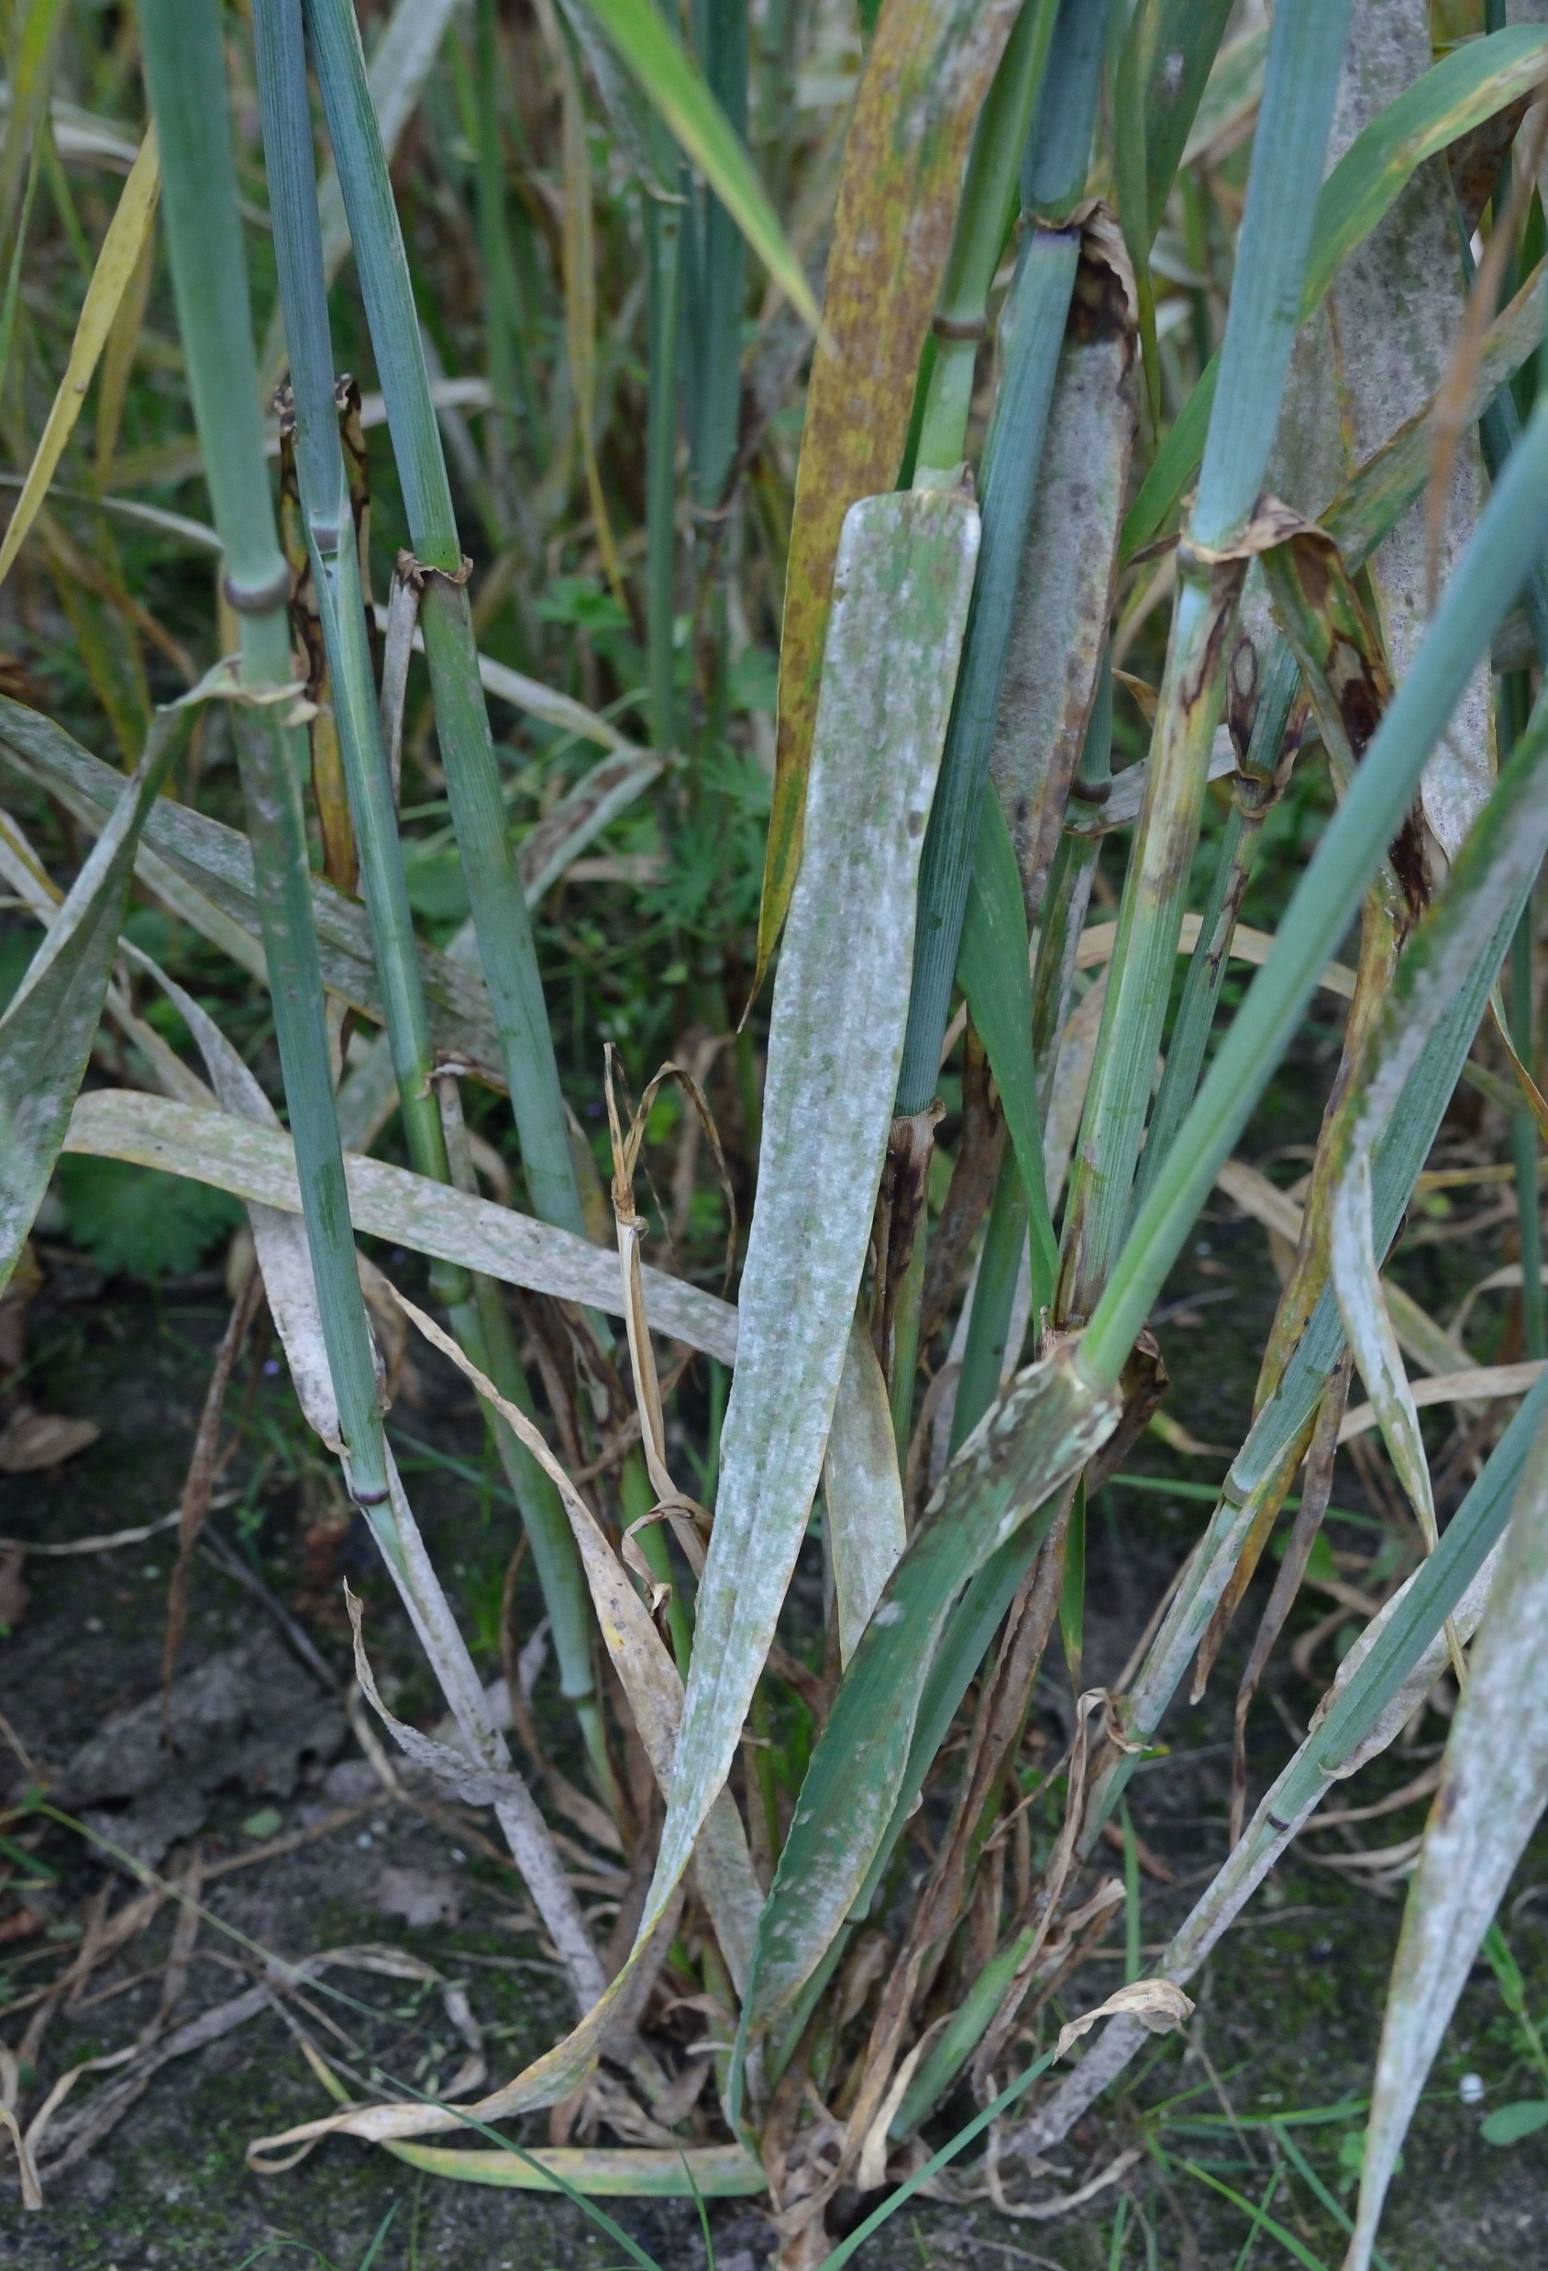
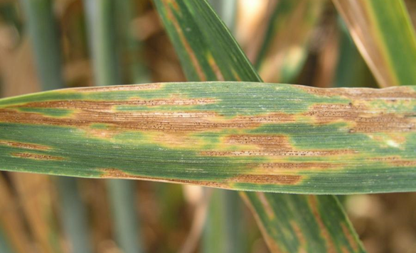
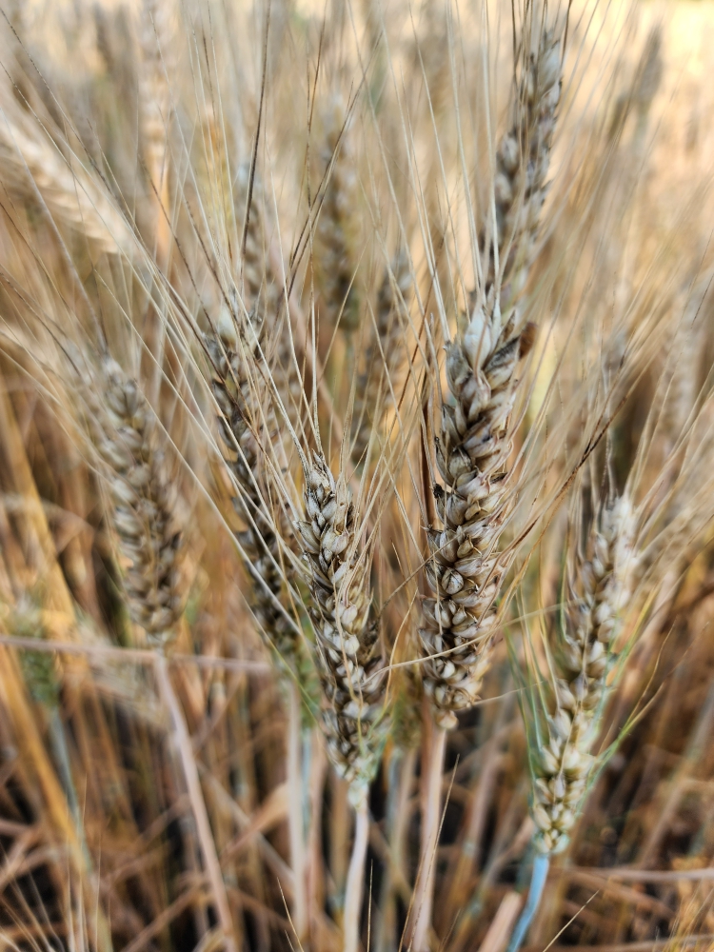
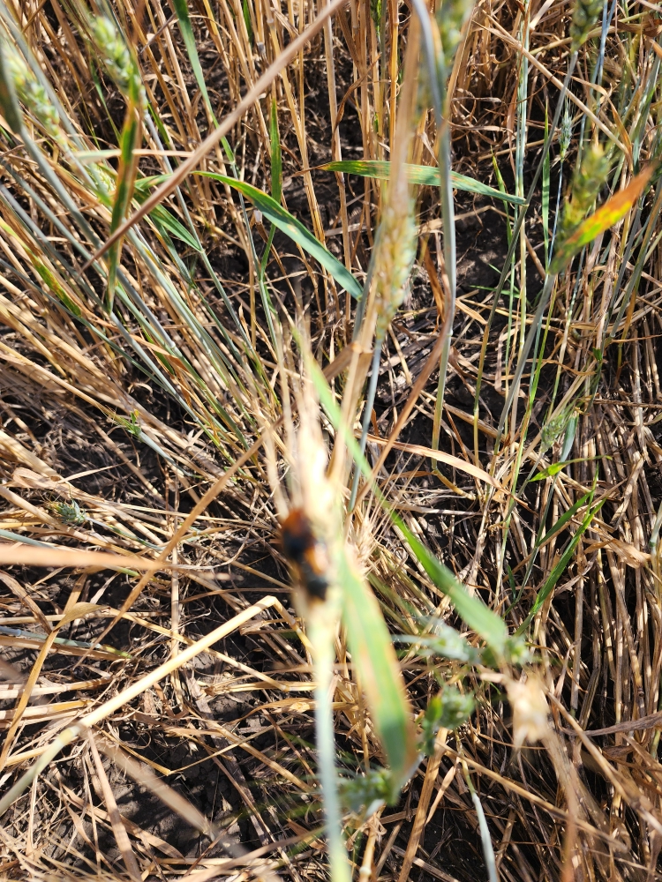
TESTING THE BIOLOGICAL EFFICIENCY OF SOME NEW PHYTOSANITARY
PRODUCTS TO COMBAT WINTER WHEAT DISEASES
1,2 Alexei BIVOL, 1 Sergiu BADARAU, 3 Natalia CÎRLIG, 3 Elena IURCU-STRĂISTARU
1Technical University of Moldova, 42 Mircesti str., 2 Moldova State University, Institute of Zoology, 1 Academiei str.
3 Moldova State University, “Alexandru Ciubotaru” National Botanical Garden (Institute), 18 Padurii str.
iurcuelenastraistaru@gmail.com
Actuality. Thats why the aim and objectives presented in the this work focus on the research-testing of new fungicides effective in combating the complex of invasive diseases. The purpose of the work are phytopathological research related to the state testing of new preparations with fungicidal action in combating the most dangerous diseases affecting the autumn wheat crop in the Republic of Moldova.
Results. We made a test program of presentation of the phytopathological aspects regarding the diseases specific to the winter wheat crop and determination the frequency of the degree of attack and the intensity of the attack of the main infectious diseases for fungicidal preparations: Binazol 300, SC, Lot no. 6, WG and F2024-azodiph, SC. In the case of preparations with fungicidal action Binazol 300, SC in combating powdery mildew - Erysiphe graminis, brown rust - Puccinia recondita, septoria-Septoria tritici and helminthsporiosis - Dreschlera tritici - repentis, Lot no. 6, WG against powdery mildew - Erysiphe graminis and helmintosporiosis - Dreschlera tritici-repentis and F-2024-azodif, SC in combating powdery mildew - Erysiphe graminis, brown rust - Puccinia recondita, septoriosis - Septoria tritici and helmintosporiosis - Pyrenophora tritici-repentis.
Conclusions. Following the analysis regarding the efficiency of these preparations, we conclude that the tested new preparations are recommended for approval against tested agents, in the following doses and tested variants: Binazol 300 SC - 1.0 l/ha, F2024-azodif - 0.7 l/ha, Lot no. 6, WG - 0.2 kg/ha, with the administration of two treatments in one vegetation period.
Figure 1. Comparative chart showing the ecological efficacy of the newly tested product Binazol 300 SC, compared to the untreated control and the reference standard.
Figure 2. Experimental plot for testing new fungicides with treatments at the "Vatra-Răzășească" Agricultural Production Cooperative, Ialoveni District, 2025.
Figure 3. Puccinia recondita, Septoria graminum, Erysiphe graminis, Dreschlera tritici – repentis, Fuzarium graminearum

