Slide 1


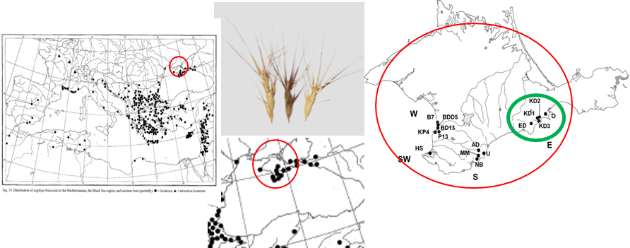
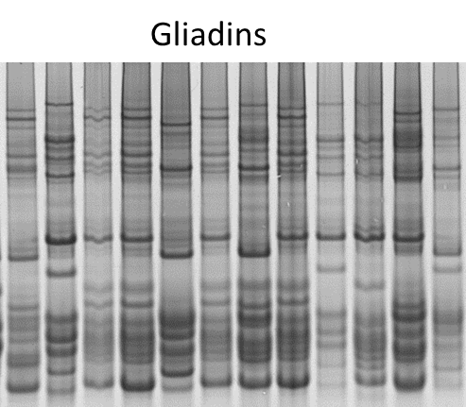
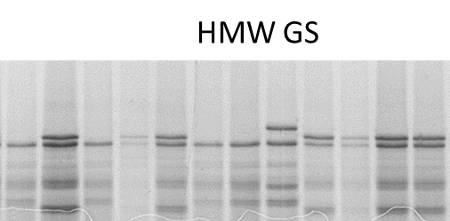
GENETIC DIVERSITY OF AEGILOPS BIUNCIALIS POPULATIONS BASED ON PROLAMIN MARKERS
Kozub Natalia^{1,2*}, Sozinov Igor², Pirko Yaroslav¹, Rabokon Anastasia¹, Sozinova Oksana^{1,2}, Spivak Svitlana¹, Blume Rostyslav¹, Sakharova Vladyslava¹, Karelov Anatolii¹, Blume Yaroslav¹
¹Institute of Plant Protection NAAS of Ukraine, Kyiv, Ukraine; ²Institute of Food Biotechnology and Genomics NAS of Ukraine, Kyiv, Ukraine; *E-mail: natalkozub@gmail.com
Aegilops biuncialis Vis. (UUM^{b}M^{b}) can serve as an indicator species for the Southern Coast zone of the Crimean Peninsula, and indices of its genetic diversity can be used for monitoring the state of populations and their changes caused by climatic or anthropogenic factors.
The aim of the research was to evaluate the genetic diversity of Ukrainian populations of Ae. biuncialis as of 2014, in particular, in the Eastern portion of the species range on the Crimean peninsula, using prolamin loci as genetic markers.
Number of alleles (Na), effective number of alleles (Ne), observed heterozygosity (Ho) and genetic diversity according to Nei (He) in Ae. biuncialis populations from the Eastern part of the Crimean peninsula (mean for 4 loci)
Results. There were 5-9 alleles at Gli-U1, 3-5 at Gli-M^{b}1, 1-4 at Glu-U1, and 3-5 at Glu-M^{b}1, depending on the population. The effective number of alleles was, on average, 2.4. Observed heterozygosity Ho ranged from 0 to 0.054 with the mean value of 0.017. The populations showed the medium level of genetic diversity, except for one Kara-Dag population, which showed a low level (0,174). The genetic diversity index He for the Eastern part of the species range was 0.496, and the prevailing alleles were a, d, j at Gli-U1, a at Gli-M^{b}1, b at Glu-U1, amd a at Glu-M^{b}1.
Materials and Methods. In the period prior to 2014, we collected plant material (spikes) from different natural populations of Ae. biuncialis on the Crimean Peninsula. Gliadin and high-molecular–weight glutenin subunit (HMW GS) alleles were used as genetic markers. We analyzed 1 seed per spike from five Ae. biuncialis populations (from Kara-Dag (3 populations, KD1, KD2, KD3), Echky-Dag (ED), and Ordzhonikidze (O)) (depicted by the green oval on the map). Gliadins were analyzed by APAGE (Kozub et al. 2009) and HMW GSs, by SDS-electrophoresis (Laemmli, 1970). Alleles at the loci Gli-U1, Gli-M_{b}1, Glu-U1, and Glu-M^{b}1 were identified.
Population | Na | Ne | Ho | He
KD1 | 4.5 | 2.8 | 0.054 | 0.507
KD2 | 3.5 | 1.3 | 0.01 | 0.174
KD3 | 5.0 | 2.4 | 0.005 | 0.535
ED | 5.3 | 2.1 | 0.017 | 0.409
O | 4.0 | 2.7 | 0 | 0.543
Conclusions. The diversity indices based on prolamin allele analysis in the Ae. biuncialis samples in the populations from the Eastern portion of the species range on the Crimean peninsula can be used as a reference for future monitoring of the state of respective populations and their changes due to climatic or anthropogenic impacts.
Acknowledgments: This study was supported by the research project 2025.07/0348 “Investigation and conservation of diversity of Ukrainian populations of Aegilops biuncialis as an important source of useful genes for enriching the wheat gene pool” funded by NFDU.

