Slide 1


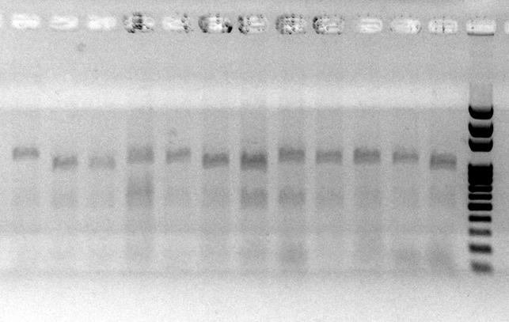
IDENTIFICATION OF RESISTANCE GENE Lr21 TO LEAF RUST IN WHEAT CULTIVARS AND LINES
Halyna Lisova^{1*}, ORCID 0000-0002-2045-4857
Liudmyla Velykozhon², ORCID 0000-0002-5935-9363
Bogdan Morgun², ORCID 0000-0001-7041-6894
¹Institute of Plant Protection, NAAS of Ukraine, Kyiv, Ukraine, E-mail: *mail_gl@ukr.net
²Institute of Cell Biology and Genetic Engineering, National Academy of Sciences of Ukraine, Kyiv, Ukraine
Aim of the Study was to determine the presence of the resistance gene Lr21 in wheat cultivars and lines using DNA markers.
Materials and Methods: The study used spring and winter samples from the wheat collection of the National Center for Plant Genetic Resources of Ukraine (V. Ya. Yuriev Plant Production Institute of the NAAS of Ukraine). To identify the Lr21 leaf rust resistance gene, polymerase chain reaction (PCR) was performed using primers Lr21D14-L (5´-CGC TTT TAC CGA GAT TGG TC-3’) and Lr21D14-R (5´-CCA FFG AGC ATC CAT GGT GR-3’) following a touchdown PCR protocol, with subsequent restriction analysis of the amplification products. The presence of an 885-bp amplicon corresponded to the Lr21 gene. Wheat resistance was evaluated according to Babayantz et al. (2014). Field studies were conducted during 2024–2025. An epiphytotic outbreak of leaf rust was recorded in 2025.
Results. Thirty-one cultivars and six wheat lines of diverse ecological and geographical origin were analyzed. Among the spring wheat genotypes, the Lr21 gene was identified in 10 cultivars, including ‘AC Cora’, ‘Amidon’, ‘Dandy’, ‘Vyshyvanka’, and ‘Memory’. The gene was also detected in four North American lines: KS93U1, KS93U194, KS93U61, and KS93U63. Evaluation of resistance of the identified Lr21 carriers to the local leaf rust population showed that cultivars ‘AC Cora’ and ‘Amidon’, as well as lines KS93U194, KS93U61, and KS93U63, exhibited high resistance, scoring 7–8–9 points. Under the severe leaf rust epidemic conditions of 2025, cultivars ‘Vyshyvanka’ and ‘Memory’ and line KS93U1 showed reduced resistance and were classified as slightly susceptible (5 points). Cultivar Dandy became susceptible, with a score of 3 points.
Conclusions. The resistance assessment results indicate that, in addition to the Lr21 gene, the genomes of cultivars ‘AC Cora’ and ‘Amidon’ and lines KS93U194, KS93U61, and KS93U63 may contain other effective leaf rust resistance genes. Further studies are required to identify these genes and determine their contribution to resistance.
1 2 3 4 5 6 7 8 9 10 К₁ К₂ М
Results of electrophoretic separation of wheat DNA amplification products after restriction to determine the Lr21 gene.
Lane numbers correspond to wheat DNA sample numbers; K1 – control (wheat not carrying the Lr21 gene); K2 – control (AC Cora wheat, carrying the Lr21 gene); M – DNA Ladder Mix molecular weight marker (Solis BioDyne); 1 - Pam’yati Maistrenka, 2 - AC Cora, 3 - Amidon, 4 - Dandy, 5 - Vyshyvanka, 6 - KS93UI, 7 - KS93U194, 8 - KS93U61, 9 - KS93U63, 10 - Memory.

