Slide 1


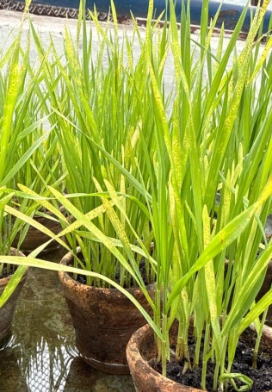
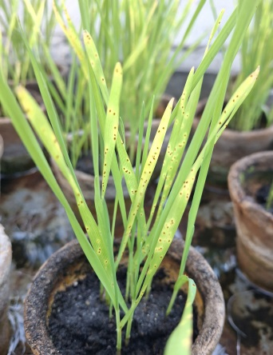
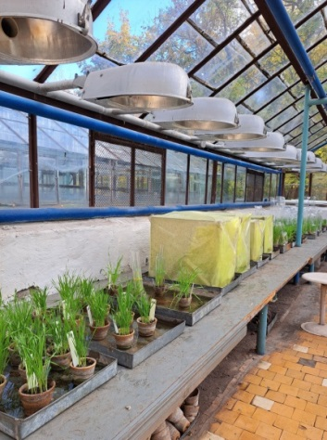
IDENTIFICATION OF SEEDLING RESISTANCE TO LEAF RUST IN EUROPEAN WINTER WHEAT CULTIVARS
Halyna Lisova, ORCID 0000-0002-2045-4857, mail_gl@ukr.net
Svitlana Konovalova, ORCID 0009-0009-8234-9049
Institute of Plant Protection, National Academy of Agrarian Sciences of Ukraine, Kyiv, Ukraine
Aim of the Study was to determine seedling resistance in winter wheat cultivars of European origin against a leaf rust population typical of the Right-Bank Forest-Steppe zone of Ukraine.
Materials and Methods. The study included 18 winter wheat cultivars of European breeding obtained from the collection of the National Center for Plant Genetic Resources of Ukraine at the V. Ya. Yuriev Institute of Plant Production of the NAAS of Ukraine. The Ukrainian cultivar Podolianka was used as a susceptible control. Seeds were grown under greenhouse conditions until the second-leaf stage. Inoculation was carried out using a mixture of the most prevalent and virulent races of leaf rust. Disease assessment was conducted 14 days after inoculation according to the E.B. Mains and H.S. Jackson scale, where 0 = immune, 0; = nearly immune, 1 = resistant, 2 = moderately resistant, X = heterogeneous, 3 = moderately susceptible, and 4 = susceptible.
Results. The control cultivar ‘Podolianka’ exhibited a susceptible reaction type of 4, indicating the absence of resistance to the most virulent leaf rust races. Among the evaluated cultivars, only ‘Semnal’(ROU) demonstrated immunity (reaction type 0). Cultivars ‘Voinik’ (ROU), ‘MV Mente’ (HUN), and ‘Futurum’ (DEU) expressed resistance at reaction type 1. A moderately resistant response (reaction type 2) was observed in cvs ‘Producent’(DEU), ‘Malibu’ (DEU), and ‘Evklid’ (FRA), suggesting the possible presence of effective seedling resistance genes in their genomes. Moderate susceptibility (reaction type 3) was recorded for ‘Pitar’ (ROU), ‘FGMUT293’ (ROU), ‘MV Kepe’ (HUN), ‘MV Bojtar’ (HUN), ‘Nordika’ (CZE), ‘Praktik’ (DEU), and ‘Matchball’ (FRA), indicating the absence of effective seedling resistance genes against the local pathogen population. Susceptibility (reaction type 3–4) to the most virulent races was observed in ‘Zamolxe’ (ROU), ‘Turanus’ (AUT), and ‘RGT Reform’ (FRA), which likewise lacked effective seedling resistance genes.
Conclusions. The study identified seedling resistance to leaf rust in seven winter wheat cultivars of European origin. These cultivars may serve as potential carriers of effective resistance genes against the local population of the leaf rust pathogen in the Right-Bank Forest-Steppe zone of Ukraine. Further research is required to identify and develop molecular markers for these resistance genes.

