Slide 1
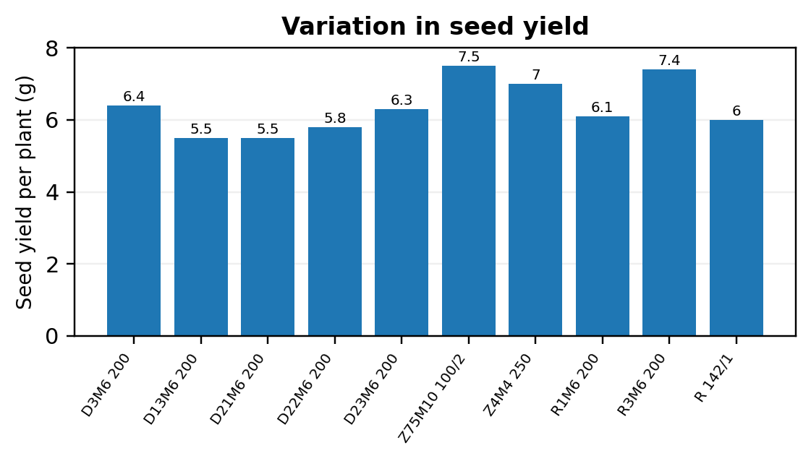
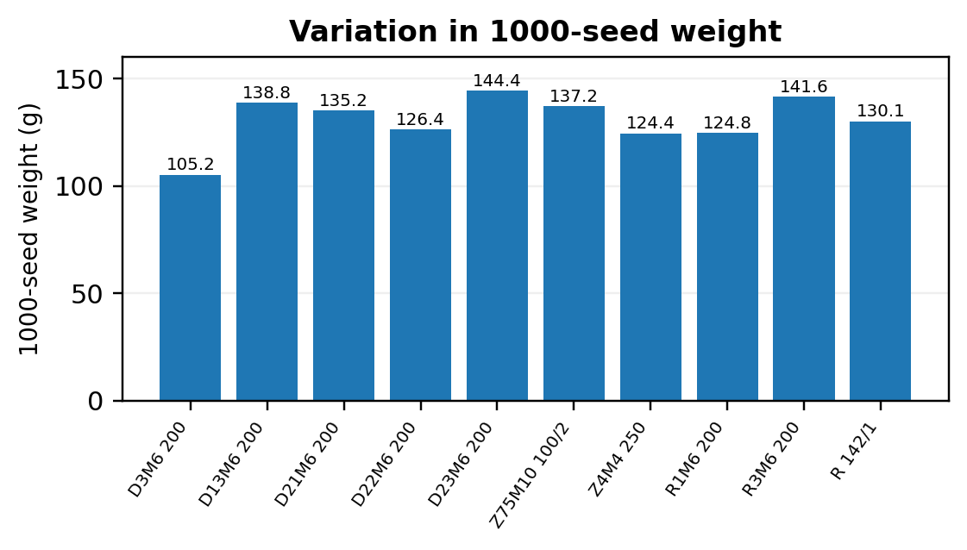
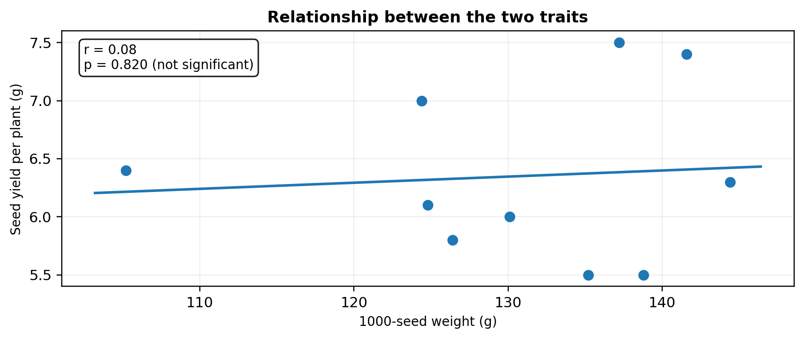
RELATIONSHIP BETWEEN SEED YIELD AND 1000-SEED WEIGHT IN MUTANT SOYBEAN GENOTYPES
Malii Aliona
Institute of Genetics, Physiology and Plant Protection, Moldova State University, Chișinău, Republic of Moldova • aliona.malii@sti.usm.md
AIM OF THE STUDY
To evaluate the relationship between seed yield per plant and 1000-seed weight in soybean mutant genotypes under field conditions.
MATERIALS AND METHODS
• Field experiment conducted in 2025 at the experimental fields of the Institute of Genetics, Physiology and Plant Protection, MSU.
• Biological material: 10 soybean genotypes obtained through X-ray-induced mutagenesis.
• Generation evaluated: M5.
• Traits evaluated: seed yield per plant and 1000-seed weight.
• Pearson correlation analysis was used.
RESULTS
CONCLUSIONS
• 1000-seed weight should not be considered the sole selection criterion for soybean productivity.
• Selection for seed yield and seed weight should be performed differentially according to genotype.
• The observed variability provides opportunities for identifying promising genotypes and broadening the genetic diversity of soybean breeding material.
p = 0.820 • n.s.
KEY FINDING
r = 0.08
p = 0.820 (not significant)
INTERPRETATION
The two traits showed relative independence across the analyzed mutant genotypes.
ACKNOWLEDGMENTS
Research conducted within subprogram 011102 “Expansion and conservation of genetic diversity and improvement of agricultural crop gene pools in the context of climate change” (2024–2027).
Keywords: soybean, mutagenesis, X-rays, seed yield, genetic variability
Observed ranges: seed yield 5.5–7.5 g; 1000-seed weight 105.2–144.4 g

