Slide 1
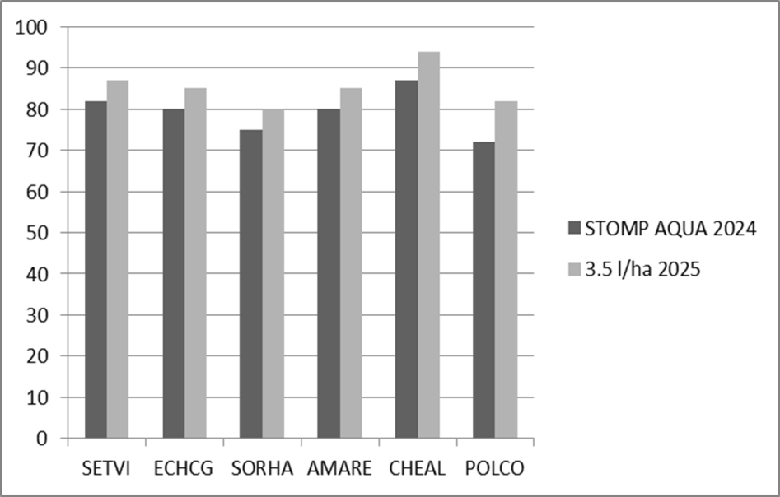
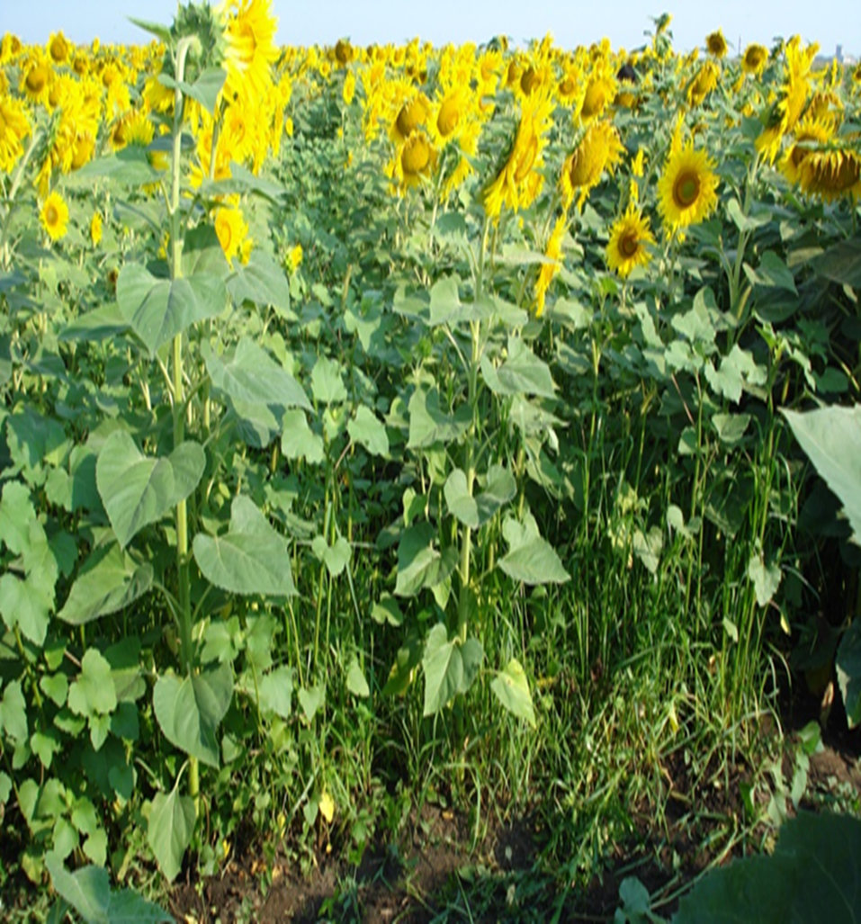
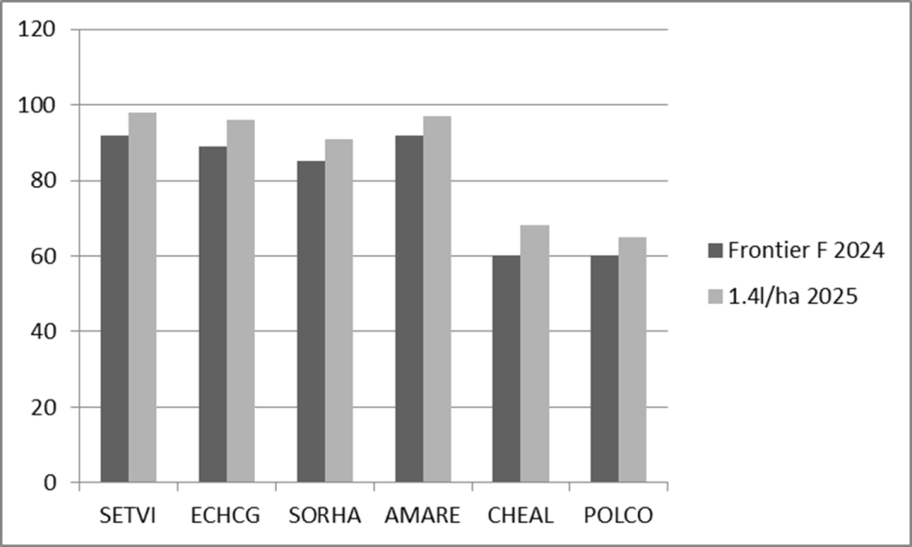
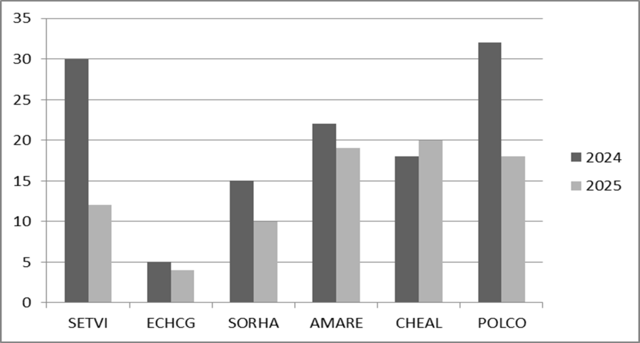
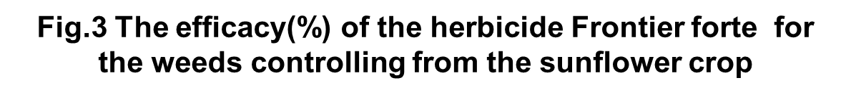
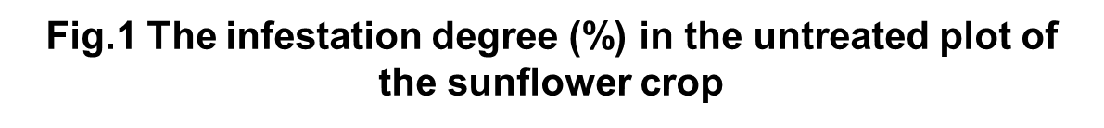
Optimization of chemical methods for weed control in sunflower crops under the pedoclimatic conditions FROM Fundulea
CERGAN MIHAELA, MĂTURARU GHEORGHE
National Agricultural Research and Development Institute Fundulea, 915200 Fundulea, Călăraşi County, Romania
Email:erbicide.incda@yahoo.com
Keywords: sunflower, weed species, infestation degree, herbicides
INTRODUCTION
Sunflower (Helianthus annus), a species with a slow growth rate in the first phenophases and a reduced capacity for competition, is strongly affected by weeds, which can lead to significant production losses. Agricultural damage caused by weeds is manifested on production at a quantitative and qualitative level and, last but not least, on the costs of applying the recommended technologies.
Agricultural damage caused by weeds is manifested on production at a quantitative and qualitative level and, last but not least, on the costs of applying the recommended technologies
In the field,the main objective is to permanently eliminate weed competition below the damage threshold throughout the growing season, in order to reduce water and nutrient consumption by them, so that plants continue to grow culture to have a normal development, which will lead, in the end, to obtaining high yields, qualitative and at the level of the biological potential of the hybrids (Popescu, 2007).
The segetal flora is very diverse and numerous, through the numerical ratio of weed species present and especially the numerous combinations between the various biological groups.
Materials and Methods
The sunflower crop presents a high and different degree of infestation (75%) with characteristic species, depending on the location area, the applied technological links and the preceding plant. The cause of the appearance of different weed species is correlated with climatic aspects, with the seed reserve in the soil and with the low power of the plant to compete. The segetal flora is very diverse and numerous, through the numerical ratio of weed species present and especially the numerous combinations between the various biological groups. This variety is explained by the diversity of pedoclimatic conditions existing in the areas where this crop plant is cultivated (Anghel et al., 1972)
Results and Discussions
In the figure 2 shows the average effectiveness results recorded after the preemergence application of the herbicide treatment with Stomp Aqua (3,5l/ha).Stomp Aqua (pendimethalin 455 g/L) is a pre-emergence herbicide, the weeds die immediately after germination or emergence, thereby being eliminated from competition at an early stage. It ensures effective control of annual grasses and certain susceptible broad-leaved weeds, giving the sunflower crop a clean start to the growing season.
The efficacy results obtained after the application of the treatment show a good control effect 85-76% for Setaria viridis,Echinochloa crus-galli and Sorghum halepense. Following the application of this treatment, the control level for annual dicotyledonous weeds ranged from 91%-77% (CHEAL, AMARE and POLCO).
The next variant (figure 3) treated was with the herbicide Frontier forte(1,4l/ha,dimethenamid-P) herbicide designed for pre-emergence soil application. Following application, the active substance is absorbed through the weed coleoptiles, while the radicles take up only very small amounts.
The efficacy results obtained after the application of the treatment show a good control effect 95-88% for Setaria viridis, Echinochloa crus-galli and Sorghum halepense.
Following the application of the treatment, the annual dicotyledon Amaranthus retroflexus showed an average control efficacy of 95%.The control level for the other two annual weed species, Chenopodium album and Polygonum convolvulus, was significantly lower, at 64% and 63%.
The crop has a diverse weed infestation level with monocotyledonous and dicotyledonous weeds.The causes of the appearance of different weed species are correlated with the zonal climatic conditions, the seed reserve in the soil and the competition between the plant and the weed.
In pedoclimatic conditions specific to the area of ​​NARDI - Fundulea, the sunflower cultivation presents high weed infestation, a weed spectrum and a specific dominance. The study and control of weeds is an important research direction, as they cause damage that can affect production by up to 35% - 70%. Weeds are unwanted plants that grow on agricultural land, causing significant damage that results in reduced yields, reduced quality, and increased production costs.
The experience of sunflower crop realized in the experimental field showed an infestation degree of 75%, in the crop being present the weeds extremely diversified, depending on: the pre-emergent plant, the local pedo-climatic conditions(cambic chernoseum,3.2%OM;37% clay; Ph -6.5)
The most representative weed species were Setaria viridis, Echinochloa crus gali, Sorghum halepense, Amaranthus retroflexus, Chenopodium album and Polygonum convolvulus.(Fig.1).
Fig.2 The efficacy(%) of the herbicide Stomp Aqua for
the weeds controlling from the sunflower crop
Conclusions
The sunflower crop presents a high level of infestation annually, with characteristic species. The causes of the appearance of different weed species are correlated with: zonal climatic conditions,the seed reserve in the soil; competition between the plant and the weed.
In the untreated plots, the precipitation favors the emergence and growth of weeds to the detriment of sunflower plants.
Pre-emergence herbicide treatments (sunflower,BBCH-00) demonstrated good control, highlighting their economic efficiency through a single application

