Slide 1


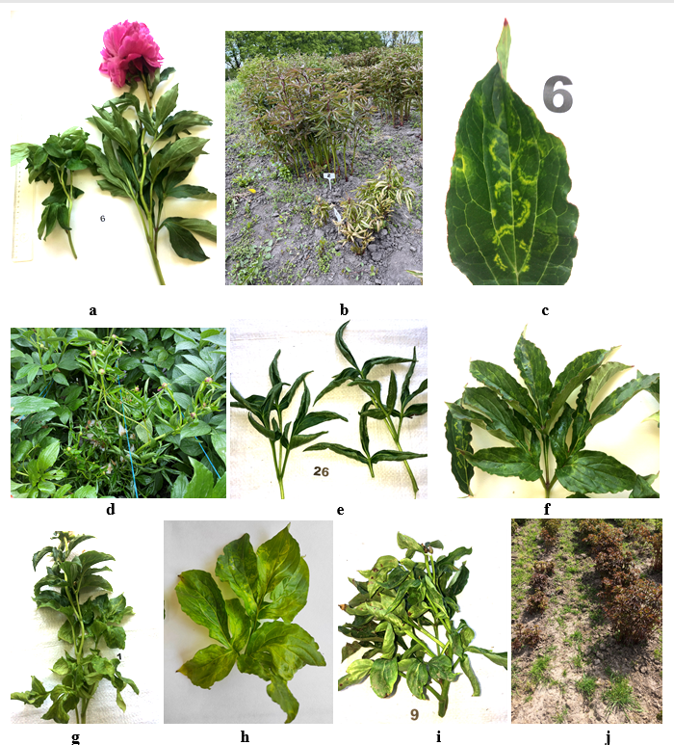
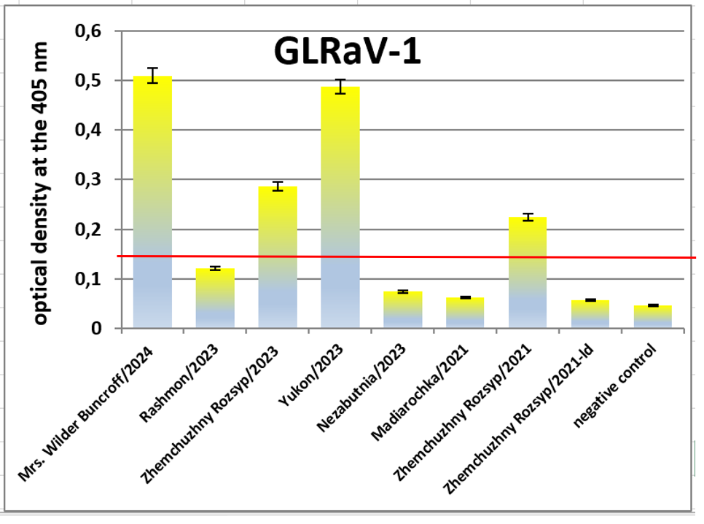
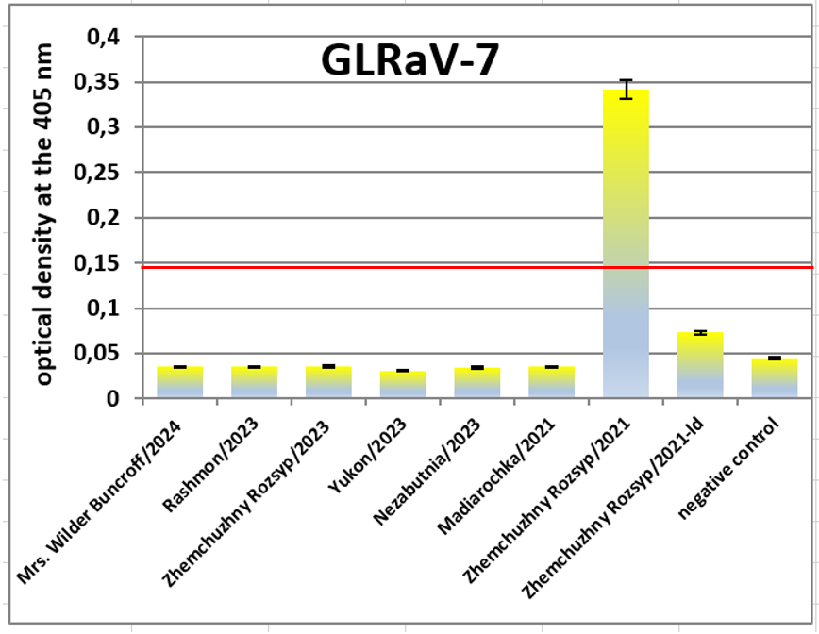
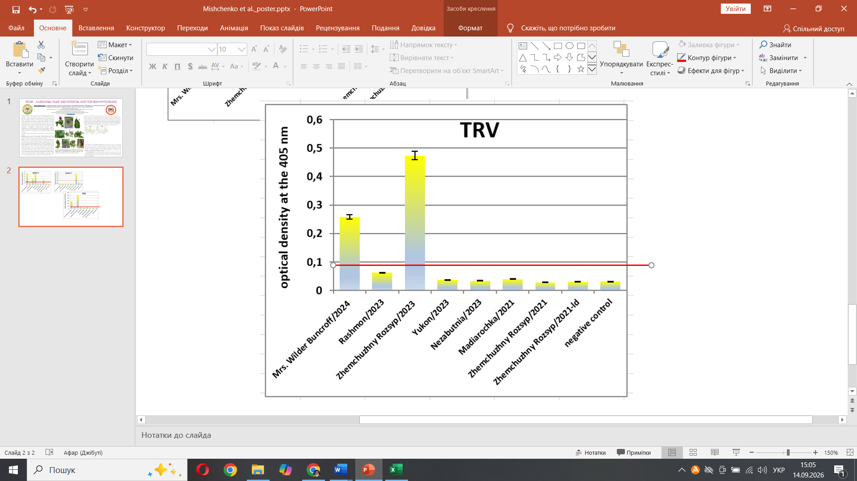
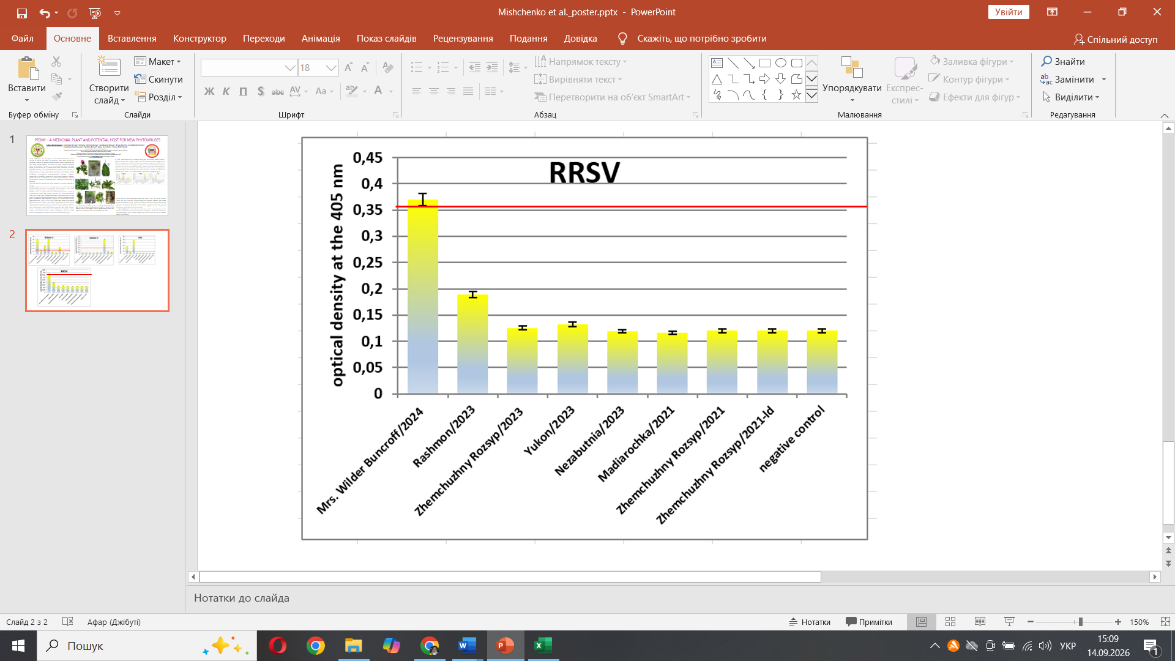
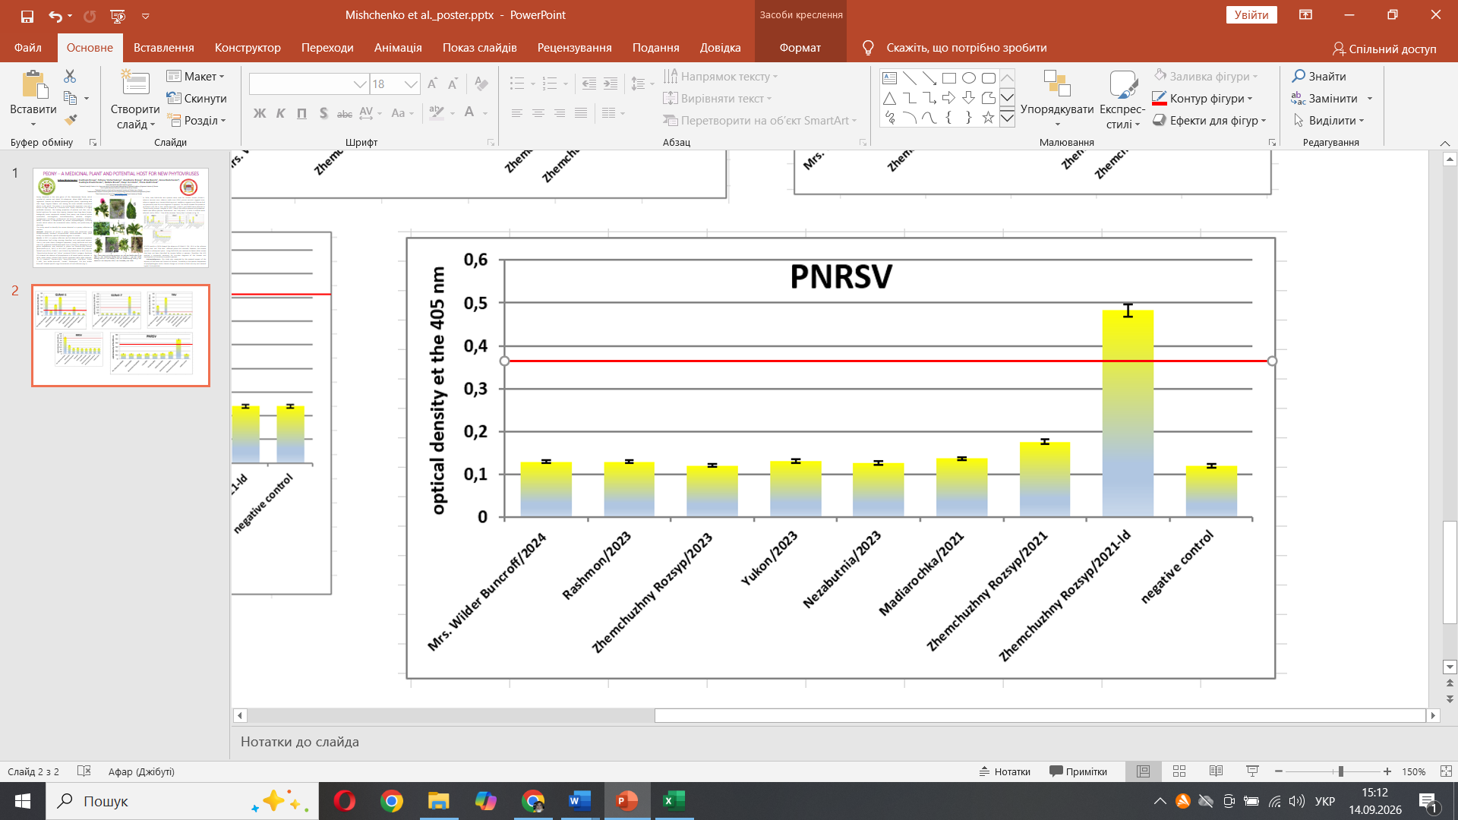
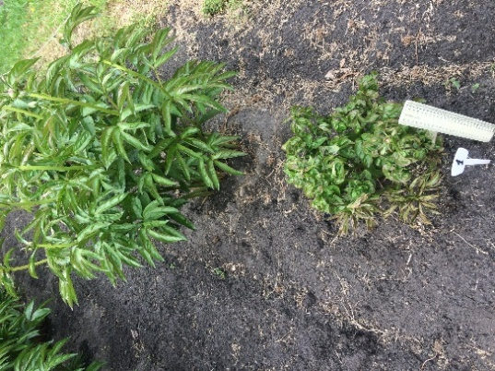
Peony – a Medicinal Plant and Potential Host for NEW Phytoviruses
Lidiya Mishchenko¹, Liudmyla Коnup², Tetiana Shcherbakova³, Anastasiia Konup², Alina Dunich¹, Anna Dashchenko⁴,
Liudmyla Hlushchenko⁵, Natalia Kozub⁶, Vasyl Gorobets³, Olena Andriichuk¹
¹Taras Shevchenko National University of Kyiv, Ukraine
²National Scientific Centre «V.Ye. Tairov Institute of Viticulture and Winemaking», National Academy of Agrarian Sciences of Ukraine
³M.M.Gryshko National Botanical Garden, National Academy of Sciences of Ukraine
⁴National University of Life and Environmental Sciences of Ukraine, Kyiv, Ukraine
⁵Medicinal Plant Research Station of the Institute of Agroecology and Environmental Management of NAAS, Ukraine
⁶Plant Protection Institute, National Academy of Agrarian Sciences of Ukraine
E-mail: lmishchenko@ukr.net
Peony (Paeonia) is the only genus of the Paeoniaceae family, which includes 41 species and about 20 subspecies. About 8000 cultivars are registered. Peonies are beloved perennial garden plants, captivating with their large, fragrant flowers, and among the most valuable ornamental plants in the world. The peony is an economically important crop and a source of high income on a minimal area. Peony cultivation is a highly profitable business. The healing properties of peonies and their use in herbal medicine for more than twenty diseases have long been known. Biologically active compounds isolated from peony raw material exhibit antioxidant, anticoagulant, anti-inflammatory, sedative, analgesic, hypoglycemic, antiallergic, antibacterial, and antiviral properties. However, peony cultivation is complicated by various phytopathogens, including viruses, which reduce the ornamental value, viability, and productivity of plantings.
This study aimed to identify the viruses detected in a peony collection in Ukraine.
Methods. Detection of viruses in peony leaves was performed using double-antibody sandwich enzyme-linked immunosorbent assay (DAS-ELISA). For DAS-ELISA, specific antibodies against 11 viruses.
Results. In 2021, in a peony collection, we first observed severe symptoms of deformation, leaf curling, stunting, dwarfism, and rarely weak mosaics. That is, not quite classic virological symptoms. Using DAS-ELISA and real-time PCR, grapevine leafroll-associated virus 3 (GLRaV-3), belonging to the genus Ampelovirus, was detected in plants var.´Zhemchuzhny Rozsyp´ (Mishchenko et al., 2022). In 2021-2022, plants were tested for grapevine fanleaf virus (GFLV), GLRaV-1, and GLRaV-3 by DAS-ELISA. In 2023, the var. ´Zhemchuzhna Rozsyp´ and ´Yukon´ contained GLRaV-1 antigens. Real-time PCR showed the absence of phytoplasmas in all tested peony varieties. In 2024, seven peony cultivars with similar symptoms were again selected: ´Mr. G.F. Hemerik´, ´Sonoma YeDo´, ´Mary Eddy Jones´, ´Judy Anne´, ´Edwin C. Bills´, ´Mrs. Wilder Buncroft´, ´Lorelei´, ´Skarbnytsia´. The ´Mrs. Wilder Buncroft´ showed specific rings characteristic of viral infection (Fig.1).
In 2024, new DAS-ELISA test systems were used for various viruses (GLRaV-7, tobacco necrosis virus, tobacco rattle virus (TRV), prunus necrotic ringspot virus, tobacco ringspot virus, tomato black ring virus, raspberry ringspot virus) that we had not previously used for virus diagnostics in peonies. The results showed the presence of GLRaV-1 and TRV in ´Mrs. Wilder Buncroft´. GLRaV-7 and PNRSV were detected in ´Zhemchuzhny Rozsyp´ samples in 2021. PNRSV also affects peonies and grapevine. PNRSV also affects peonies ´Rashoomon´ and ´Judy Anne´ (Fig.2). In 2025, 9 cultivars were selected, and in 7 varieties were sampled in 2026. One of the varieties ´Henry Sass´ is shown in Fig. 1h.
Fig.2. Detection of viruses in peony plants by DAS-ELISA
RT-PCR results in 2026 showed the absence of GLRaV-3, TRV, and GFLV in the cultivars ´Henry Sass´ and ´Elsa Sass´. Affected plants are removed; however, the disease spreads in subsequent years.
Conclusions. Using DAS-ELISA, we have detected other viruses in peonies that have not been described previously. Therefore, the HTS method is extremely necessary for accurate diagnosis of the disease and development of measures to protect peonies.
Acknowledgments: This study was supported by the research project of the Ministry of Education and Science of Ukraine, ‘Variability in the species composition of phytopathogens under climate change as a threat to food security and national health’ 0125U002320
Fig. 1. Peony plants with disease symptoms: var. Judy Ann (healthy plant at the right); b – var. Nezabutnia (healthy plant at the left); c – var. Mrs. Wilder Buncroff, 2025; d,e – var. Polonez; f – var. Mrs. Wilder Buncroff, 2024; g, – var. Hemerik; h – var. Henry Sass, 2026; i – var. Gismonda; j –var. Yukon

