Slide 1


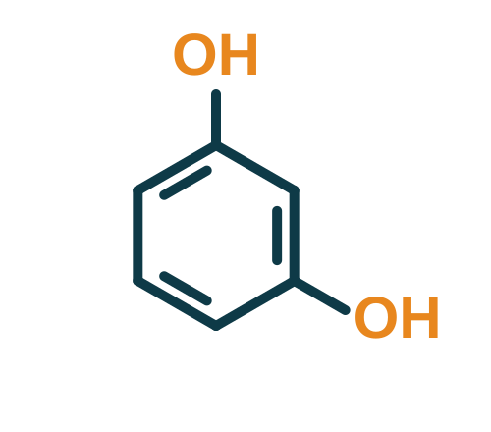


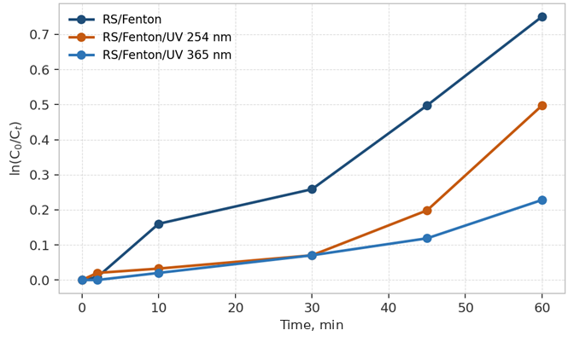







Faculty of Chemistry and Chemical Technology
FENTON OXIDATION OF RESORCINOL IN AQUEOUS SOLUTION. EFFECT OF INITIAL SUBSTRATE CONCENTRATION
MOLDOVA STATE UNIVERSITY
Larisa MOCANU (ORCID: 0000-0003-3306-5292) Maria GONȚA (ORCID: 0000-0003-3476-0967)
Laboratory of Physical and Quantum Chemistry, Institute of Chemistry, Moldova State University, Chisinau, Republic of Moldova | larisamocanu@usm.md
Aim of the Study
Results
Why is resorcinol (RS) studied in the Republic of Moldova?
RS concentration decreased over time at all [RS]₀, confirming effective Fenton degradation. The highest degradation efficiency was achieved at the lowest [RS]₀ :
Potential endocrine disruptor
0.1 mg/L
Toxic to the cardiovascular/ nervous system
NTPA-001: discharge into natural receivers
Persistent
30 mg/L
57.6%
91.2%
82–91%
Must meet discharge limits →
NTPA-002: discharge into sewer networks
Stage 1:
Fenton oxidation, 60 min
Stage 2:
activated carbon adsorption
COD reduction at all tested [RS]₀
Aim: to evaluate the effect of [RS]₀ on its Fenton degradation and to find the optimal substrate concentration.
[RS]₀ increased to 9.08·10⁻⁴ M → degradation (%) decreased, while the absolute mass of RS removed increased
Fig. 1. Kinetic plots ln(C₀/C_{t}) vs. time for RS degradation by Fenton and Fenton/UV (254 nm and 365 nm) processes.
Materials and Methods
Optimal substrate concentration: [RS]₀ = 2.27·10⁻⁴ M
Stage 1: Fenton oxidation (batch, 60 min, 22 °C)
Fe²⁺ + H₂O₂ → Fe³⁺ + •OH + OH⁻
Conclusions
Acknowledgments
[RS]₀ = (2.27–9.08)·10⁻⁴ M
pH = 2.5
[Fe²⁺]₀ = 1·10⁻⁵ M
[H₂O₂]₀ = 1·10⁻³ M
The initial substrate concentration significantly influences both degradation and mineralization efficiency.
This study was supported by the research project No. 010603, Advanced research in computational and ecological chemistry, identification of technological procedures for treatment, formation of water quality and quantity, funded by NARD.
Stage 2: adsorption on activated carbon
The lowest tested concentration gave the highest degradation rate under fixed Fenton reagent conditions.
Analysis: RS by UV/Vis at λ = 275 nm (T80+; R² = 0.9995); COD at λ = 600 nm (R² = 0.9998)
Kinetics: pseudo-first-order model; k (s⁻¹) and t_{1/2} (s) from ln(C₀/C_{t}) vs. t
Fenton oxidation can be applied to resorcinol-containing wastewaters; an optimized [RS]₀ enhances removal and mineralization.
Keywords: phenol, wastewaters, Fenton processes, advanced oxidation processes

