Slide 1
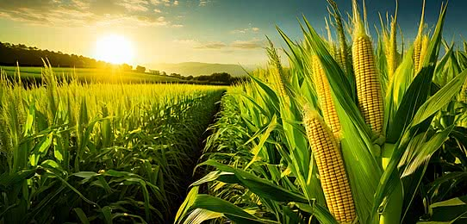
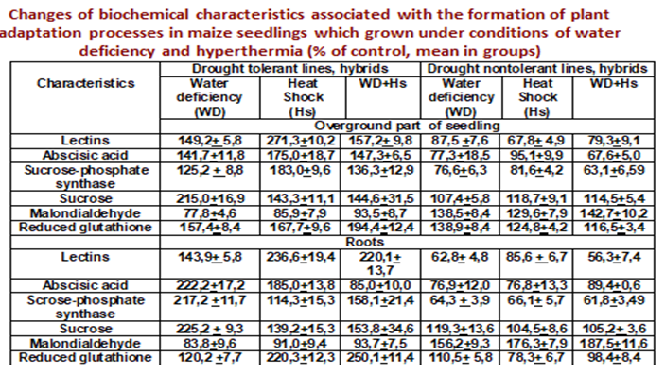
BIOCHEMICAL RESPONSES TO ABIOTIC ENVIRONMENTAL FACTORS IN CORN
Olga Molodchenkova¹, Lidiya Mishchenko²,
Olga Ryshchakova¹, Lidiya Bezkrovna¹
¹Plant Breeding and Genetics Institute-National Center of Seed and Cultivar Investigation
²Taras Shevchenko National University of Kyiv
The goal of the study is to characterize protective reactions in corn genotypes in response to water deficit and heat shock with the aim to identify biochemical traits of drought tolerance.
Materials and Methods. Three-day seedling of corn lines with different levels of drought tolerance were used in the research. They were let germinate on filter paper on a germination chamber at 25ºС at relative humidity 60%. Water deficit was created by placing the seedlings in the chamber with relative humidity 35-40%. Heat shock was created by placing the seedlings in the germination chamber at 37ºC. Stress factors were applied for 6 hours. We measured biochemical adaptive responses using spectrophotometry, protein electrophoresis, hemagglutination of trypsinized erythrocytes, gas chromatography.
Results. Activation of soluble lectins, sucrose-phosphate synthase, accumulation of abscisic acid, reduced glutathione and sucrose under water deficit and heat shock compared to the control in the seedlings of drought tolerant lines and reduce these characteristics in the seedlings of non-drought tolerant lines were shown.
Conclusions. These findings can be used to select drought-tolerant corn genotypes and implement them in breeding programs to create lines and hybrids with improved drought resilience.

