Slide 1

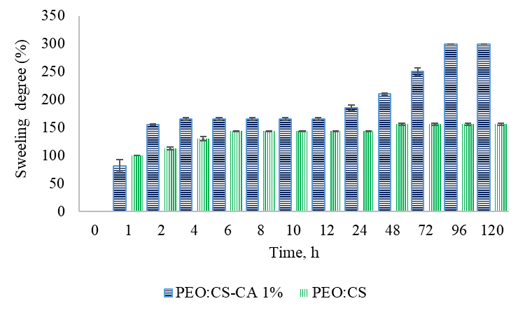
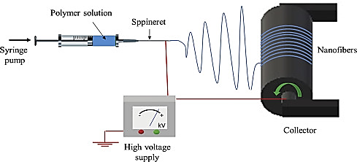
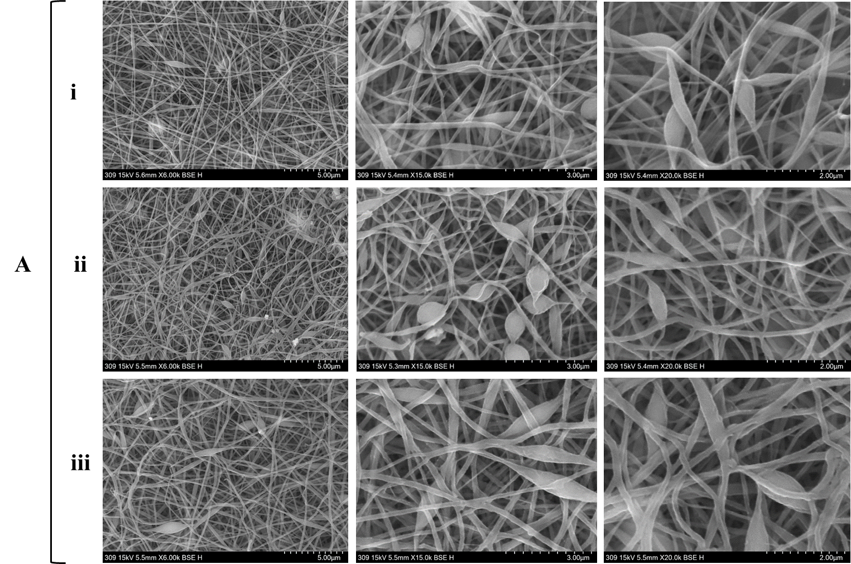
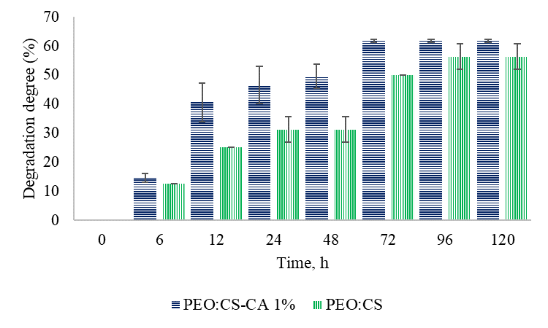
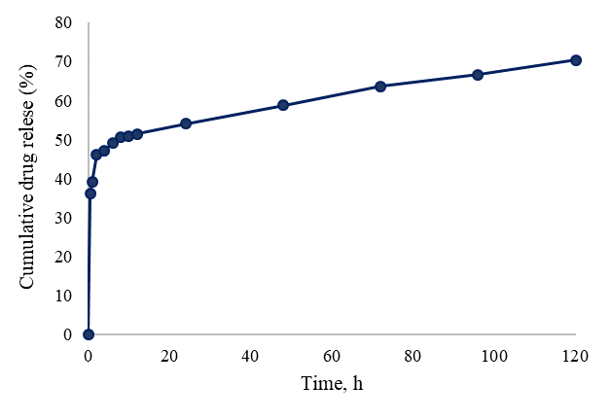
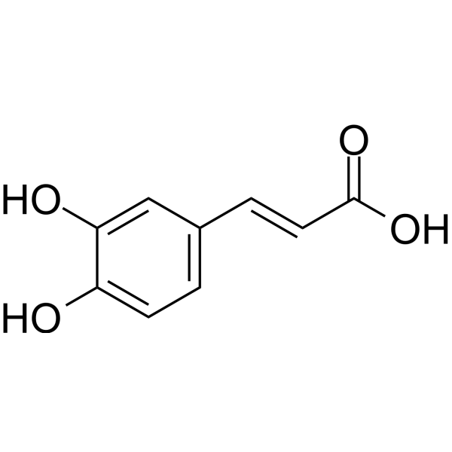
Results
NATURAL SCIENCES IN THE DIALOG OF GENERATIONS, IX EDITION
NATIONAL CONFERENCE WITH INTERNATIONAL PARTICIPATION September 21–22, 2026, Chisinau, Republic of Moldova
*Corresponding author:
C. Grigoras, PhD student
carolina.grigoras@usm.md
IN VITRO BEHAVIOR OF ELECTROSPUN PEO:CS MEMBRANES INCORPORATING CAFFEIC ACID
Grigoraș Carolina¹, Gonța Maria¹, Ghițman Jana²
¹Moldova State University ² Advanced Polymer Materials Group, National University of Science and Technology POLITEHNICA Bucharest
AIM OF THE STUDY
MATERIALS AND METHODS
RESULTS
The need to study the in vitro behavior of these electrospun membranes derives from the importance of evaluating the structural stability and their ability to release bioactive compounds in a controlled manner.
To achieve the proposed goal, electrospun membranes of the PEO:CS were prepared, with and without the incorporation of caffeic acid (PEO:CS and PEO:CS_CA (1%)).
Materials: PEO:CS blend (7:3), biologically active substance – caffeic acid.
a.
b.
CONCLUSIONS
Figure 1. Schematic representation of the electrospinning
process [Rafaela S. Andre, et.al., 2023, Mater. Dev.]
Electrospun membranes demonstrated fast initial release of the
loaded drug, which may contribute to effective bacterial growth
inhibition.
The immediate release phase is primarily due to drug molecules
located on or near the surface of the fibers.
The prolonged release is governed by gradual polymer matrix
degradation, ensuring continued drug availability over time.
The combined burst and sustained release behavior highlights
the membranes’ promise for biomedical applications requiring
infection control..
Assays: degree of swelling; degree of degradation;
cumulative release profile.
c.
Figure 2. Chemical structure of caffeic acid
Figure 3. In vitro behavior: a. sweelling degree;
b. degradation degree; c. cumulative drug release
Acknowledgments: This study was supported by the research project No. 010603.

