Slide 1


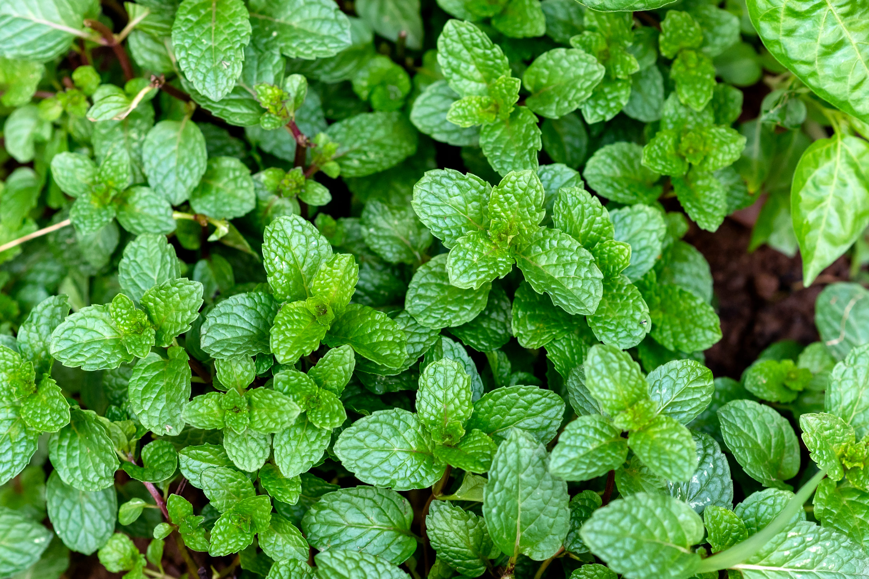
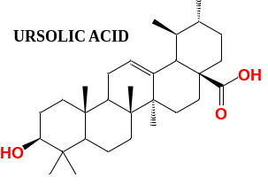
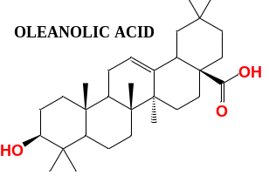
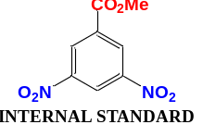
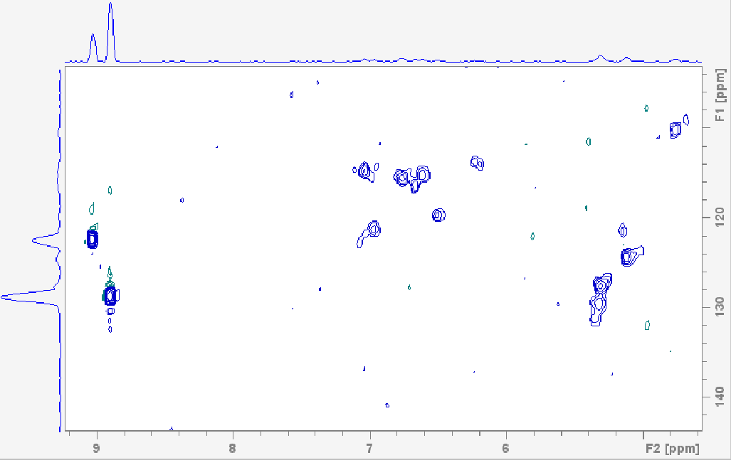
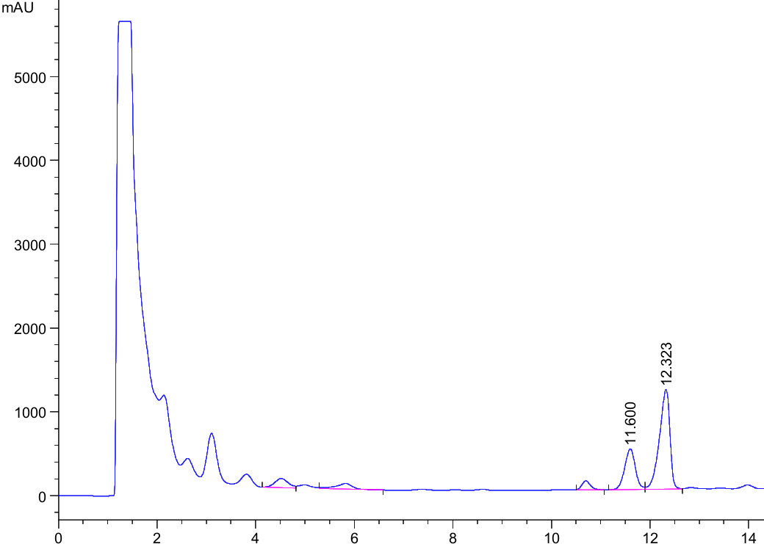
QUANTITATIVE DETERMINATION OF TRITERPENIC ACIDS IN MENTHA PIPERITA. A COMPARATIVE STUDY OF NMR AND HPLC
Gabriela Hahuleac¹, Adrian Topală¹, Marina Grinco¹, Zinaida Balmuș² , Veaceslav Kulcițki¹
INTRODUCTION
¹ Moldova State University, Institute of Chemistry, Chișinău, Republic of Moldova
2 Moldova State University, Institute of Genetics, Physiology and Plant Protection, Chisinau,Republic of Moldova
E-mail: topala.adrian@usm.md
Mentha piperita is an aromatic crop widely used in traditional medicine and valued as a rich source of biologically active compounds. Among these, triterpenic acids exhibit anti-inflammatory, antioxidant, anticancer, and antimicrobial activities. This study presents a 2D quantitative NMR method for the determination of ursolic and oleanolic acids in 10 Mentha varieties, with results compared to HPLC.
HSQC SPECTRUM MENTHA NISTRU-310 WITH INTERNAL STANDARD
Nr. | PLANT | TRITERPENIC ACID | w% OF ACID 2D-NMR | w% OF ACID HPLC
1 | Mentha Linaloolnaia | Ursolic acid | 6.6 | 6.2
 |  | Oleanolic acid | 4.1 | 2.2
2 | Mentha spicata | Ursolic acid | 8.2 | 17.1
 |  | Oleanolic acid | 2.9 | 3.2
3 | Mentha Karvonaia-20 | Ursolic acid | 8.3 | 6.3
 |  | Oleanolic acid | 3.2 | 0.6
4 | Mentha Nistru-310 | Ursolic acid | 20.1 | 18.9
 |  | Oleanolic acid | 8.2 | 3.5
5 | Mentha Usigen | Ursolic acid | 4.7 | 6.7
 |  | Oleanolic acid | 11.0 | 3.0
6 | Mentha Simferopolskaia-200 | Ursolic acid | 2.8 | 2.6
 |  | Oleanolic acid | 2.6 | 2.0
7 | Mentha MB-2 (Marea Britanie) | Ursolic acid | - | 1.1
 |  | Oleanolic acid | - | 0.4
8 | Mentha VNIIEMK | Ursolic acid | 3.2 | 2.3
 |  | Oleanolic acid | - | 1.5
9 | Mentha Crispa (România) | Ursolic acid | 5.8 | 1.1
 |  | Oleanolic acid | 2.8 | 0.8
10 | Mentha violeta | Ursolic acid | 3.5 | 1.1
 |  | Oleanolic acid | 3.4 | 1.0
IS
AO
HPLC CHROMATOGRAMS OF MENTHA NISTRU-310
AU
RESULTS AND CONCLUSION
UA
The content of triterpenic acids reached the highest value in the crude extract of variety Nistru 310, obtained in the Republic of Moldova. These results confirm the validity of the NMR method for the quantitative estimation of triterpenic acid content in Mentha extracts for various biomedical and industrial applications and demonstrate the high potential for the exploitation of anti-inflammatory and antioxidant agents from Mentha-related products.
Acknowledgments: This study was supported by the research project 010601 „Chemical study of secondary metabolites from local natural sources and exploitation of their application potential based on the expansion of molecular diversity with multiple functionality (MetNatVal)”, funded by the Ministry of Education and Research of the Republic of Moldova.
OA
EXPERIMENTAL
Plant extracts have been obtained using UAE with 96% aqueous ethanol. qNMR determination included HSQC experiments in optimized conditions while HPLC analysis has been performed on an Agilent 1100 chromatographic system equipped with a UV detector (210 nm) using a C18 column (150×4.6 mm, 3.5 μm) with a gradient elution with aqueous TFA-methanol mixtures.

