Slide 1

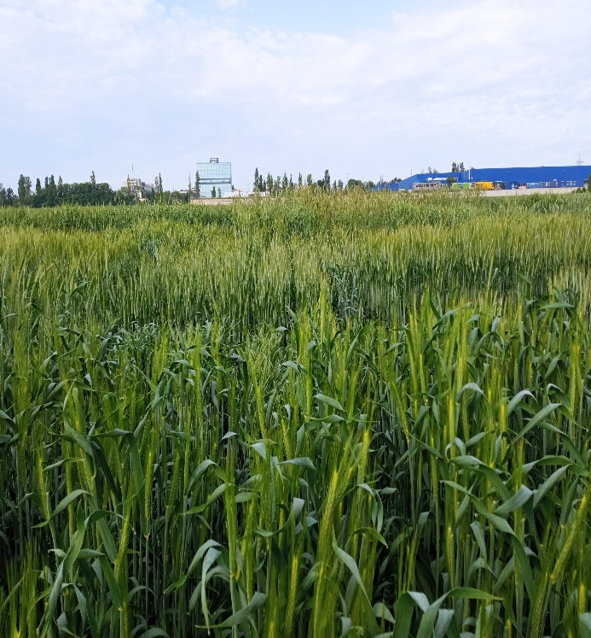
EVALUATION OF SPIKE PRODUCTIVITY ELEMENTS IN F2 WINTER TRITICALE HYBRIDS
Leatamborg Svetlana, Rotari Silvia, Gore Andrei
USM, Institute of Genetics, Physiology and Plant Protection, RM
e-mail:svetlana.leatamborg@sti.usm.md
Triticale is currently considered a crop capable of stabilizing the global harvest of feed and food grain. Triticale is highly adaptable, often producing higher yields than other grain crops, especially under unfavorable environmental conditions.
The goal is to create new triticale varieties that are productive, winter-hardy, drought-resistant, and well-adapted to agro-climatic conditions.
The F2 population was evaluated based on morphobiological traits (plant height, spike length, number of spikelets per spike, number of grains, grain weight and 1000-grain weight). The productivity elements were studied by the method of structural analysis of a sample consisting of 120 plants.
A study of the F2 population of the hybrid combinations studied revealed the average values ​​for spike length, spikelet number, grain number per spike, grain weight per spike, and 1000-grain weight: 13.3±0.2; 33.6±0.5; 79.9±2.4; 4.7±0.2; and 58.9±0.9, respectively. Variability in spike productivity traits among the studied F2 hybrids ranged from 4.0% to 15.5%. The degree and frequency of transgression in the best hybrid combinations by spike length varied within the range: Tg=1.2-12.4%, Tf=10-95%, by the number of spikelets – Tg=0.9-10.5%, Tf=5-75%, by the number of grains – Tg=3.8-10.9%, Tf=5-80%, by the weight of grains – Tg=7.8-18.8%, Tf=10-80%. Transgressive forms by the weight of 1000 grains were significantly less common. Calculation of the correlation coefficient revealed that the F2 hybrid populations exhibited the most pronounced positive correlation (0.81–0.93) between the traits grain number and grain weight.
This level of variation reflects the diversity of F2 hybrids and the ability to identify plants with a desired combination of traits for further selection of the most productive plants.
Counting positive transgressions in the F2 population demonstrates the importance of the genotypes involved in hybridization.
Since spike productivity was strongly correlated with the number of grains per spike, when breeding for high yield, it is important to select plants with a high grain content per spike, taking into account the 1000-grain weight.
As a result of studying and selecting hybrid combinations in F2 based on economically valuable traits, the best of them will be studied in the following generations.
The research was carried out within the Subprogram 011102 Extension and conservation of genetic diversity, improvement of gene pools of agricultural crops in the context of climate change

