Slide 1
SNP-BASED ASSESSMENT OF GENETIC DIVERSITY AND BREEDING RESOURCE IN FIG GERMPLASM
Qamar Qurbanova
Genetic Resources Institute of ARSEM, Baku, Azerbaijan
Chișinău, 2026

Slide 2

GENOMIC CHARACTERISTICS OF FICUS CARICA L.
One of the earliest domesticated plant
Chromosome number of 2n = 2x = 26
Wide morphological and genetic diversity
Genome size of approximately 333 Mb
A limited number of genomic studies

Slide 3

MOLECULAR SELECTION
Molecular breeding is a selection approach based on the use of genetic markers (ISSR, RAPD, SSR, etc.) and genomic information (GBS and whole-genome resequencing)
This approach enables the early identification of desirable traits using molecular genetic markers
ADVANTAGES
Accelerates the breeding process
Increases selection accuracy
Reduces the influence of environmental factors on trait selection

Slide 4
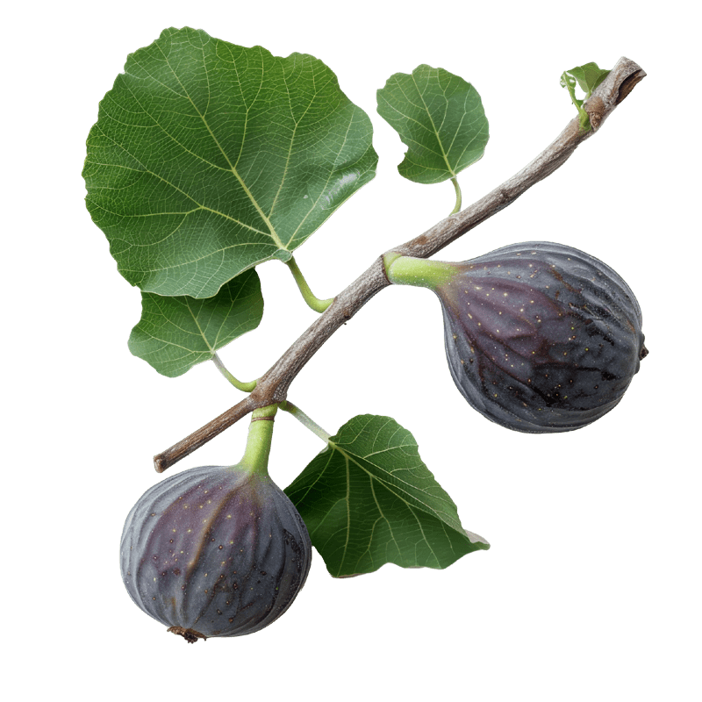
RESEARCH GAPS IN FIG GENETICS
Limited genomic research on fig genetic diversity
Insufficient information on genetic relationships and population structure
Lack of genomic information on wild fig genetic resources
Need for genomic data to support future fig breeding
OBJECTIVE
Assess genetic diversity, characterize the genetic distinctiveness and population structure of wild Hyrcanian figs, and investigate genetic relationships among local and globally cultivated fig varieties using SNP markers

Slide 5

MATERIALS AND METHODS
50 GENOTYPE
DNA EXTRACTION AND SEQUENCING
Genomic DNA extraction
DNA concentration and quality assessment
Sequencing library preparation
Sequencing
35 CULTIVATED
15 WILD
SNP CALLING AND POPULATION STRUCTURE ANALYSIS
Quality control & adapter trimming
Read alignment
SNP calling
SNP filtering
LD pruning
Final SNP dataset
Population structure (ADMIXTURE)
PCA
Genetic distance & NJ tree
FST & Reynolds’ distance
Genetic diversity (Ho, He, PIC, FIS)

Slide 6
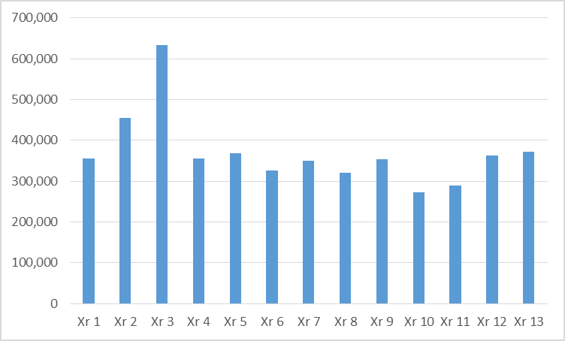
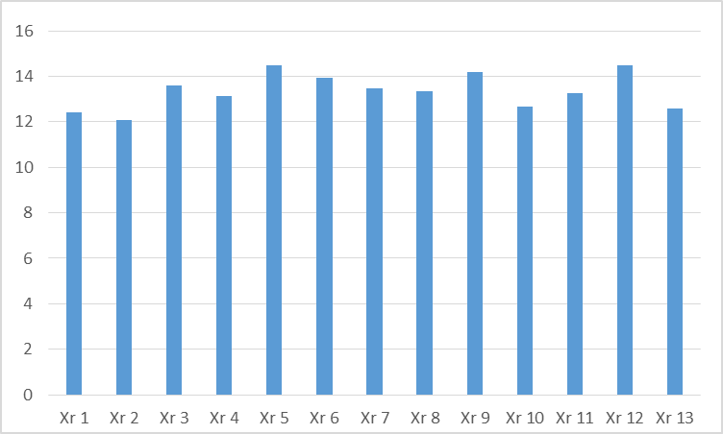
Number and density of SNPs across chromosomes

Slide 7
Transition | Number | Transversion | Number
C → T | 838959 | T → A | 368206
G → A | 838040 | A → T | 366973
T → C | 703096 | G → T | 210532
A → G | 702496 | C → A | 209100
 |  | T → G | 188684
 |  | A → C | 188305
 |  | G → C | 102418
 |  | C → G | 102147
Ts% | 64% | Tv% | 36%
Ts/Tv | 1.8

Slide 8
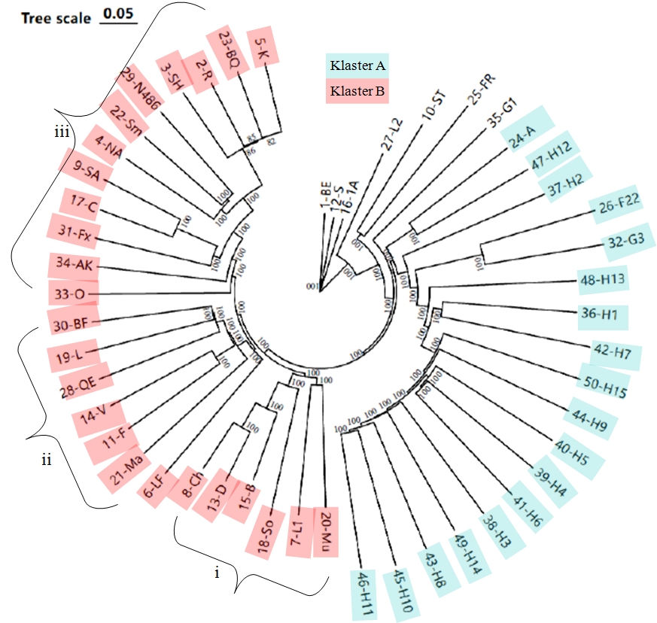
CLUSTER ANALYSIS
GD = 0,34
GD = 0.33
GD = 0,15-0,20

Slide 9
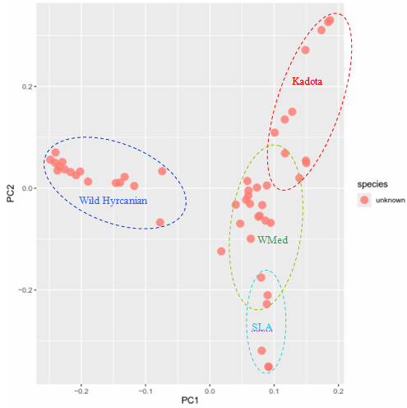
PRINCIPAL COMPONENT ANALYSIS

Slide 10
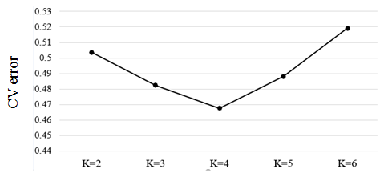
ADMIXTURE ANALYSIS

Slide 11
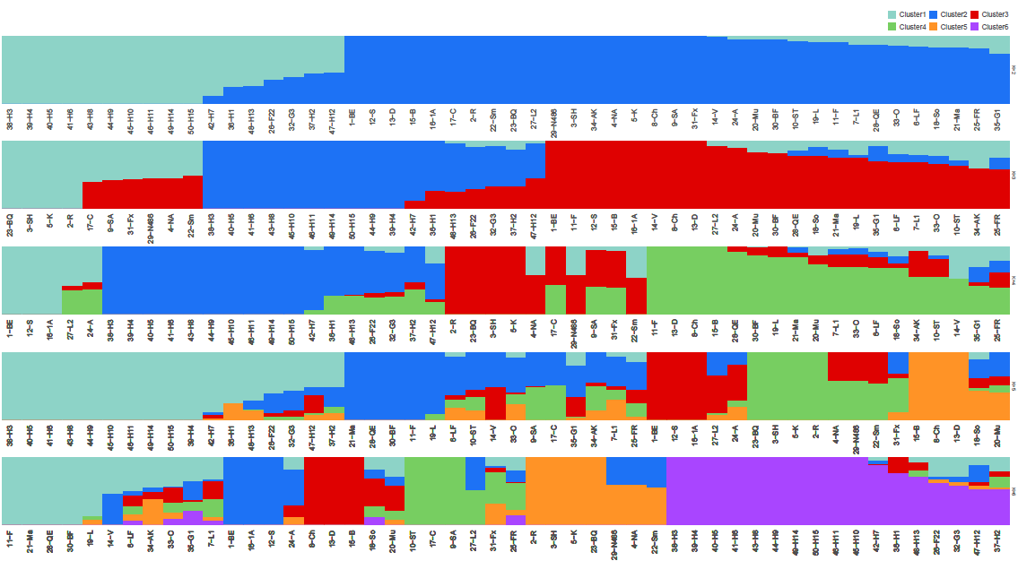
ADMIXTURE ANALYSIS

Slide 12
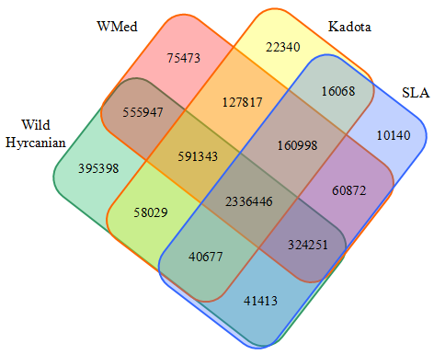
Venn diagram showing the distribution of group-specific and shared SNPs among the four fig gene pools.

Slide 13
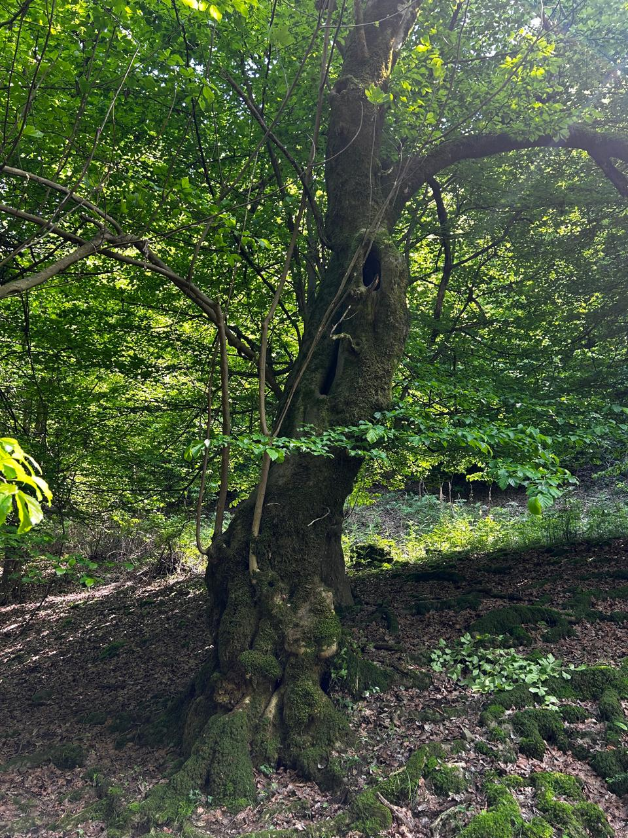
STATUS OF WILD FIG TREES
Wild Hyrcanian figs an isolated gene pool
They represent a valuable reservoir of underutilized genetic diversity for conservation and utilization.
Gene flow with cultivated genotypes is still occurring
Breeding efforts are needed to broaden the genetic base

Slide 14
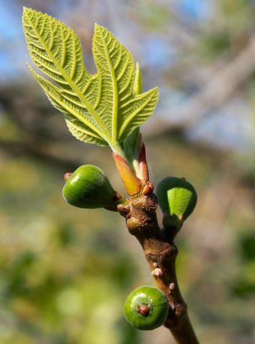
CONCLUSİON
SNP-based analysis revealed substantial genetic diversity among cultivated and wild fig genotypes
Cultivated genotypes showed a relatively narrow genetic base and low genetic differentiation, consistent with clonal propagation and long-term germplasm exchange
Most local and introduced cultivated genotypes were associated with the West Mediterranean genetic pool
The genome-wide SNP dataset provides a foundation for population genetic studies, marker-assisted selection, and future breeding and conservation

Slide 15

THANKS FOR YOUR ATTENTİON

