Slide 1
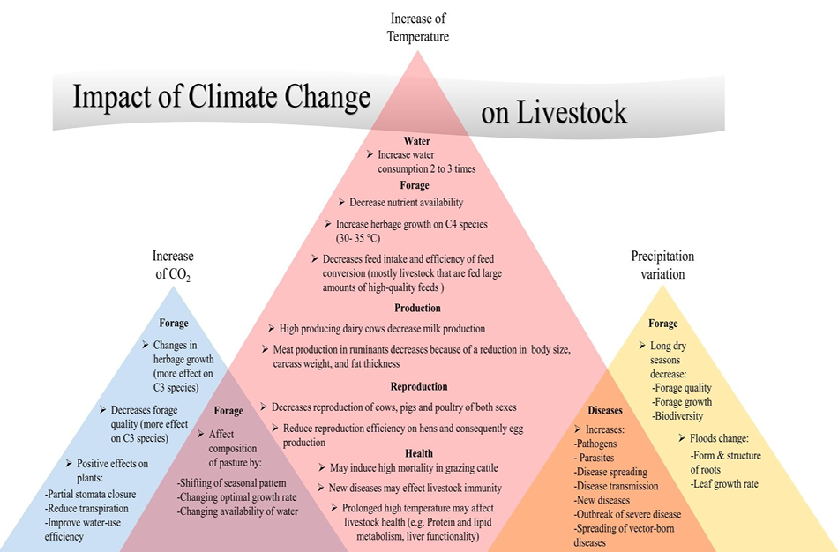
MEASURES FOR ADAPTATION OF LIVESTOCK ECOSYSTEMS TO CLIMATE CHANGE
Străteanu Amalia-Gianina*
ORCID: 0000-0003-0340-5444
Sandu Mariana*
ORCID: 0000-0003-3704-5758
Udrea Lavinia**
ORCID: 0000-0001-8277-0014
*Center for Studies and Research for AgroForestry Biodiversity “Acad. David Davidescu”, Romanian Academy; ** Valahia University of Târgoviște
E-mail: strateanumalia.research@gmail.com
AIM OF THE STUDY
RESULTS: ADAPTATION PRIORITIES
Climate change, resource scarcity, and economic pressures are threatening the livestock sector globally.
The primary aim of studies is to identify key measures to adapt livestock ecosystems to climate change and sustain long-term sector viability.
Shelter management and heat stress mitigation
• Smart climate control and ventilation systems
• Shade provision in extensive systems
2. Nutritional strategies and feed adaptation
• Reducing reliance on imports
• Precision feeding
3. Water resource and pasture management
• Efficient water collection and storage systems
• Adapted pasture rotation
4. Genetics and resilience-focused selection
• Selection for climate resilience
• Species diversification
5. Disease control and epidemiological surveillance
• Early warning systems
• Digitalization of livestock farming
MATERIALS & METHODS
Involve a combination of systematic literature reviews, process-based biophysical modeling, and empirical field assessments across varied agro-ecological zones.
Qualitative overview of climate risks and adaptation priorities.
Rojas-Downing, etal., 2017
Conventional livestock systems are highly vulnerable to global warming.
Heat stress and resource shortages reduce productivity and raise costs.
Viability requires genetic resilience, optimized nutrition and upgraded infrastructure.
CONCLUSIONS
ACKNOWLEDGEMENTS
This study was supported by funding provided by the state budget through the 2026 research program of the National Institute for Economic Research “Costin C. Kiriţescu”, Romanian Academy (PSS 1.8 Studies on the identification of risks associated with climate change and their effects on the management of animal genetic resources, coordinator Research Scientist III Ph.D. Mariana Sandu, Center for Studies and Research on Agroforestry Biodiversity “Acad. David Davidescu”).
Notes:
Source: author-supplied abstract, “MEASURES FOR ADAPTATION OF LIVESTOCK ECOSYSTEMS TO CLIMATE CHANGE”, supplied 10 September 2026. No external verification requested or performed. The poster summarizes that abstract, not the prior literature synthesis.
Authors: Străteanu Amalia-Gianina*, 0000-0003-0340-5444; Sandu Mariana, 0000-0003-3704-5758; Udrea Lavinia, 0000-0001-8277-0014.
Affiliations listed collectively because individual mapping was not supplied. Correspondence retained verbatim: strateanumalia.research@gmail.com.
Source context (not independently verified; omitted from poster body for focus): EU agri-food sector covers 38% of territory; over 30 million employees in 2023 including 8.5 million in agricultural production; 7% of gross value added; third-largest net exporter; food and beverage exports stated as €48 billion in 2024. Animal husbandry emissions stated as 14.5% of global emissions. These contextual statistics are not presented as independently sourced facts.
Main source content: climate change, resource scarcity and economic pressures threaten livestock. Direct impacts include heat stress, reduced production, reproductive problems and excessive mortality. Indirect impacts include forage degradation, water shortages, new diseases and vectors. Adaptation areas are housing modernization, nutrition management, genetic selection and transition to agro-silvo-pastoralism. The stated conclusion is critical vulnerability of conventional husbandry and transition toward genetic resilience, nutritional optimization and infrastructure upgrades.
Materials and methods: the supplied abstract has no experimental protocol, sample, dataset or measured effects. The poster describes its qualitative scope without inventing any of these.
Acknowledgements (verbatim content with typographic quotation marks): This study was supported by funding provided by the state budget through the 2026 research program of the National Institute for Economic Research “Costin C. Kiriţescu”, Romanian Academy (PSS 1.8 Studies on the identification of risks associated with climate change and their effects on the management of animal genetic resources, coordinator Research Scientist III Ph.D. Mariana Sandu, Center for Studies and Research on Agroforestry Biodiversity “Acad. David Davidescu”).

