Slide 1



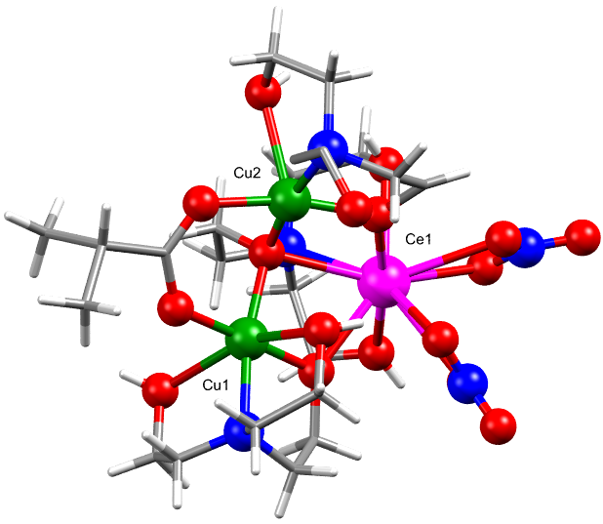
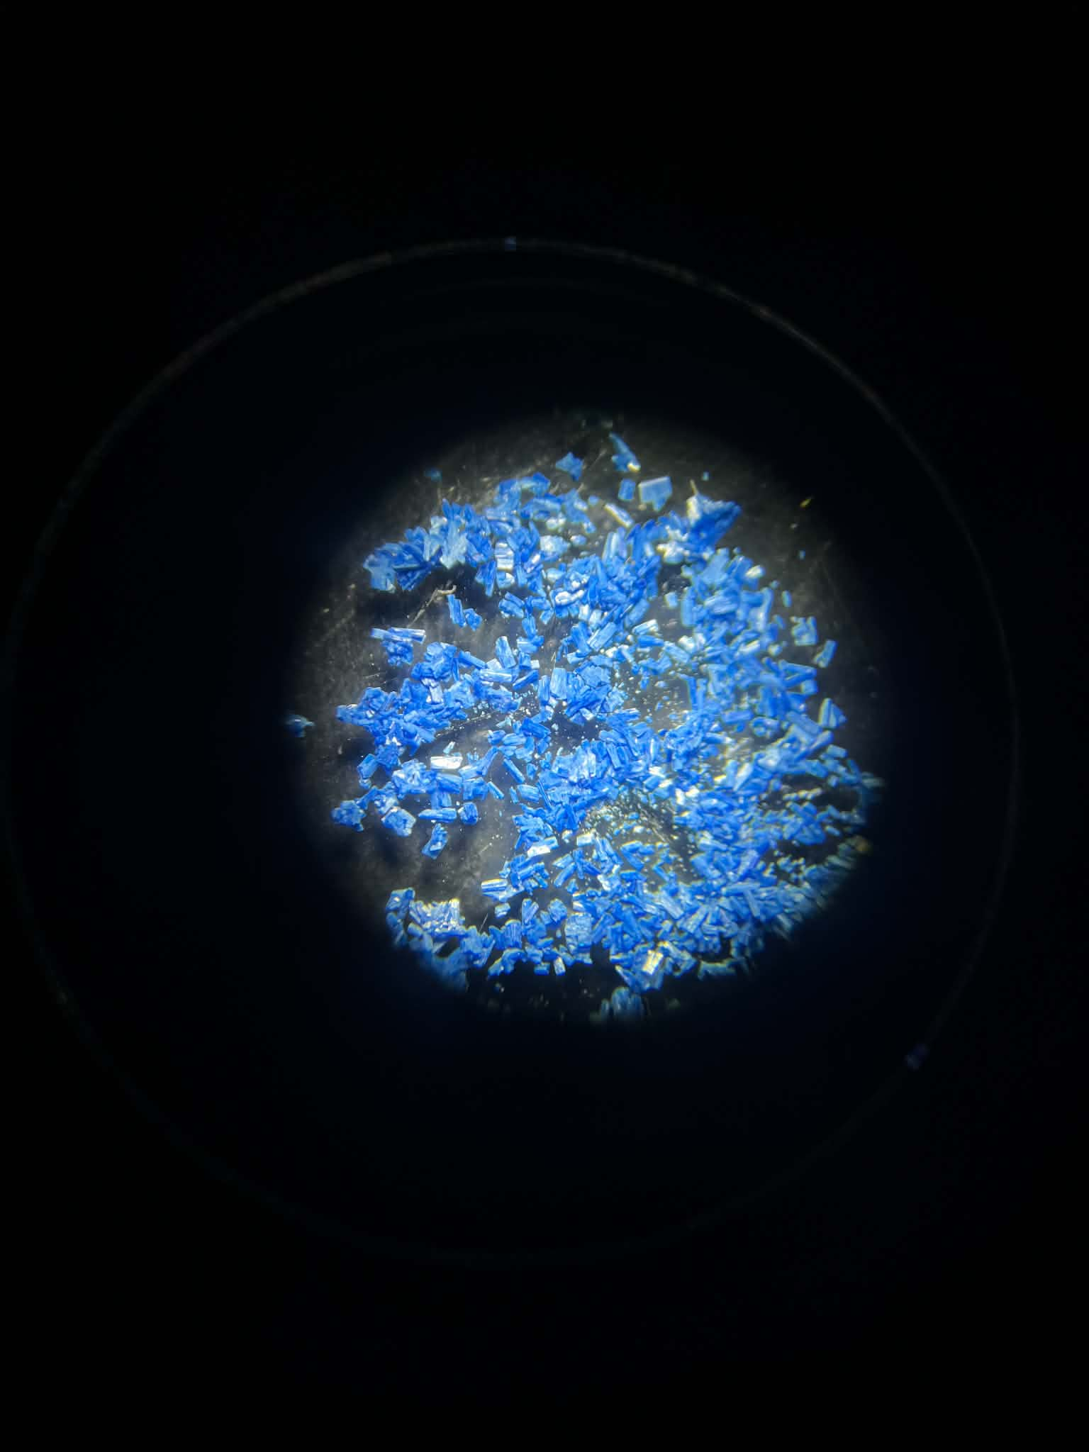
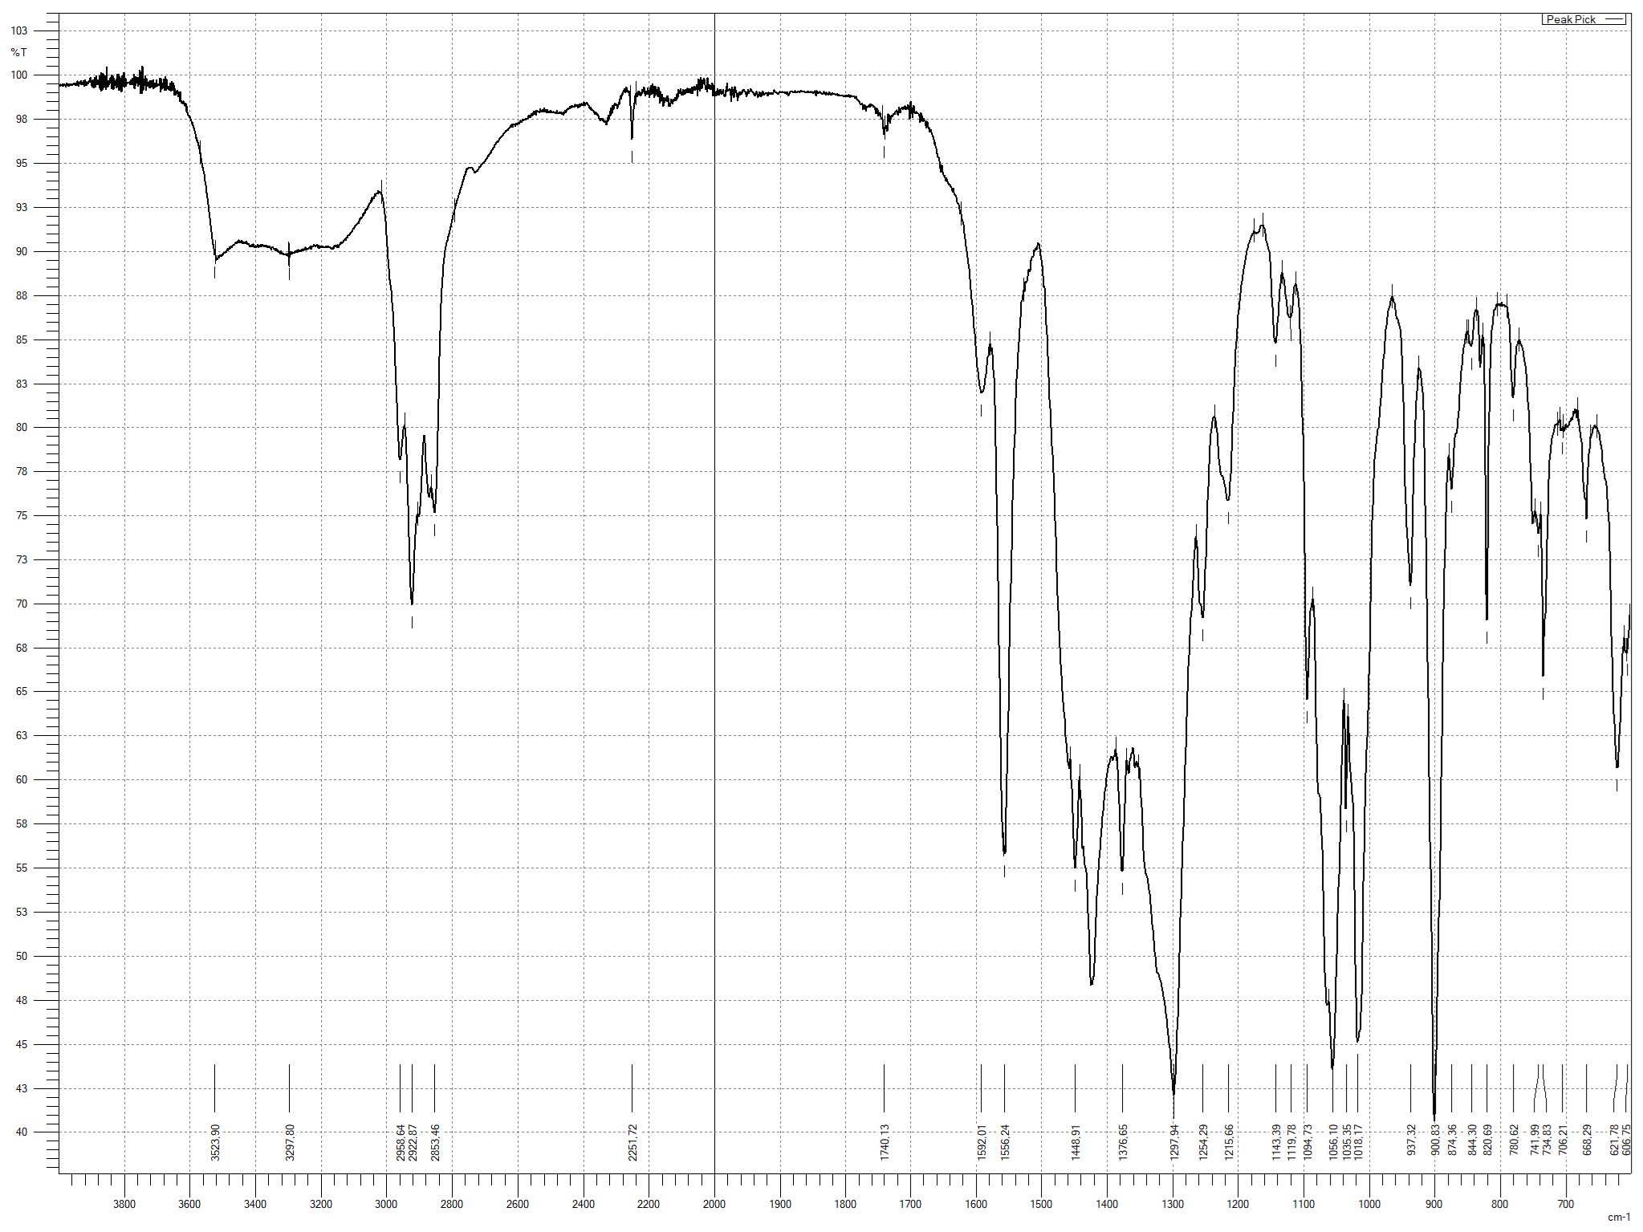
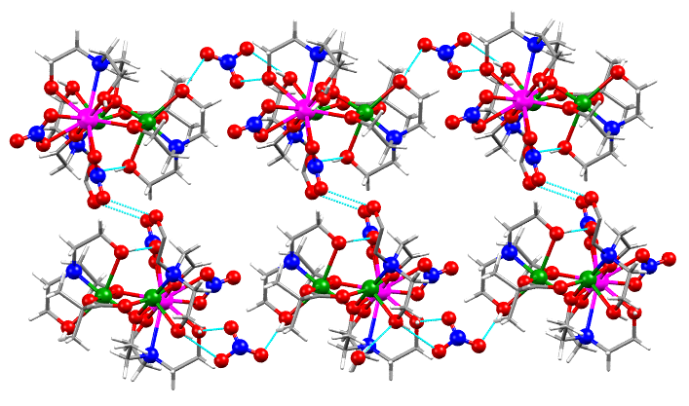
A TRINUCLEAR HETEROMETALLIC {CeCu₂} CLUSTER CONTAINING ISOBUTYRATE AND TRIETHANOLAMINE LIGANDS
Olga Capbătut,¹ Victor Ch. Kravtsov,¹ Paul Kögerler,² Svetlana G. Baca¹
¹Institute of Applied Physics, Moldova State University, Chisinau, Moldova
²Institute of Inorganic Chemistry, RWTH Aachen University, Aachen, Germany
mail: olga.capbatut@ifa.usm.md
INTRODUCTION
RESULTS
CRYSTAL STRUCTURE
Heterometallic 3d–4f coordination compounds have attracted considerable attention due to their remarkable structural diversity and ability to combine the properties of transition-metal and lanthanide ions within a single molecular system.
A new coordination compound, [CeCu₂(ib)(H₂tea)₃(NO₃)₂]NO₃·H₂O·CH₃CN (1) (where Hib = isobutyric acid and H₃tea = triethanolamine), was synthesized via an ultrasonic method.
Structurally, its trinuclear molecular structure consists of one Ce(III) and two Cu(II) centers bridged by one isobutyrate and three mono-deprotonated H₂tea⁻ ligands, with one oxygen atom from an H₂tea⁻ ligand linking all three metal centers in a μ₃-fashion.
IR SPECTROSCOPY
υ(O-H) | 3524
υ_{as}(CH₃) | 2959
υ_{s}(CH₃) | 2923
δ_{as}(CH₃) | 1449
δ_{s}(CH₃) | 1377
υ_{as}(СOO) | 1592,1566
υ_{s}(СOO) | 1449
υ(C-N/C-O) | 1143,1056
υ(NO₃) | 1298
Crystal date for compound
Crystal system | Triclic
Space group | P-1
a (Å) | 10.9622
b (Å) | 11.0433
c (Å) | 17.4828
α (˚) | 102.374
β (˚) | 103.003
γ (˚) | 91.475
V (Å³) | 2008.18
Fig. 1. Structure of the cationic complex [CeCu₂(ib)(NO₃)₂(H₂tea)₃]⁺
CONCLUSIONS
Successful Synthesis: Obtained a unique heterometallic trinuclear {CeCu₂} cluster using mixed isobutyrate/triethanolamine frameworks.
Structural Diversity: Demonstrated distinct coordination environments for the two Cu(II) sites (5- and 6-coordinate).
Bridging Efficiency: Confirmed the rare µ₃-oxygen bridging mode of the mono-deprotonated H₂tea‒ ligand.
The molecular units are associated through a network of hydrogen bonds, which contributes to the stabilization of the supramolecular assembly.
Fig. 2. Hydrogen-bonded cluster network.
Acknowledgments: The authors are grateful for the subprogram 011202 financed by the Ministry of Education and Research of R. Moldova and the bilateral project “MultiClust” (01DK25013 and 25.80013.5007.07GER) supported by the German Federal Ministry of Education and Research (BMBF).
Crystal date for compound
Crystal system | Triclinic
Space group | P-1
a (Å) | 10.1731
b (Å) | 11.1731
c (Å) | 17.4841
α (˚) | 78.402
β (˚) | 78.351
γ (˚) | 87.145
V (Å³) | 2036.84
Crystal date for compound
Crystal system | Triclinic
Space group | P-1
a (Å) | 10.1731
b (Å) | 11.1731
c (Å) | 17.4841
α (˚) | 78.402
β (˚) | 78.351
γ (˚) | 87.145
V (Å³) | 2036.84
Crystal date for compound
Crystal system | Triclinic
Space group | P-1
a (Å) | 10.1731
b (Å) | 11.1731
c (Å) | 17.4841
α (˚) | 78.402
β (˚) | 78.351
γ (˚) | 87.145
V (Å³) | 2036.84
Crystal date for compound
Crystal system | Triclinic
Space group | P-1
a (Å) | 10.1731
b (Å) | 11.1731
c (Å) | 17.4841
α (˚) | 78.402
β (˚) | 78.351
γ (˚) | 87.145
V (Å³) | 2036.84

