Slide 1

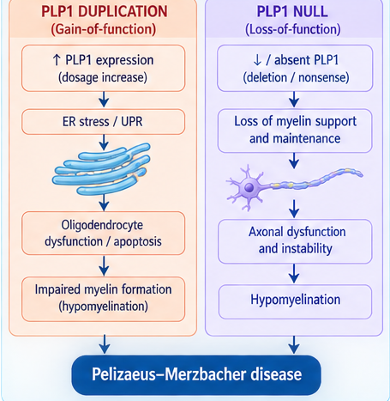
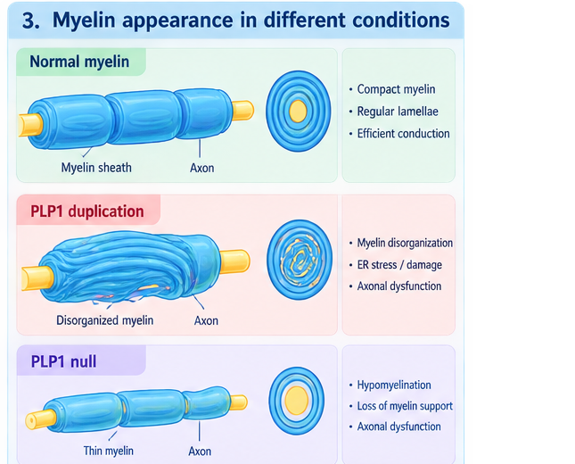
PLP1 MUTATIONS AND GENETIC CONTROL OF MYELINATION IN PELIZAEUS–MERZBACHER DISEASE
Gheorghe TULEA, Elena CHESOV
Department of Molecular Biology and Human Genetics / Faculty of Medicine No.1, Nicolae Testemitanu State University of Medicine and Pharmacy of the Republic of Moldova
1
Aim of the Study
This poster explains the genetic mechanisms affecting oligodendrocytes and myelin formation — particularly PLP1 gene mutations — as they manifest in Pelizaeus–Merzbacher disease (PMD), and summarizes current treatment approaches.
PLP1 Gene & Genetic Background
PMD is the most common hypomyelinating leukodystrophy, inherited as X-linked recessive. PLP1 (Xq22.1, ~17 kb, 7 exons) encodes PLP1 (276 aa) and its splice isoform DM20, together forming ~50% of total myelin protein. Coding mutations were initially found in under half of patients, revealing genetic heterogeneity; PLP1 duplication was later established as the most common cause via a gene-dosage mechanism, while PLP1 deletions remain comparatively rare.
KEYWORDS
PLP1 mutation • Pelizaeus–Merzbacher disease • Oligodendrocyte dysfunction • Hypomyelination • PLP1 duplication
2
Materials and Methods
PLP1 Duplication: ER–Mitochondria & Endosomal Trafficking
Potential Therapeutic Approaches
In duplication-mutant fibroblasts, reduced maximal oxygen consumption and shorter, more spherical mitochondria indicate impaired respiratory function. Expanded ER sheets form closer contacts with mitochondria (MAMs), potentially driving Ca²⁺ overload. Separately, excess PLP1 accumulates in the cell body and colocalizes with cholesterol in late endosomes/lysosomes, disrupting myelin-raft trafficking.
No approved treatment exists. Preclinical strategies include pharmacologic PLP1 mRNA reduction (progesterone-receptor antagonism), cholesterol-enriched diets aiding PLP membrane incorporation, and curcumin, which enhances misfolded-PLP clearance via ER Ca²⁺-ATPase inhibition. iPSC-derived oligodendrocyte and neural stem cell transplantation have reached early-phase clinical trials, showing safety but not yet proven efficacy.
A literature search used keywords such as “PLP1 mutation,” “Pelizaeus–Merzbacher disease,” “oligodendrocyte dysfunction,” “hypomyelination,” and “PLP1 duplication” across PubMed, Scopus, and Google Scholar. Eight articles published within the last 5 years were identified, reviewed, and analyzed.
3
Results
Findings vary by mutation type: missense mutations misfold PLP1 and trigger ER stress; PLP1 duplication (~60–70% of cases) is a dosage-dependent gain-of-function; null mutations trigger nonsense-mediated mRNA decay, leaving PLP1 absent. Each mechanism is detailed below.
4
Conclusions
Missense vs. Null Mutations: Divergent Severity
Missense mutations are the most phenotypically heterogeneous, ranging from mild (HSP2) to severe connatal forms depending on the domain affected and ER-degradation efficiency. Null mutations (deletions, nonsense, frameshift) paradoxically cause milder disease despite complete PLP1 loss: myelin stays largely compact, but axonal support is impaired, with frequent peripheral neuropathy.
PMD is fundamentally a genomic-dosage and protein quality-control disorder: gain-of-function mechanisms (duplication, missense misfolding) and loss-of-function null mutations converge on oligodendrocyte dysfunction through UPR-mediated apoptosis, endosomal/myelin-raft disruption, and ER–mitochondria (MAM) dysfunction — pointing to PLP1 dosage and protein-folding control as key therapeutic targets.
Distribution of PLP1 mutation types among patients

