Slide 1

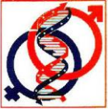
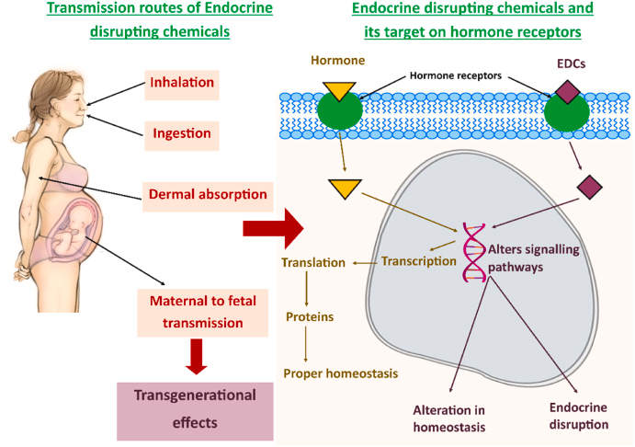
NATURAL SCIENCES IN THE DIALOGUE OF GENERATIONS
The National Conference with International Participation, edition Ixth
September 21-22, Chisinau, Republic of Moldova, 2026
ENDOCRINE-DISRUPTING CHEMICALS AND DIABETES MELLITUS TYPE 2
Authors: VUDU Lorina, VUDU Stela, PITERSCHI Carolina, SEREMET Aristia, JOSE Jyothi, PULIKKAKUNNEL Joseph
Affiliations: USMF “Nicolae Testemițanu”, Laboratorul de endocrinologie
Aim of the study
To explore the impact of endocrine disrupting chemicals (EDCs) on the development of type 2 diabetes mellitus (T2DM), focusing on their mechanisms of disrupting hormonal and metabolic functions to inform prevention strategies.
Materials and Methods:
Systematic search of databases PubMed, Scopus, Web of Science
Results
Conclusions:
-> Clinical studies show a strong link between bisphenol A, phthalates, polychlorinated biphenyls, per-polyfluoroalkyl substances and increased insulin resistance and diabetes risk.
-> Exposure during critical periods (prenatal, childhood) causes epigenetic changes.
-> Multiple EDCs amplifies metabolic risk, even at low levels.
-> EDCs are a modifiable environmental factor that should be targeted to reduce T2DM incidence.
-> The diabetogenic effects of EDCs are mediated through insulin resistance, pancreatic β-cell dysfunction, oxidative stress, chronic inflammation, mitochondrial impairment, and alterations in hormonal signaling pathways.
-> Preventive strategies focused on reducing exposure to ECDs may help decrease the burden of metabolic diseases.
Legends: Human exposure to EDCs occurs through contaminated food and water, air pollution, household products, plastics, cosmetics, occupational exposure can cause transgenerational effects, and endocrine disruption

