Slide 1


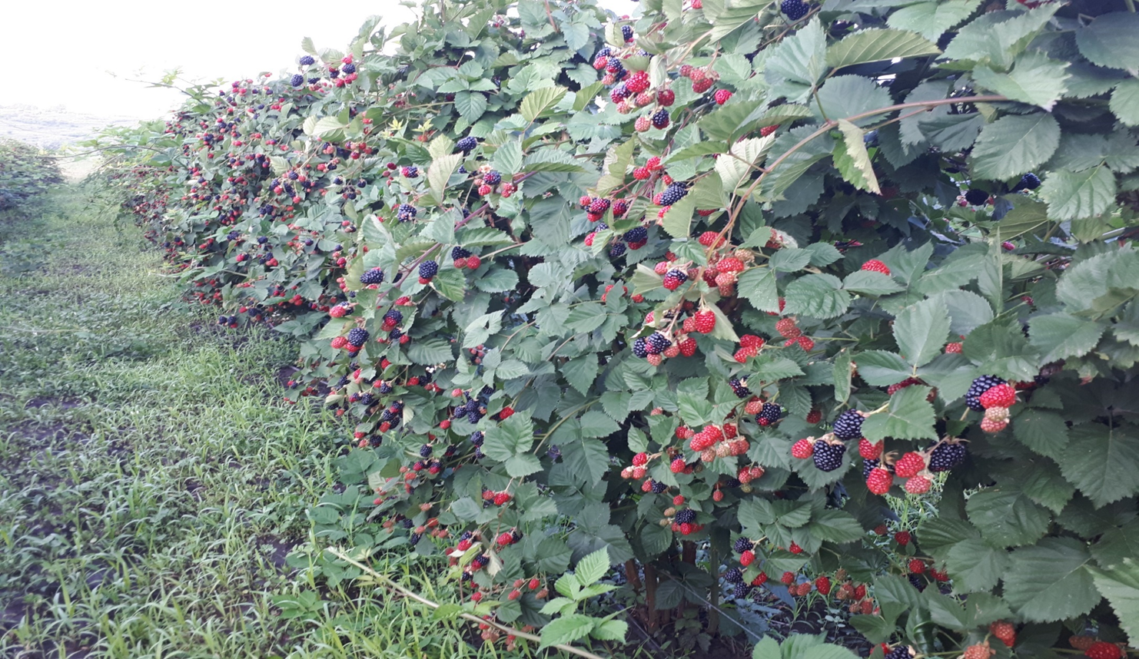
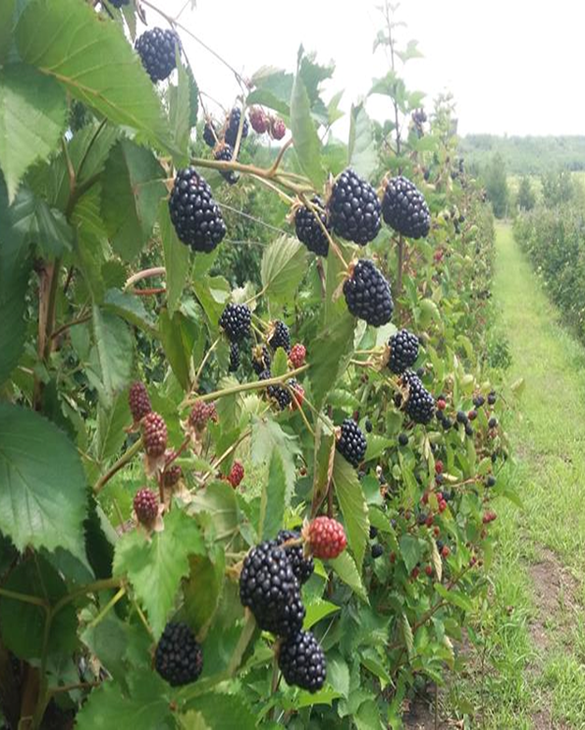
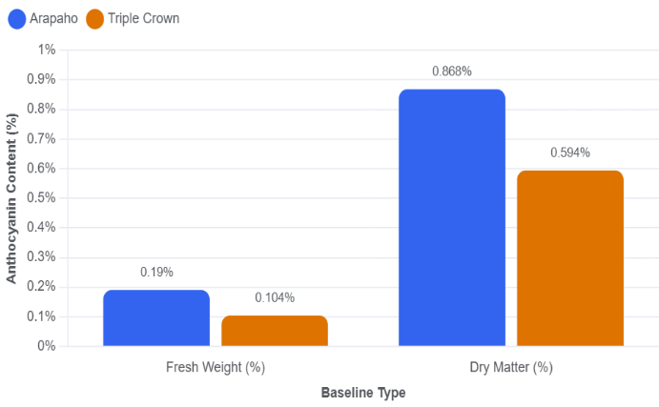
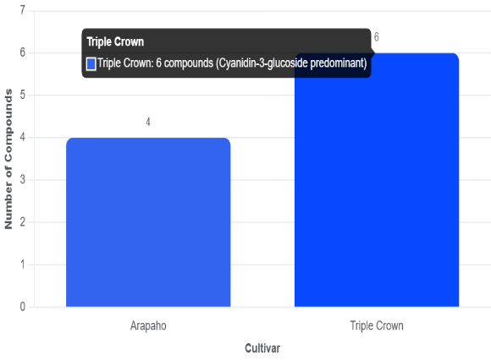
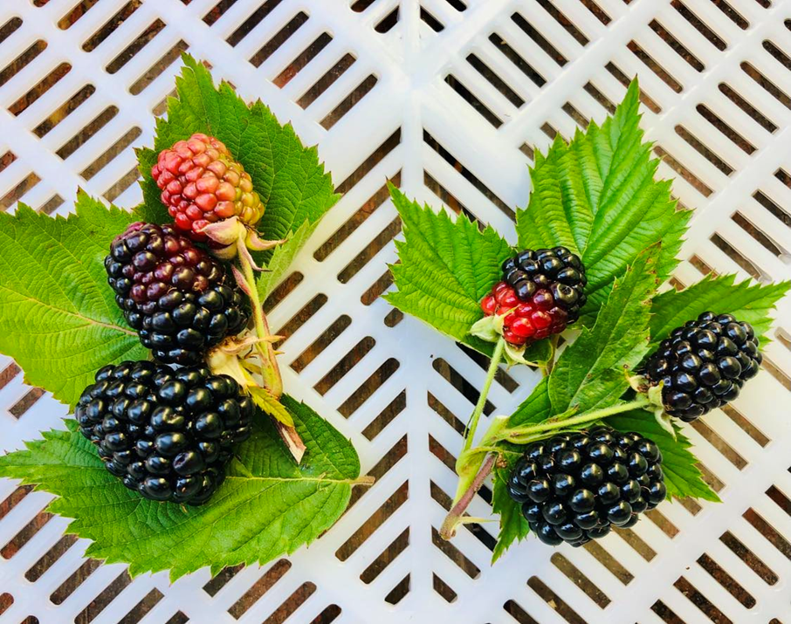
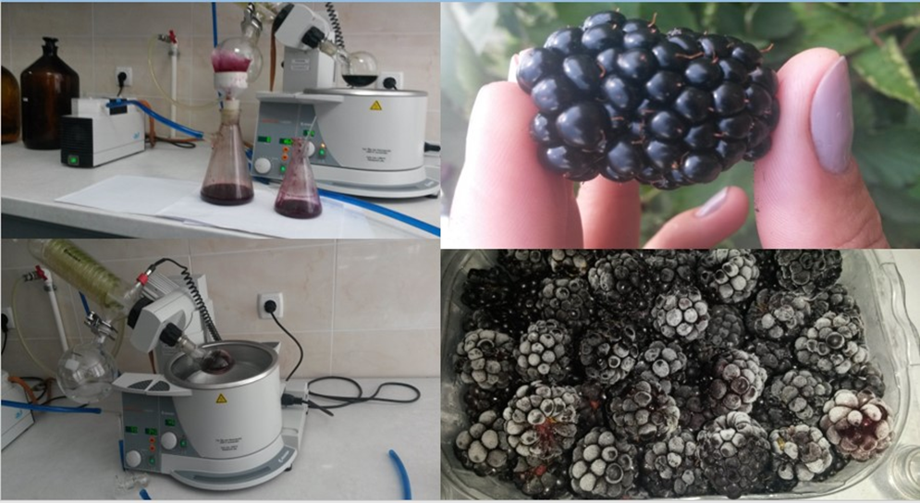
ANTHOCYANINS IN ARAPAHO AND TRIPLE CROWN BLACKBERRIES IN REPUBLIC OF MOLDOVA
Irina Pompuș
Scientific-Practical Center of Medicinal Plants of the Nicolae Testemitanu State
University of Medicine and Pharmacy, Chisinau, Republic of Moldova
Aim of the study. The present study aimed to evaluate the total anthocyanin content and anthocyanin composition of blackberry fruits from the cultivars Arapaho and Triple Crown cultivated under the environmental conditions of the Republic of Moldova.
Results. The total anthocyanin content in fresh fruits reached 0.190% in the cultivar Arapaho and 0.104% in Triple Crown. On a dry matter basis, the corresponding values were 0.868% and 0.594%, respectively. Fruit moisture content was 78.1% in Arapaho and 82.5% in Triple Crown.
The results demonstrated that Arapaho accumulated approximately 82.7% more anthocyanins than Triple Crown. HPLC analysis revealed four anthocyanin compounds in Arapaho fruits and six compounds in Triple Crown fruits, four of which were common to both cultivars. Cyanidin-3-glucoside was identified as the predominant anthocyanin in both cultivars.
Triple Crown Arapaho
Materials and methods. Fully ripe fruits harvested in 2024 were analyzed for total anthocyanin content using cyanidin-3-glucoside chloride as a reference compound. The anthocyanin profile was determined by high-performance liquid chromatography (HPLC).
Acknowledgments: This study was carried out with the financial support of the Drug Development Center, National Institute for Research in Medicine and Health of the “Nicolae Testemitanu” State University of Medicine and Pharmacy, Research Project “Development of new pharmaceutical products from local raw materials”, subprogram code 080301.
Conclusions. The obtained results indicate significant cultivar-dependent differences in anthocyanin accumulation and composition. Arapaho was characterized by a higher anthocyanin concentration, whereas Triple Crown exhibited a more diverse anthocyanin profile. These findings contribute to the characterization of blackberry germplasm cultivated in the Republic of Moldova and may support the selection of cultivars with enhanced nutritional and antioxidant potential.
National Conference with International Participation: Natural Sciences in the Dialogue of Generations, VIIIth edition, Chisinau, Republic of Moldova, September 17–19, 2025

