Slide 1
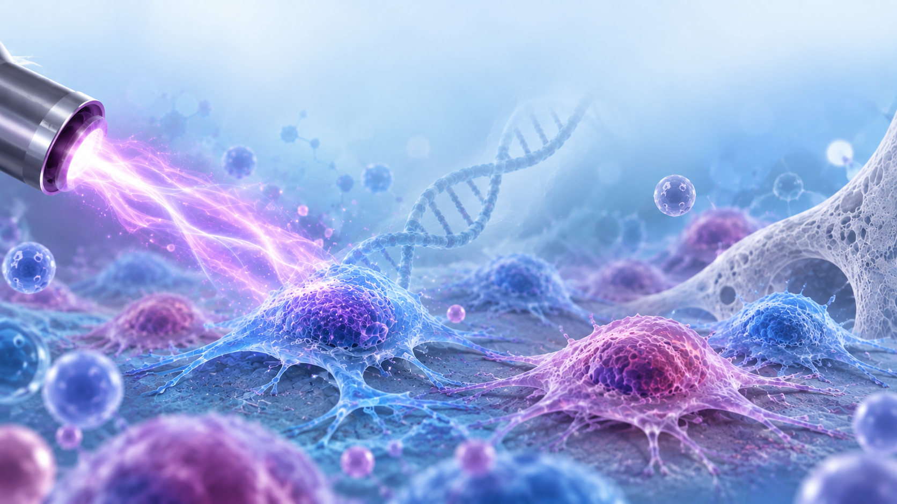


COLD PLASMA INDUCES DISTINCT GENE PROFILES IN OSTEOBLASTS & OSTEOSARCOMA
STACHE Bogdan¹, MIHĂILĂ Ilarion², GERBER Ioana Cristina², TOPALĂ Ionuț³, GORGAN Dragoș-Lucian^{1,*}
¹ Faculty of Biology, „Alexandru Ioan Cuza” University of Iasi, Iasi, Romania; ² Integrated Center of Environmental Science Studies in the North-Eastern Development Region (CERNESIM), Alexandru Ioan Cuza University of Iasi, Iasi, Romania; ³ Faculty of Physics, Alexandru Ioan Cuza University of Iasi, 700506 Iasi, Romania; *E-mail: lucian.gorgan@uaic.ro
Introduction: Osteosarcoma is the most common primary malignant bone tumor in children and adolescents. Despite advances in multimodal treatment, clinical outcome remains limited, especially when associated with metastatic spread, relapse, or chemoresistant phenotypes, highlighting the need for alternative therapeutic strategies. Cold atmospheric plasma (CAP), a partially ionized gas generated at near-room temperature, has emerged as a promising approach in cancer treatment due to its reported capacity to selectively impair tumor cell viability. However, the molecular mechanisms underlying this selective effect remain incompletely understood. In this study, we investigated the changes induced by indirect CAP treatment in the expression of key anti-apoptotic genes in osteosarcoma cells (HOS) compared with normal osteoblasts (HOB).
Materials and methods:
Results:
Figure 5. The effects of indirect CAP treatment on HOB and HOS cells viability
Values are means ± SEM (n = 5) and statistical significance (ns—nonsignificant, * p ≤ 0.05, ** p ≤ 0.01, *** p ≤ 0.001 and **** p ≤ 0.0001) was determined by two-way ANOVA followed by Šídák’s or Dunnett’s post hoc multiple comparison test.
Conclusions: These findings suggest that the absence of a coordinated anti-apoptotic response in osteosarcoma cells may contribute to the selective cytotoxicity induced by indirect CAP treatment. The differential regulation of anti-apoptotic genes could therefore represent one of the molecular mechanisms involved in the tumor-selective effects of plasma-activated media.
Figure 6. Analysis of BCL2, CFLAR and XIAP gene expression in HOB and HOS cells, at 2 and 24 hours post-treatment, respectively.
IXth National Conference with International Participation “Natural Sciences in the Dialogue of Generations”, September 21–22, 2026, Chisinau, Republic of Moldova

