Slide 1

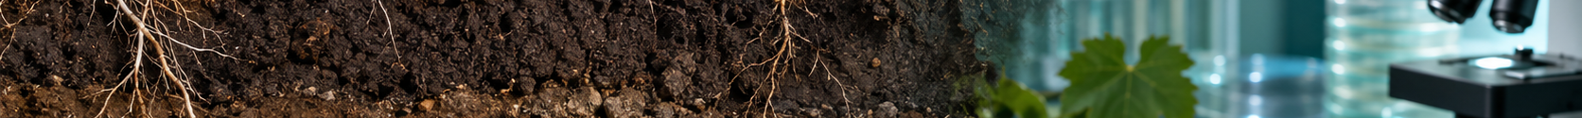
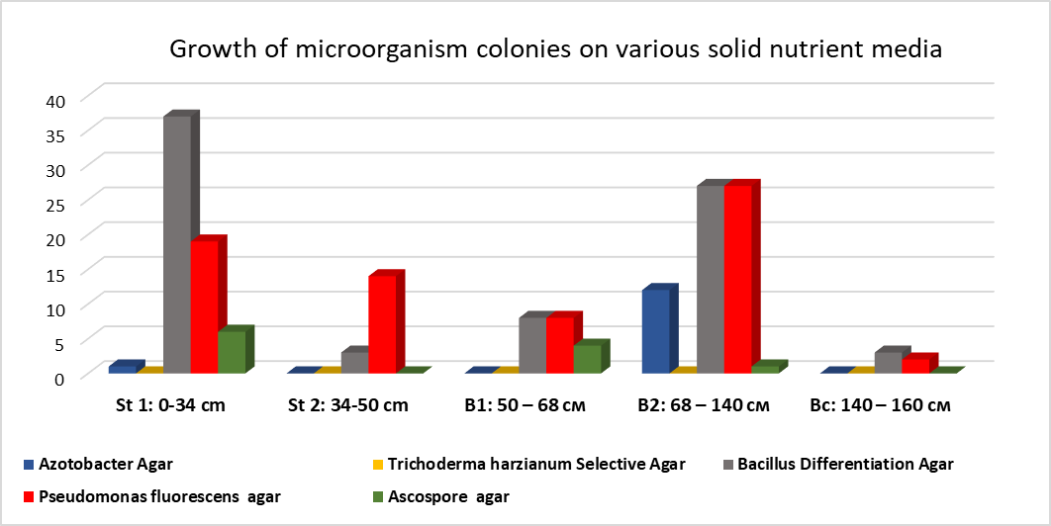
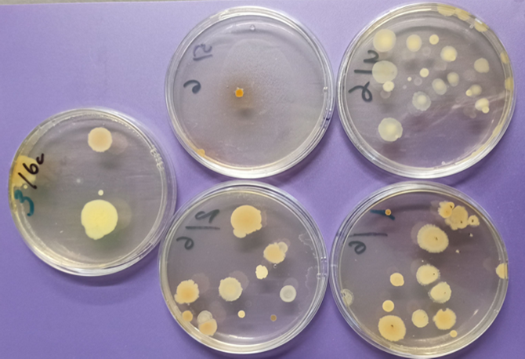
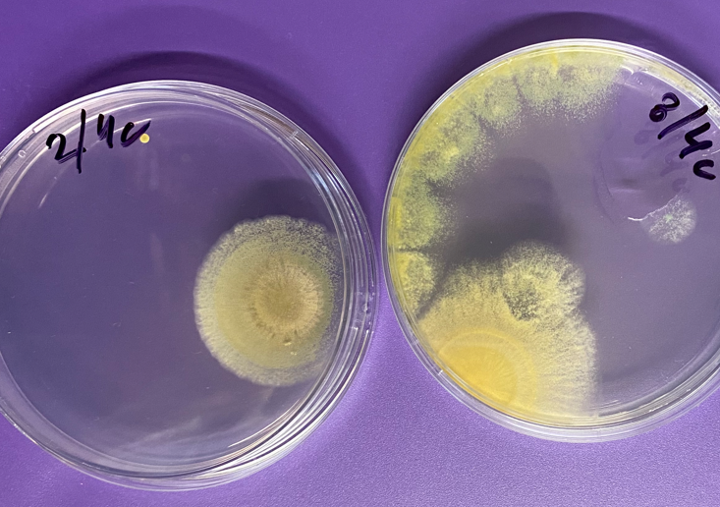
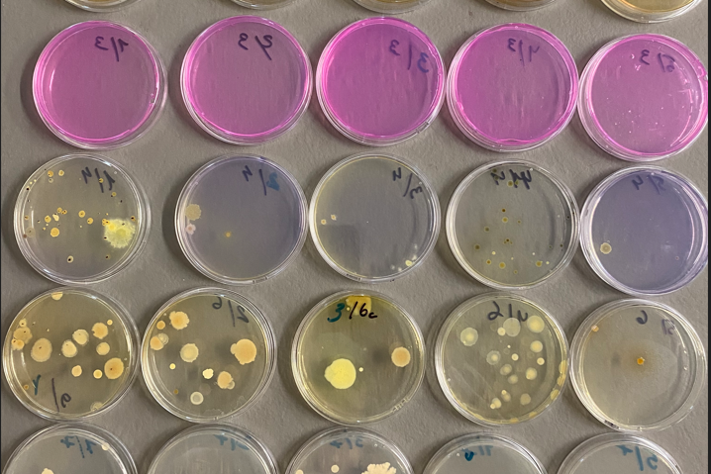
VERTICAL STRATIFICATION OF SOIL MICROBIAL DIVERSITY
IN IRRIGATED CHERNOZEM VINEYARD SOILS
Tatiana Stratulat* | Yulia Ursulenco | NIARAVM, Chisinau, Republic of Moldova
LITERATURE CONTEXT & AIM
MATERIALS AND METHODS
SOIL PROFILE
QUANTITATIVE RESULTS
Subsoil supplies water and nutrients, stores relatively stable organic carbon, and supports important ecosystem functions. Compaction, salinisation and climate-driven drought or heavy rainfall can alter soil biota and restrict root growth.
Soil microbial communities regulate C and N cycling, nutrient availability and soil structure. Their vertical organisation in irrigated vineyard chernozems remains insufficiently studied.
Aim: to evaluate microbial diversity along a genetic soil profile and identify depth-related patterns.
Soil profile: St₁ 0-34 cm; St₂ 34-50 cm; B₁ 50-68 cm; B₂ 68-140 cm; Bc 140-160 cm. Sample mass: 9.90-10.20 g.
Soil extract: 10 g soil + 90 g water (1:10); 20 min at 27°C. Serial 1:10 dilutions: 1:100, 1:1,000 and 1:10,000.
Plating: 100 µL of 1:10,000 suspension spread per plate; duplicate plates. Incubation: 27°C; results assessed after 10 days.
Media: Azotobacter Agar; Trichoderma harzianum Selective Agar; Bacillus Differentiation Agar; Pseudomonas fluorescens Agar; Ascospore Agar.
Colony assessment: size, form, margin, elevation, surface, colour, structure and consistency.
Horizon Mean colonies CFU g⁻¹
St₁ 0-34 cm 63 6332
St₂ 34-50 cm 17 1717
B₁ 50-68 cm 19 1863
B₂ 68-140 cm 67 6653
Bc 140-160 cm 6 598
St₁ 0-34 cm
St₂ 34-50 cm
B₁ 50-68 cm
B₂ 68-140 cm
Community composition changed markedly with depth. The surface horizon showed the richest morphological diversity; the deepest horizon had the lowest number of colonies. The B₂ horizon retained high abundance but a simpler community structure.
Bc 140-160 cm
1:10,000 dilution
10-day count
GROWTH ON CULTURE MEDIA
REPRESENTATIVE CULTURE PLATES
CONCLUSIONS
• Irrigated vineyard chernozem showed distinct vertical differentiation of microbial communities.
• The surface horizon combined the greatest morphological diversity with high colony abundance.
• Deeper horizons showed community simplification and a greater role of spore-forming bacteria; the deepest horizon had the lowest CFU value.
• Soil-profile characteristics should be considered when interpreting microbial biodiversity in irrigated perennial systems.
Surface and subsurface extracts cultivated on selective and nutrient media.
Mean colony number on tested nutrient media after 10 days.
ACKNOWLEDGMENTS | Institutional Programme 230102 “Research regarding the evolution of irrigated chernozems in horticultural plantations and testing pedoameliorative methods to prevent and/or combat their degradation” (2024-2027), funded by the Ministry of Education and Research of the Republic of Moldova. * tatiana.stratulat@incaamv.gov.md

