Slide 1


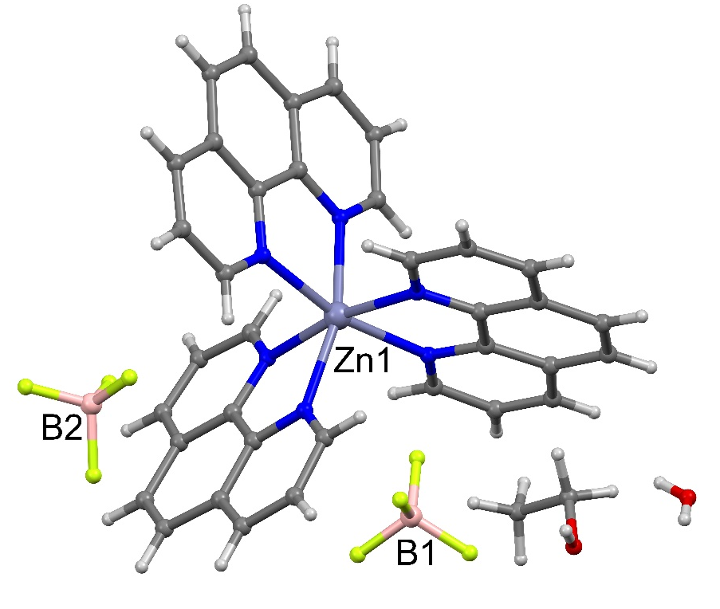
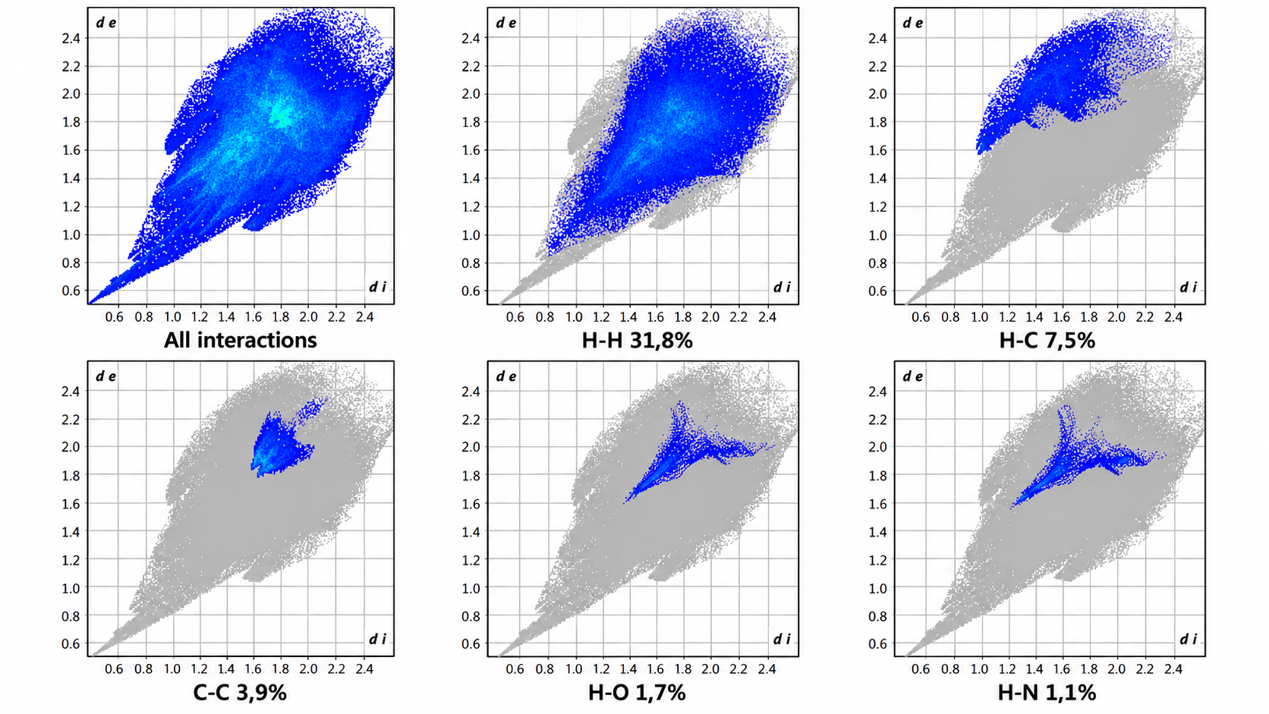
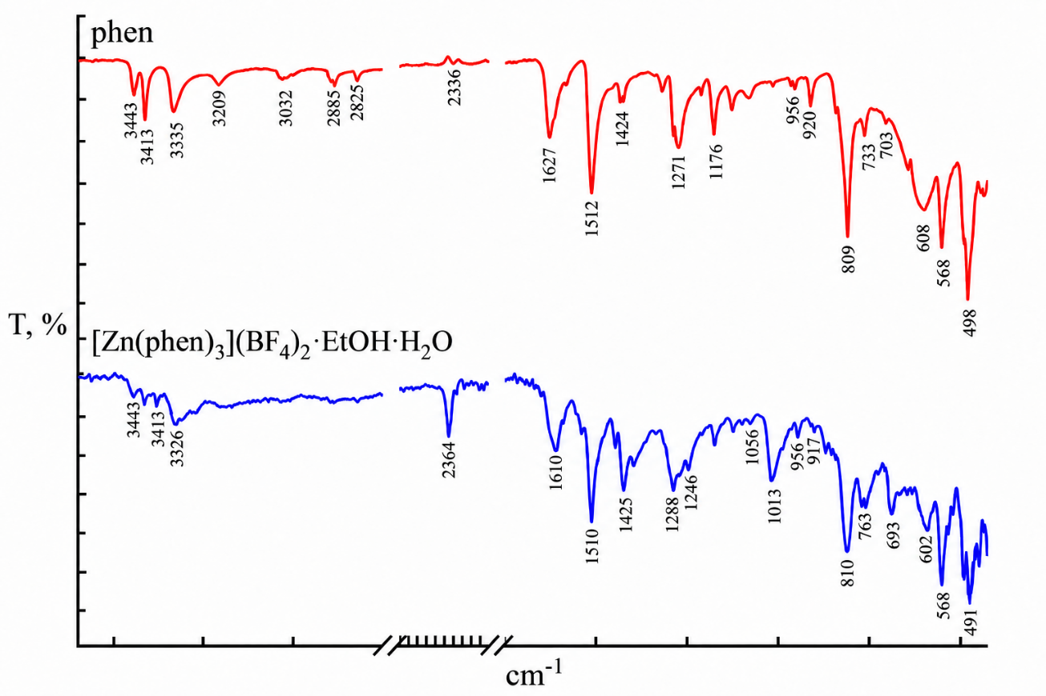
SYNTHESIS AND CRYSTAL STRUCTURE OF Zn(II)
COORDINATION COMPOUND WITH PHENANTHROLINE
N. Craciun, ORCID: 0000-0001-9918-0678,
M. S. Fonari, ORCID:0000-0002-2508-5368
¹Institute of Applied Physics, Moldova State University, Academiei 5, Chisinau MD2028, Republic of Moldova;
*E-mail: nicoletacaimac@gmail.com
1
INTRODUCTION
X-RAY
2
Analysis of the Cambridge Structural Database and literature sources highlights the ability of transition metal cations to form stable coordination compounds with the 1,10-phenanthroline (phen) ligand. Due to the planar geometry and aromatic nature of this ligand, the resulting complexes can exhibit various supramolecular arrangements, stabilized by interactions between aromatic fragments. These structural features contribute to the formation of diverse crystal networks and provide compounds with significant potential in supramolecular chemistry and crystal engineering.
A new coordination compound [Zn(phen)₃](BF₄)₂·EtOH·H₂O was obtained through the interaction of the phen ligand with salt Zn(BF₄)₂.6H₂O , in the CH₃OH:C₂H₅OH solvent mixture. The Zn(II) cation is coordinated by three neutral phen molecules, which act as bidentate ligands through nitrogen donor atoms. The metal cation adopts a slightly distorted octahedral geometry, with an N₆ donor set provided by three phen ligands, Zn-N distances being in the range 2.153(3)-2.191(3) Å. Each phen ligand forms a chelate ring with the metal center, contributing to stability of the complex cation.
3
HIRSHFELD SURFACE ANALYSIS
For the obtained coordination compound, some physicochemical analyses were carried out to confirm the structure, the infrared spectroscopy confirmed the presence of the ligands. The distribution of intermolecular interaction was evaluated using Hirshfeld surface analysis. Hirshfeld surface analysis and 2D fingerprint plots clearly indicate the maximum contribution attributed to H⋯H (31,8%), C⋯H (7,5%), and C⋯C (3,9%) contacts, which confirm the dominance of intermolecular interactions.
Empirical formula | C₃₈H₃₂B₂F₈N₆O₂Zn
T, K | 293(2)
Formula weight | 843.68
Crystal system | Triclinic
Space group | P-1
Volume, Å³ | 1882.6(2)
a/Å | 11.3002(8)
b/Å | 12.8753(8)
c/Å | 14.4044(8)
α/⁰ | 82.350(5)
β/⁰ | 75.946(6)
γ/⁰ | 67.972(6)
IR SPECTROSCOPY
4
The IR specta of the coordination compound and the pure ligands dadpm were measured and confirm the presence of organic ligands used in the synthesis. The absorption bands observed at 3450-3373 cm⁻¹ are assigned to asymmetric and symmetric stretching vibrations ν(NH₂), while deformation vibrations δ(NH) were registered at 1600 cm⁻¹.The bands at 2826-2886 cm⁻¹ are assigned to the ν_{s}(CH₂) and ν_{as}(CH₂) stretching vibrations.
5
CONCLUSION
Synthesis and structural characterization of the Zn(II) coordination compound with 1,10-phenanthroline are reported. X-ray studies confirm that the obtained product represents a coordination compound with a distorted octahedral geometry around the Zn(II) center. The structural features and supramolecular interactions observed in this compound can contribute to a better understanding of the role of 1,10-phenanthroline in the crystal engineering of coordination architectures.
Funding: Subprogram 011202 ”Design and fabrication of intelligent materials with advanced magnetic, adsorption, luminescent and biologically active properties”, financed by the Ministry of Education and Research of R. Moldova.

